Slide 1
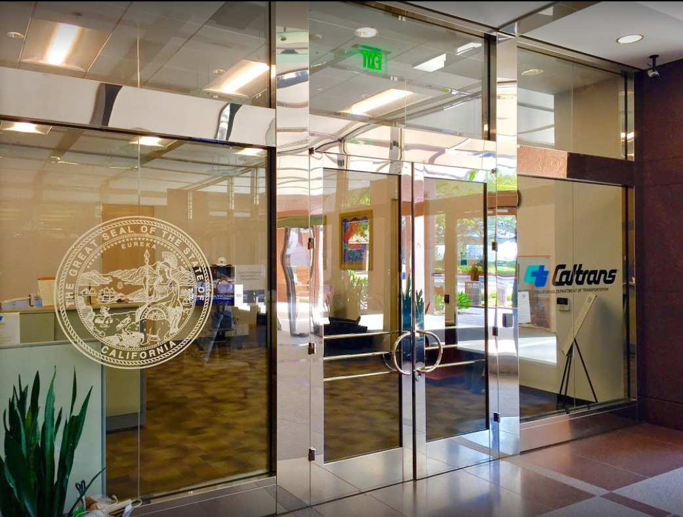

TECHNICAL STEERING COMMITTEE MEETING
LOCAL ASSISTANCE UPDATE
Tifini Tran
District Local Assistance Engineer (DLAE)
Caltrans District 12
Tifini.Tran@dot.ca.gov
(657) 328-6275
April 8, 2020

Slide 2
TECHNICAL STEERING COMMITTEE MEETING
LOCAL ASSISTANCE UPDATE
TABLE OF CONTENTS
PAGE | UPDATE ITEM
1 ATP
2 ATP (Cont’d)
3 CTC Meetings
4 Invoices
5 Inactive Invoices
6 DBEs
7 CWAs
8 HSIP
9 HBP
10 Title VI

Slide 3
Active Transportation Program (ATP)
The ATP Cycle 5 call for projects was recently announced in late March.
June 15, 2020 – deadline to submit ATP Cycle 5 Applications. Hard copy submittals are still required.
Please see the following websites for more information and guidelines:
Caltrans website: https://dot.ca.gov/programs/local-assistance/fed-and-state-programs/active-transportation-program/cycle5
CTC website: https://catc.ca.gov/programs/active-transportation-program
1

Slide 4
Active Transportation Program (ATP) (cont’d)
April 30, 2020 – Deadline for the next quarter of ATP progress reports
Agencies will continue using the CalSMART system for progress reports.
Info and instruction can be found on Caltrans’ ATP webpage
Reports will cover progress up to March 31.
Districts will not be providing comments this quarter.
ATP Completion or Final Report
Completion Reports are due within six months of contract acceptance or the project becoming operable, open to the public, or if all Non-Infrastructure activities are complete.
Final Reports are due within 180 days of the conclusion of all remaining project activities.
As a reminder, it is in the agency’s best interests to be sure to submit Completion and Final Reports, as this will eliminate the need to submit progress reports.
Completion and Final reports will likely move to CalSMART in the future, but should still be submitted via email at this time.
2

Slide 5
CTC Meetings
Due to the COVID-19 crisis, CTC meetings will go forward as planned, but will be done remotely. Additionally, all projects allocated at the March meeting are given 12 months automatically to award instead of the usual 6 months. Currently, the CTC is not sure if a similar extension will be given at the May meeting but is considering it.
April 27, 2020 – Deadline to submit allocation and time extension requests to Caltrans District staff for the June 2020 CTC meeting
3

Slide 6
Invoices
Due to the COVID-19 crisis, Caltrans HQ will accept invoices that are submitted with an e-signature for the time being.
Electronically signed invoices should be identified with “COVID-19” at the top of the document.
This is only a temporary measure.
4

Slide 7
Inactive Invoices
May 20, 2020 – Deadline for invoice submittals for this quarter.
We will continue to contact agencies weekly to ensure inactive invoices are submitted.
If you have invoices on FHWA’s inactive list, this will jeopardize your funding.
If you have any questions or issues with submitting invoices, please contact your area engineer/planner for further assistance.
We are aware of difficulties agencies may have in processing invoices during this time. Please relay any concerns or reasons for delay you may have to your area engineer/planner.
5

Slide 8
DBEs
To comply with 49 CFR 26.37(c), the prime contractor/consultant on a project must complete the Exhibit 9-F: Disadvantaged Business Enterprise Running Tally of Payments until all DBE subcontracting or material supply activity on the entire project is completed.
It lists accurate payment amount, total amount paid to date, and total commitment amount for each DBE on the federal-aid highway project.
It also includes contract award amount and total payment to date to the prime contractor/consultant.
For projects that are awarded on or after March 1, 2020, after submitting an invoice for reimbursement that includes a payment to a DBE, but no later than the 10th of the following month, the prime contractor/consultant shall complete and email the Exhibit 9- F to business.support.unit@dot.ca.gov with a copy to local administering agencies.
6

Slide 9
Cooperative Work Agreements (CWAs)
HQ has implemented a number of changes to the CWA or Cooperative Work Agreement process based on feedback from a survey of local agencies that was done a few months ago.
Caltrans HQ will contact local agencies about CWAs, rather than the Districts.
The new CWA form includes various improvements such as a simplified spreadsheet, more detailed instructions, an updated FAQ and online webpage, and more.
Annually, from now on, the process will start in December and end the second week of March of each year.
You can contact CWA.Support@dot.ca.gov for further questions.
7

Slide 10
Highway Safety Improvement Program (HSIP)
HSIP call for projects for Cycle 10 is expected to be announced in April or May of 2020
LRSP (Local Roadway Safety Plan) funds were awarded earlier in January this year
Agencies can still submit an LRSP application as funds may be available in October 2020
Caltrans HQ is thinking of providing more LRSP funds based on their centerline mileage of the paved roads. More information will be provided at a later date if HQ makes a decision
8

Slide 11
Highway Bridge Program (HBP)
The latest Highway Bridge Program (HBP) financially constrained lists have just been released. Your local District liaison should have or will soon be contacting you about it. Please let us know if you have any questions, comments, or concerns about the list.
Agencies must keep in mind that SCAG has to approve the changes on this list if the projects are to get on FTIP. Agencies must use their newly programmed funding for whatever phases they requested for or they will lose it.
9

Slide 12
Title VI
Title VI of the Civil Rights Act of 1964 prohibits discrimination by recipient of Federal assistance on the basis of race, color, and national origin, including the denial of meaningful access for limited English proficient (LEP) Persons.
Requirements include but are not limited to:
Title VI nondiscrimination statement
Assurances (as part of the Master Agreement and Program Supplement Agreement.
Designation of a Title VI Coordinator.
Complaint Procedures.
Data Collection.
Training.
Dissemination of Information.
Contracts and Agreements.
Environmental Justice.
Public Hearings and Meetings.
Right of Way activities.
Construction contract compliance.
Monitoring.
Caltrans has also recently updated our webpage on Filing a Complaint, and it provides guidance to local agencies on how to process Title VI complaints.
10

