Slide 1
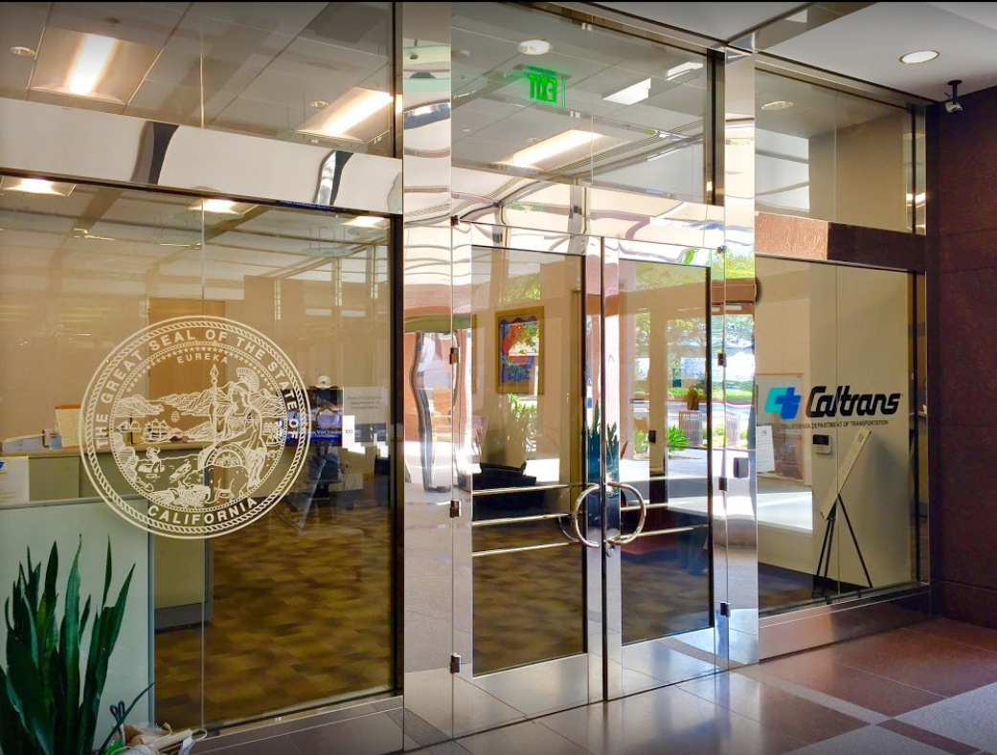

TECHNICAL ADVISORY COMMITTEE MEETING
LOCAL ASSISTANCE UPDATE
Jonathan Lawhead Kathleen Nguyen
D12 Local Assistance Branch Chief (DLAE) D12 Local Assistance Program Manager
Caltrans District 12 Caltrans District 12
Jonathan.Lawhead@dot.ca.gov Kathleen.Nguyen@dot.ca.gov
(424) 413-1124 (805) 732-9777
June 26, 2024

Slide 2
TECHNICAL ADVISORY COMMITTEE MEETING
LOCAL ASSISTANCE UPDATE
TABLE OF CONTENTS
PAGE | UPDATE ITEM
1 CTC Meetings
2 Inactive Invoices
3 ATP
4 HSIP
5 Clean California
6 LTCAP
7 DBE/QAP
8 PED Extensions
9 Title VI
10 References and Training Opportunities
11 Staff Assignments/Contacts

Slide 3
CTC Meetings
Deadlines to submit allocations and time extensions to District 12 Local Assistance:
June 17, 2024 for the August 2024 CTC Meeting
August 19, 2024 for the October 2024 CTC Meeting
1

Slide 4
Inactive Invoices
Deadline to submit inactive invoices for next quarter is August 23, 2024
New inactive quarter will begin on July 1, 2024
Reminder letters will be sent out after the new quarter begins
Inactivity may prevent E-76s from being processed
The official inactive list can be viewed here:
https://dot.ca.gov/programs/local-assistance/projects/inactive-projects
If you have questions or issues with submitting invoices, please contact your assigned Local Assistance Area Engineer for further assistance
2
Notes:
We have had several cases statewide and even in the district where E-76s were rejected last FFY because there were ongoing inactives.

Slide 5
Active Transportation Program (ATP)
CalSMART Reporting Requirements:
Open for reporting June 16, 2024
Quarterly progress reports due July 15, 2024
Quarterly progress reports are required once a project is accepted into the ATP
Completion Reports (CR) must be finalized and approved before the District can process your Final Report of Expenditures (FROE)
Final Delivery Reports (FDR) will only be approved after the FROE has been processed
Caltrans’ ATP webpage: https://dot.ca.gov/programs/local-assistance/fed-and-state-programs/active-transportation-program
3
Notes:
Completion Report is due to Caltrans within six months of construction contract acceptance or the project becoming operable (open to the public), whichever comes sooner.
Final Delivery Report is due within 180 days of the conclusion of all remaining project activities beyond the acceptance of the construction contract.
All reports are due to the CalSMART online reporting tool and can only be submitted during an open reporting period.

Slide 6
Highway Safety Improvement Program (HSIP)
HSIP Cycle 12
Call-for-Projects – May 6, 2024
Application deadline – September 9, 2024
Cycle 12 funds will be either state or federally funded
Information may be subject to change. For more info and guidance, please see Caltrans’ HSIP webpage: https://dot.ca.gov/programs/local-assistance/fed-and-state-programs/highway-safety-improvement-program
4

Slide 7
Clean California Local Grant Program (CCLGP)
Cycle 1 delivery deadline is June 30, 2024, without an extension
If an extension will be required, please reach out to your assigned Local Assistance Area Engineer ASAP
Please see the Clean CA webpage for more info and application guidelines: https://cleancalifornia.dot.ca.gov/local-grants/local-grant-program
5

Slide 8
Local Transportation Climate Adaptation Program (LTCAP)
LTCAP Cycle 2
Call for Projects: June 27-28, 2024 - August 30, 2024
Call for Projects closes August 30, 2024 by 11:59pm
Information may be subject to change. For more info and guidance, please see Caltrans’ LTCAP webpage: https://catc.ca.gov/programs/local-transportation-climate-adaptation-program
6
Notes:
Caltrans HQ Local Assistance, CTC, and Caltrans Budgets are performing a reconciliation effort to address the various challenges resulting from the passing of the Fiscal Responsibility Act of 2023 and to develop a complete fiscal plan related to this effort. An update will be provided to all Districts, MPO’s, and RTPA’s once more information is available.

Slide 9
DBE/QAP
Quality Assurance Program (QAP) forms need to be updated and approved every 5 years
QAP forms and annual DBE Forms need to be up to date and on file with Caltrans D12 Local Assistance in order to process E-76s and receive federal funding
If you have questions or issues with submitting DBE/QAP forms, please contact your assigned Local Assistance Area Engineer for further assistance
7

Slide 10
PED Extension
New way to request extensions for Project End Dates (PED)
Entirely online and replaces old E-76 system
Link: https://app.smartsheet.com/b/form/dd8ec43edae54b8aad35159cacec011a
Work done after a PED cannot be reimbursed!
More info and a report listing upcoming PED expirations can be found here: https://dot.ca.gov/programs/local-assistance/projects/projects-with-expiring-end-dates
8

Slide 11
Title VI
Title VI of the Civil Rights Act of 1964 prohibits discrimination by recipient of Federal assistance on the basis of race, color, and national origin, including the denial of meaningful access for limited English proficient (LEP) Persons.
Requirements include but are not limited to:
Title VI nondiscrimination statement
Assurances (as part of the Master Agreement and Program Supplement Agreement.
Designation of a Title VI Coordinator.
Complaint Procedures.
Data Collection.
Training.
Dissemination of Information.
Contracts and Agreements.
Environmental Justice.
Public Hearings and Meetings.
Right of Way activities.
Construction contract compliance.
Monitoring.
Caltrans has also recently updated our webpage on Filing a Complaint, and it provides guidance to local agencies on how to process Title VI complaints.
9

Slide 12
References and Training Opportunities
Cooperative Training Assistance Program:
https://ca-ctap.org/
California LTAP training:
https://caltap.org/training.aspx
Local Assistance Blog:
https://www.localassistanceblog.com/local-assistance-training/
Local Assistance Procedures Manual (LAPM)
https://dot.ca.gov/programs/local-assistance/guidelines-and-procedures/local-assistance-procedures-manual-lapm
10

Slide 13
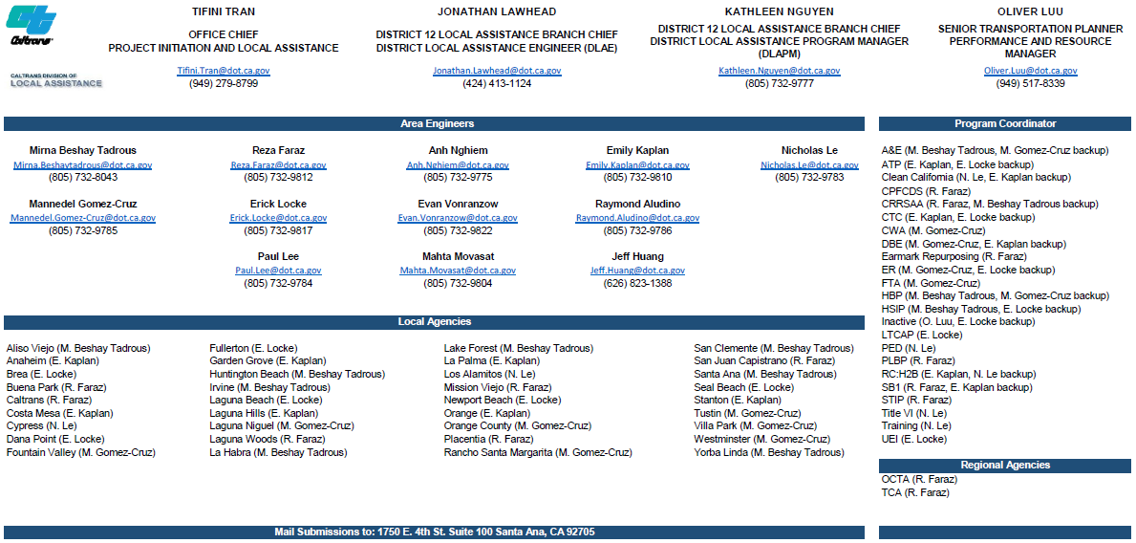
11

