Slide 1
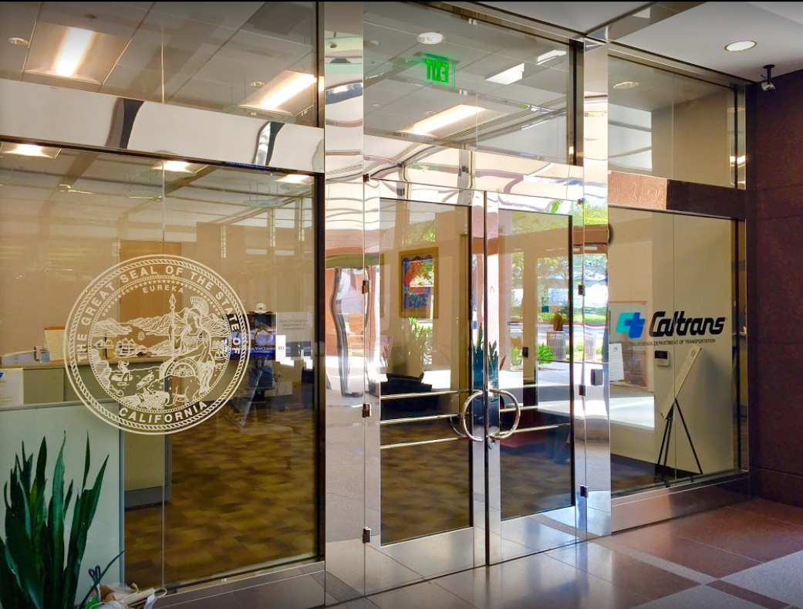

TECHNICAL ADVISORY COMMITTEE MEETING
LOCAL ASSISTANCE UPDATE
Jonathan Lawhead Oliver K. Luu
D12 Local Assistance Branch Chief Performance and Resource Manager
Caltrans District 12 Caltrans District 12
Jonathan.Lawhead@dot.ca.gov Oliver.Luu@dot.ca.gov
(657) 328-6285 (657) 328-6267
October 25, 2023

Slide 2
TECHNICAL ADVISORY COMMITTEE MEETING
LOCAL ASSISTANCE UPDATE
TABLE OF CONTENTS
PAGE | UPDATE ITEM
1 CTC Meetings
2 Inactive Invoices
3 ATP
4 Clean California
5 DBE/QAP
6 PED Extensions
7 CRRSAA/PMRF
8 Training
9 Title VI
10 Staff Assignments/Contacts

Slide 3
CTC Meetings
Deadlines to submit allocations and time extensions to District Local Assistance:
  October 9, 2023 for the December 2023 CTC Meeting
  November 27, 2023 for the January 2024 CTC Meeting
1

Slide 4
Inactive Invoices
New inactive quarter began on October 1, 2023.
Deadline to submit inactive invoices will be November 22, 2023
Reminder letters will be sent out later this month once HQ publishes a new official inactive list
Inactivity may prevent E-76s from being processed.
The official inactive list can be viewed here: https://dot.ca.gov/programs/local-assistance/projects/inactive-projects
If you have questions or issues with submitting invoices, please contact your area engineer/planner for further assistance.
2

Slide 5
Active Transportation Program
ATP Cycle 6 MPO component adopted at the June 28, 2023 CTC Meeting.
Timely Use of Funds calculator is now available
  Assists in confirming deadlines and submittal dates
  Link: https://dot.ca.gov/programs/local-assistance/fed-and-state-programs/active-transportation-program/timelyuse
For more info and guidance, please see Caltrans’ ATP webpage: https://dot.ca.gov/programs/local-assistance/fed-and-state-programs/active-transportation-program
3

Slide 6
Clean California Local Grant Program (CCLGP)
Cycle 2 awardees have been announced. For a full list of awarded projects, see the CCLGP Cycle 2 Awarded Projects webpage.
Local Agencies with Cycle 1 projects should submit invoices no more frequently than monthly and no less frequently than quarterly.
Please see the Clean CA webpage for more info and application guidelines: https://cleancalifornia.dot.ca.gov/local-grants/local-grant-program
4

Slide 7
DBE/QAP
DBE exhibits 9-B and 9-C for FFY 23/24 are due to the District ASAP if not already submitted.
Quality Assurance Program (QAP) forms need to be updated and approved every 5 years.
DBE & QAP forms need to be up to date in order to process E-76s and receive federal funding.
If you have questions or issues with submitting DBE/QAP forms, please contact your area engineer for further assistance.
5

Slide 8
PED Extension
New way to request extensions for Project End Dates (PED)
  Entirely online and replaces old E-76 system
  Link: https://app.smartsheet.com/b/form/dd8ec43edae54b8aad35159cacec011a
Work done after a PED cannot be reimbursed!
More info and a report listing upcoming PED expirations can be found here: https://dot.ca.gov/programs/local-assistance/projects/projects-with-expiring-end-dates
6

Slide 9
CRRSAA / PMRF
CRRSAA/PMRF funding for unobligated projects was subject to rescission per the Fiscal Responsibility Act of 2023.
The State and Caltrans HQ are currently running a reconciliation effort to determine which projects with federal funds affected by the recission can be exchanged for state funds – more information to come on this.
7

Slide 10
Training
LTAP link for training registration and info: https://ca-ctap.org/index.cfm?pid=1609
Fall training schedule is coming soon.
8

Slide 11
Title VI
Title VI of the Civil Rights Act of 1964 prohibits discrimination by recipient of Federal assistance on the basis of race, color, and national origin, including the denial of meaningful access for limited English proficient (LEP) Persons.
Requirements include but are not limited to:
  Title VI nondiscrimination statement
  Assurances (as part of the Master Agreement and Program Supplement Agreement.
  Designation of a Title VI Coordinator.
  Complaint Procedures.
  Data Collection.
  Training.
  Dissemination of Information.
  Contracts and Agreements.
  Environmental Justice.
  Public Hearings and Meetings.
  Right of Way activities.
  Construction contract compliance.
  Monitoring.
Caltrans has also recently updated our webpage on Filing a Complaint, and it provides guidance to local agencies on how to process Title VI complaints.
9

Slide 12
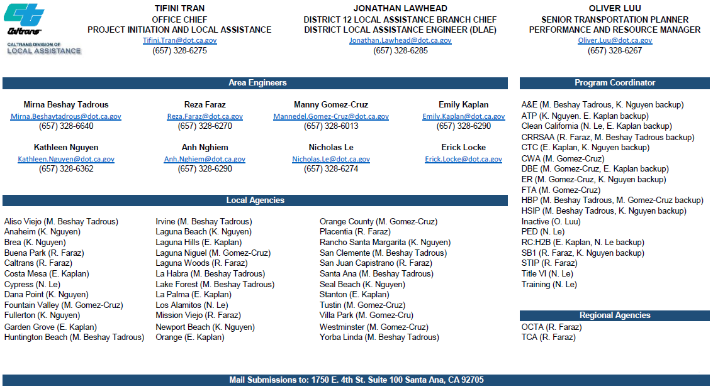
10

