Slide 1
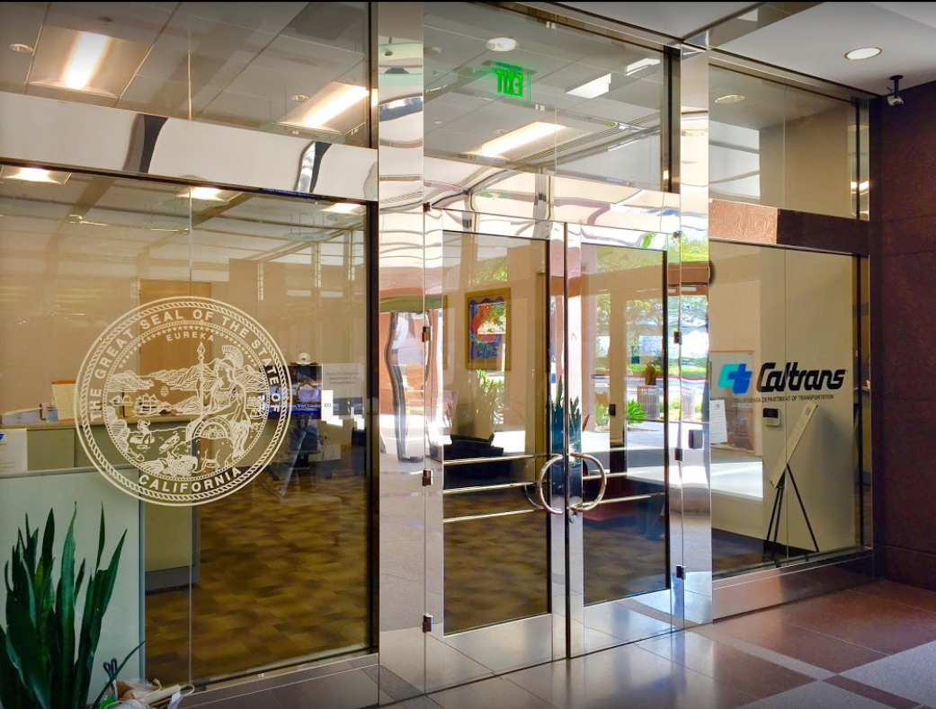

TECHNICAL ADVISORY COMMITTEE MEETING
LOCAL ASSISTANCE UPDATE
Jonathan Lawhead Oliver K. Luu
Acting D12 Local Assistance Branch Chief Associate Transportation Planner
Caltrans District 12 Caltrans District 12
Jonathan.Lawhead@dot.ca.gov Oliver.Luu@dot.ca.gov
(657) 328-6285 (657) 328-6267
June 20, 2023

Slide 2
TECHNICAL ADVISORY COMMITTEE MEETING
LOCAL ASSISTANCE UPDATE
TABLE OF CONTENTS
PAGE | UPDATE ITEM
1 CTC Meetings
2 Inactive Invoices
3 Inactive Invoices
4 ATP
5 Clean California
6 DBE/QAP
7 PED Extensions
8 CRRSAA/PMRF
9 Training
10 Title VI
11 Staff Assignments/Contacts

Slide 3
CTC Meetings
Deadlines to submit allocations and time extensions to District Local Assistance:
  August 21, 2023 for the October 2023 CTC Meeting
  October 9, 2023 for the December 2023 CTC Meeting
1

Slide 4
Authorization Deadlines
The 2022/2023 federal fiscal year ends soon in September
Agencies have until July 14 to submit E-76s/Requests for Authorization to districts
2

Slide 5
Inactive Invoices
The deadline to submit inactive invoices was May 23, 2023
Inactivity may prevent E-76s from being processed
New inactive quarter begins on July 1, 2023
The official inactive list can be viewed here: https://dot.ca.gov/programs/local-assistance/projects/inactive-projects
If you have questions or issues with submitting invoices, please contact your area engineer/planner for further assistance
3

Slide 6
Active Transportation Program
ATP Cycle 6 MPO component will be finalized for the June 2023 CTC Meeting
Timely Use of Funds calculator is now available
  Assists in confirming deadlines and submittal dates
  Link: https://dot.ca.gov/programs/local-assistance/fed-and-state-programs/active-transportation-program/timelyuse
For more info and guidance, please see Caltrans’ ATP webpage: https://dot.ca.gov/programs/local-assistance/fed-and-state-programs/active-transportation-program
4

Slide 7
Clean California Local Grant Program (CCLGP)
Cycle 2 applications are currently being evaluated
  Award notification will be in September 2023
Local Agencies with Cycle 1 projects should submit invoices no more frequently than monthly and no less frequently than quarterly
Please see the Clean CA webpage for more info and application guidelines: https://cleancalifornia.dot.ca.gov/local-grants/local-grant-program
5

Slide 8
DBE/QAP
DBE exhibits 9-B and 9-C for FFY 22/23 are due to the District by July 7, 2023
Quality Assurance Program (QAP) forms need to be updated and approved every 5 years
DBE & QAP forms need to be up to date in order to process E-76s and receive federal funding
If you have questions or issues with submitting DBE/QAP forms, please contact your area engineer/planner for further assistance
6

Slide 9
PED Extension
New way to request extensions for Project End Dates (PED)
  Entirely online and replaces old E-76 system
  Link: https://app.smartsheet.com/b/form/dd8ec43edae54b8aad35159cacec011a
Work done after a PED cannot be reimbursed!
More info and a report listing upcoming PED expirations can be found here: https://dot.ca.gov/programs/local-assistance/projects/projects-with-expiring-end-dates
7

Slide 10
CRRSAA / PMRF
CRRSAA/PMRF funding for unobligated projects were subject to rescission per the Fiscal Responsibility Act of 2023
The State and Caltrans HQ are currently running a reconciliation effort to determine which projects with federal funds affected by the recission can be exchanged for state funds – more information to come on this
8

Slide 11
Training
LTAP link for training registration and info: https://ca-ctap.org/index.cfm?pid=1609
Fall training schedule is coming soon
9

Slide 12
Title VI
Title VI of the Civil Rights Act of 1964 prohibits discrimination by recipient of Federal assistance on the basis of race, color, and national origin, including the denial of meaningful access for limited English proficient (LEP) Persons.
Requirements include but are not limited to:
  Title VI nondiscrimination statement
  Assurances (as part of the Master Agreement and Program Supplement Agreement.
  Designation of a Title VI Coordinator.
  Complaint Procedures.
  Data Collection.
  Training.
  Dissemination of Information.
  Contracts and Agreements.
  Environmental Justice.
  Public Hearings and Meetings.
  Right of Way activities.
  Construction contract compliance.
  Monitoring.
Caltrans has also recently updated our webpage on Filing a Complaint, and it provides guidance to local agencies on how to process Title VI complaints.
10

