Slide 1
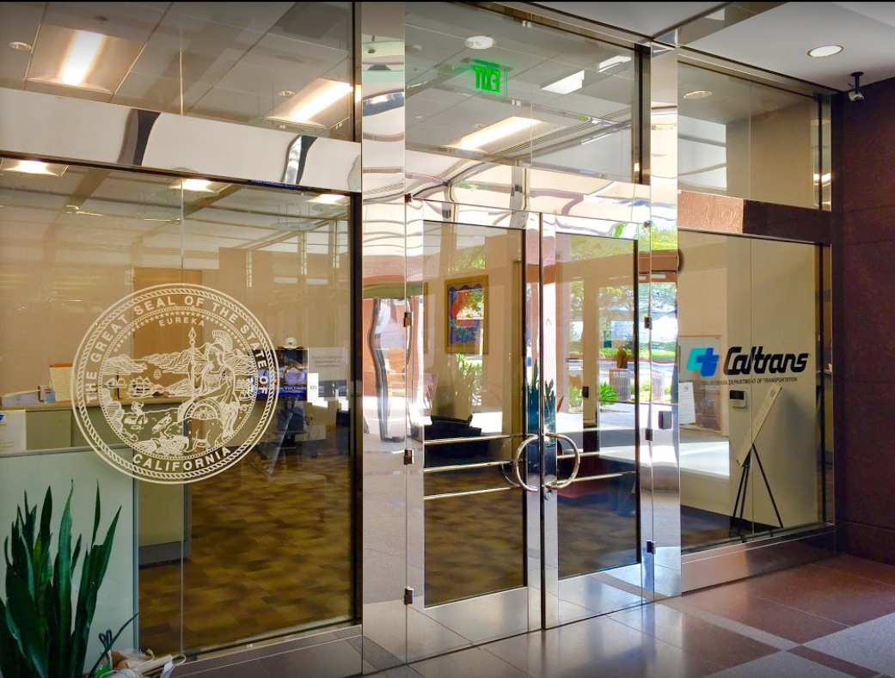

TECHNICAL ADVISORY COMMITTEE MEETING
LOCAL ASSISTANCE UPDATE
Tifini Tran Oliver K. Luu
District Local Assistance Engineer (DLAE) Associate Transportation Planner
Caltrans District 12 Caltrans District 12
Tifini.Tran@dot.ca.gov Oliver.Luu@dot.ca.gov
(657) 328-6275 (657) 328-6267
March 23, 2022

Slide 2
TECHNICAL STEERING COMMITTEE MEETING
LOCAL ASSISTANCE UPDATE
TABLE OF CONTENTS
PAGE | UPDATE ITEM
1 CTC Meetings
2 Inactive Invoices
3 Active Transportation Program
4 Clean California Local Grant Program
5 HBP (Bridge) Program
6 Training
7 Title VI
8 Staff Assignments/Contacts

Slide 3
CTC Meetings
Upcoming deadlines to submit allocations and time extensions to District Local Assistance:
  May 2, 2022 for the June 2022 CTC Meeting
  June 20, 2022 for the August 2022 CTC Meeting
1

Slide 4
Inactive Invoices
The current inactive quarter began on January 1, 2022. The deadline to submit inactive invoices to Caltrans for this quarter has passed.
The new quarter begins on April 1, 2022.
Caltrans’ official list of inactive projects can be viewed here: https://dot.ca.gov/programs/local-assistance/projects/inactive-projects
If you have any questions or issues with submitting invoices, please contact your area engineer/planner for further assistance
2

Slide 5
Active Transportation Program
The Cycle 6 call for projects recently happened on Mar 16-17
Reminder about ATP project deadlines:
  If you come in for a time extension for one phase of your project, that the time extension is exclusive to that phase
  Time extensions should be submitted to the CTC meeting or two before the month of the milestone deadline
For more info and guidance, please see Caltrans’ ATP webpage: https://dot.ca.gov/programs/local-assistance/fed-and-state-programs/active-transportation-program
3

Slide 6
Clean California Local Grant Program (CCLGP)
Projects were awarded earlier this month; see the Clean CA webpage for the full list of projects: https://cleancalifornia.dot.ca.gov/local-grants/workshops-milestones
If your project got awarded, you will need to execute a Restricted Grant Agreement (RGA)
If your project was not awarded, the webpage will also have debriefing info
Please see the Clean CA webpage for more info, including the guidelines and FAQ: https://cleancalifornia.dot.ca.gov/local-grants/local-grant-program
4

Slide 7
HBP (Bridge) Program
HQ wants to remind agencies of a few policies
HBP project eligibility may require re-evaluation if there are design changes
LAPG 6-A forms must be fully completed with all required attachments, or else they will be returned without review
LAPG 6-D forms must list both participating and non-participating costs
All considerations relating to a project’s PE>10 deadline are “paused” so that the PE>10 deadline won’t negatively impact the project. Please hold off on requesting PE>10 Time Extensions and Determinations until further guidance can be provided.
5

Slide 8
Training
LTAP link for training registration and info: https://californialtap.org/index.cfm?pid=1077
Federal Aid Series
  Getting Your Federal Aid Started (Apr 19-20, Jun 14-15)
  Environmental Requirements (May 10-11)
  Procedures for Right-of-Way Acquisition (Jul 26-27, Oct 4-5)
Emergency Relief program webinar (Apr 14, 19, 21, 26)
FHWA Right of Way Workshops (Feb 8-10, Mar 15-17)
Labor Compliance (Apr 25-28)
Resident Engineers Academy (Apr 25-28)
6

Slide 9
Title VI
Title VI of the Civil Rights Act of 1964 prohibits discrimination by recipient of Federal assistance on the basis of race, color, and national origin, including the denial of meaningful access for limited English proficient (LEP) Persons.
Requirements include but are not limited to:
  Title VI nondiscrimination statement
  Assurances (as part of the Master Agreement and Program Supplement Agreement.
  Designation of a Title VI Coordinator.
  Complaint Procedures.
  Data Collection.
  Training.
  Dissemination of Information.
  Contracts and Agreements.
  Environmental Justice.
  Public Hearings and Meetings.
  Right of Way activities.
  Construction contract compliance.
  Monitoring.
Caltrans has also recently updated our webpage on Filing a Complaint, and it provides guidance to local agencies on how to process Title VI complaints.
7

