Slide 1
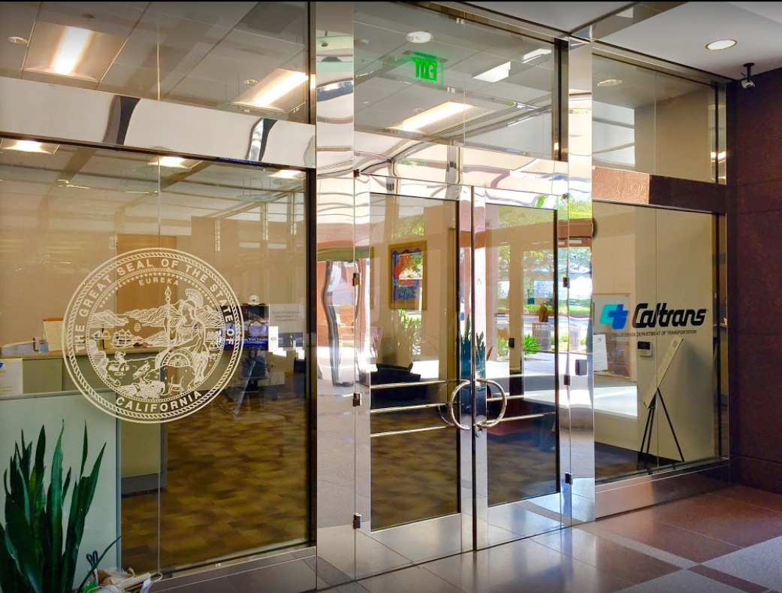

TECHNICAL ADVISORY COMMITTEE MEETING
LOCAL ASSISTANCE UPDATE
Tifini Tran Oliver K. Luu
District Local Assistance Engineer (DLAE) Associate Transportation Planner
Caltrans District 12 Caltrans District 12
Tifini.Tran@dot.ca.gov Oliver.Luu@dot.ca.gov
(657) 328-6275 (657) 328-6267
June 23, 2021

Slide 2
TECHNICAL STEERING COMMITTEE MEETING
LOCAL ASSISTANCE UPDATE
TABLE OF CONTENTS
PAGE | UPDATE ITEM
1 CTC Meetings
2 Inactive Invoices
3 LAPM and LAPG Changes
4 Training
5 Training (Cont.)
6 Title VI
7 Staff Assignments/Contacts

Slide 3
CTC Meetings
Upcoming deadlines to submit allocations and time extensions to District Local Assistance:
  Aug 15 for the Oct 2021 CTC Meeting
  Oct 10 for the Dec 2021 CTC Meeting
1

Slide 4
Inactive Invoices
The current inactive quarter began April 1, 2021
The next inactive quarter starts July 1, 2021
If your agency has invoices on FHWA’s official inactive list, this will jeopardize your funding.
2

Slide 5
LAPM and LAPG Changes
Two LAPM forms have been revised as of May 2021
  Exhibit 3-A – Project Authorization
  Exhibit 13-F – Local Public Agency Real Property Services Checklist
LAPM Chapter 20 – Audits and Corrective Actions
  Lists of deficiencies removed as of May 2021
  Focus is instead on expectations during the audit
LAPG Chapter 6 – Highway Bridge Program (HBP)
  Many revisions to project delivery requirements as of June 2021
  For more info, see this office bulletin: https://dot.ca.gov/-/media/dot-media/programs/local-assistance/documents/ob/2021/ob21-02.pdf
3

Slide 6
Training
ADA Transition Plan Implementation for Local Public Agencies (Jun-Jul)
  Four-part webinar series hosted by FHWA about ADA
  Register here: http://www.localassistanceblog.com/2021/06/07/ada-transition-plan-implementation-for-local-public-agencies/
Value Engineering Workshop (Oct 5-8)
4

Slide 7
Training
Other trainings with dates TBA later this year:
  Federal Aid Series – Getting Your Federal Aid Started
  Resident Engineers Academy
  Title VI Workshop
  Labor Compliance
Register for various Local Assistance courses here: https://californialtap.org/index.cfm?pid=1077
5

Slide 8
Title VI
Title VI of the Civil Rights Act of 1964 prohibits discrimination by recipient of Federal assistance on the basis of race, color, and national origin, including the denial of meaningful access for limited English proficient (LEP) Persons.
Requirements include but are not limited to:
  Title VI nondiscrimination statement
  Assurances (as part of the Master Agreement and Program Supplement Agreement.
  Designation of a Title VI Coordinator.
  Complaint Procedures.
  Data Collection.
  Training.
  Dissemination of Information.
  Contracts and Agreements.
  Environmental Justice.
  Public Hearings and Meetings.
  Right of Way activities.
  Construction contract compliance.
  Monitoring.
Caltrans has also recently updated our webpage on Filing a Complaint, and it provides guidance to local agencies on how to process Title VI complaints.
6

