Slide 1
2021 Pavement Management Relief Funding (PMRF) Program
Wednesday, October 27, 2021

Slide 2
2021 PMRF PROGRAM
Overview:
Provides $10.931 million in Coronavirus Response and Relief Supplemental Appropriations Act funding to the 35 Orange County local agencies for local streets and roads rehabilitation and maintenance projects.
Funding:
Distributed via formula based on 2021 population data provided by the California Department of Finance
$200,000 minimum guarantee
No local match required
This funding is federal and must follow requirements as established by the California Transportation Commission (CTC), California Department of Transportation (Caltrans), and the Federal Highway Administration (FHWA) for federal funds
Any funding not obligated by July 1, 2023 will return to OCTA to be reprogrammed to a priority OCTA project

Slide 3
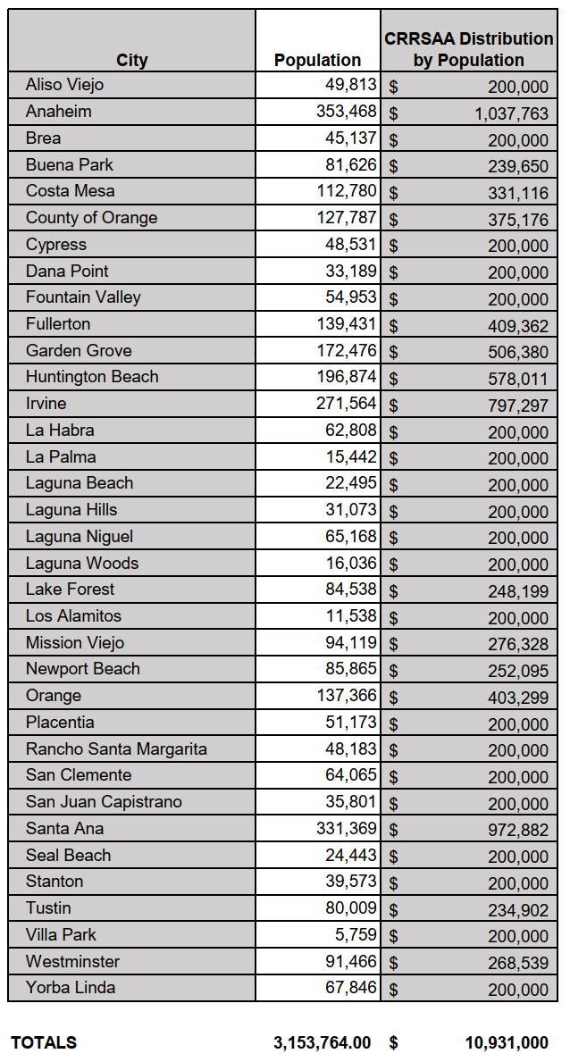
FUNDING DISTRIBUTION

Slide 4
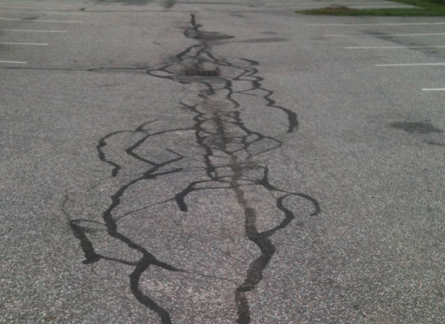
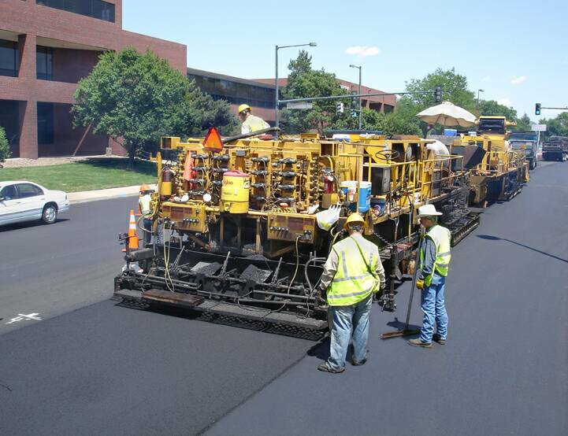
Eligible expenditures
Categories
Pavement Preservation/Preventive Maintenance
Treatments can include slurry seals, microsurfacing, crack seals, and similar sealing non-structural treatments.
Rehabilitation
Work undertaken to extend the service life of an existing facility.
Includes placement of additional surfacing and/or other work necessary to return an existing roadway, including shoulders, to a condition of structural or functional adequacy, for the specified service life.
Might include the partial or complete removal and replacement of portions of the pavement structure.
Reconstruction
Replacement of the entire existing pavement structure by the placement of the equivalent or increased pavement structure.
Usually requires the complete removal and replacement of the existing pavement structure utilizing either new or recycled materials.

Slide 5
Eligible expenditures
Activities
Construction
Construction engineering up to 15% of the project cost
Bike lanes within the limits of the project as necessary
Repair or replacement in kind of parking lanes, curbs, gutters, driveway approaches, catch basins, concrete bus pads, and minor profile revisions (i.e. curb to curb) as required by project
Use of alternative materials such as rubberized asphalt, Portland cement concrete, etc.
Construction or modification of curb ramps within the limits of the project as necessary to satisfy Americans with Disabilities Act requirements

Slide 6
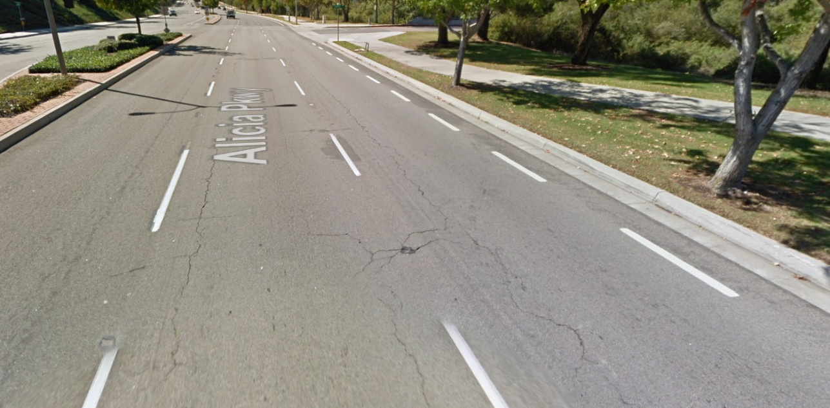
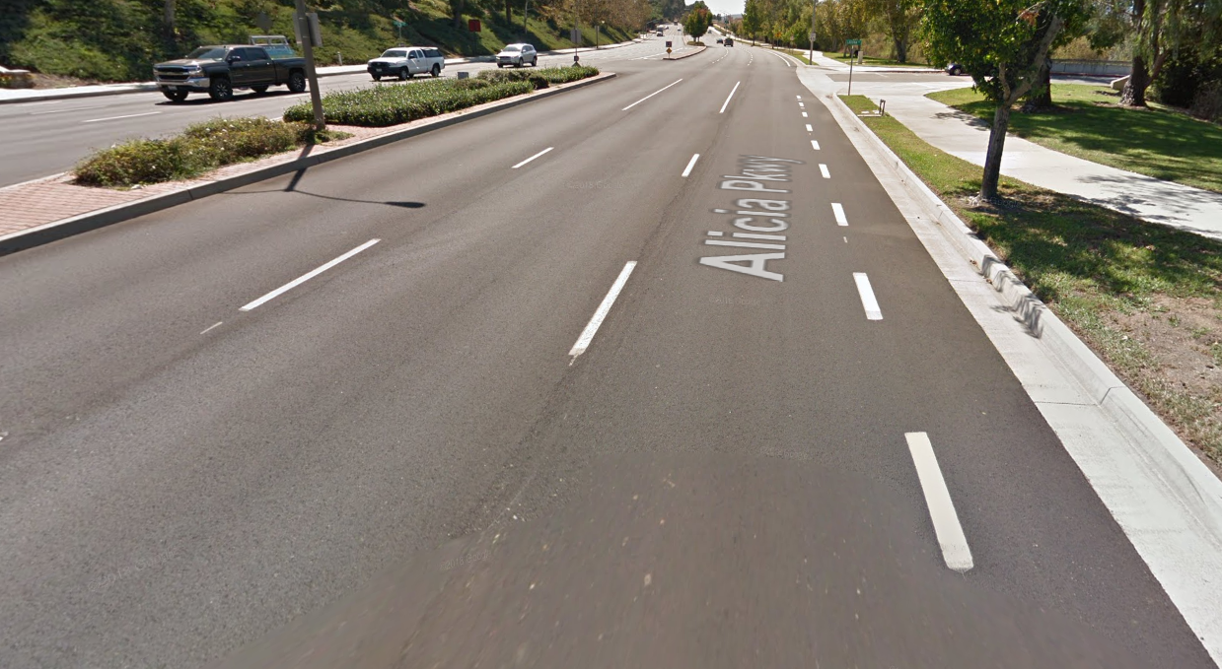
PROJECT ELIGIBILITY
Projects submitted for this program must be federally eligible.
Funds should be utilized on facilities within the CA Road System Map or the National Highway System.
Streets or roads that are functionally classified as Minor Collector or above are eligible.

Slide 7
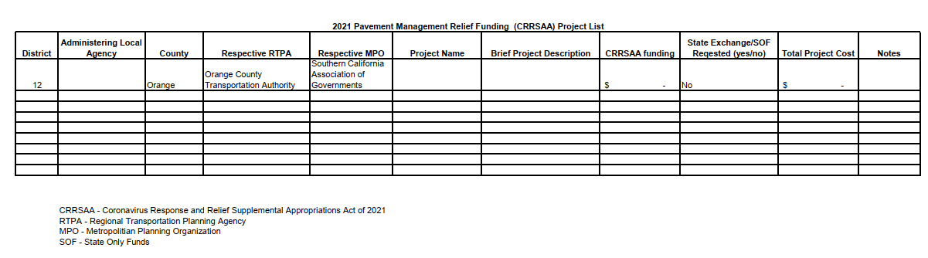
APPLICATION PROCESS
Agencies may submit up to three (3) projects within the application as long as the funding request does not exceed the local agency’s allocation.
Application required documents:
Project list (Excel file) – see below
Draft ePPR
City/County Council Resolution
Applications must be submitted electronically (emailed) to Heidi Busslinger (hbusslinger@octa.net) and Ben Ku (bku@octa.net) no later than Monday, February 28, 2022.

Slide 8
Allocation/Caltrans process
Allocation/obligation required documents and actions:
FTIP programming – OCTA will assist the agencies with this process
ePPR via CalSMART
CRRSAA Allocation Form
Authorization Request
CRRSAA Finance Letter
Please submit these documents directly to your Caltrans District 12 Local Assistance Engineer and copy OCTA staff.
A local agency cannot advertise for construction or award a contract prior to receiving obligation and authorization to proceed.
Reimbursable work may begin following the obligation and authorization to proceed process.
Agencies have six months to award a contract following obligation and authorization to proceed approval

Slide 9
OBLIGATION DEADLINE
Any funding not obligated by July 1, 2023 will be transferred to OCTA to be reprogrammed to a priority OCTA project.
This will ensure that 100% of these funds remain within the County.
CTC has indicated that any regional funding not obligated by June 2024 will return to the State for State use.
OCTA suggests that agencies submit obligation documents to Caltrans Local Assistance no later than April 1, 2023 to ensure a July 1, 2023 obligation/authorization to proceed.

Slide 10
2021 PMRF Program SCHEDULE
November 15, 2021 – Applications due to OCTA for January 2022 CTC meeting
January 10, 2022 – Applications due to OCTA for March 2022 CTC meeting
January 26-27, 2022 – Project list approved at CTC meeting
February 28, 2022 – Applications due to OCTA for May 2022 CTC meeting
March 16-17, 2022 – Project list approved at CTC meeting
May 18-19, 2022 – Project list approved at CTC meeting
April 1, 2023 – Submit obligation and authorization to proceed documents to Caltrans Local Assistance for review and approval
July 1, 2023 – Any PMRF funding not obligated will be transferred to OCTA

Slide 11
ADDITIONAL INFORMATION
Reimbursement
Agencies will submit invoices to Caltrans Local Assistance for reimbursement.
Invoices will require documentation of both costs and payment by local jurisdiction.
Agencies must submit invoices to Caltrans at least once every six months to avoid inactivity.
Reporting
Caltrans is responsible for quarterly reporting to the CTC on these projects and Local Assistance may request additional information.
OCTA will also require additional information for internal reporting purposes.
Scope Changes
Significant scope changes must be approved by the CTC.
Agencies will submit required documents to Caltrans Local Assistance and copy OCTA staff at least eight weeks prior to the next scheduled CTC meeting.
Provisions of Use
Environmental documentation (NEPA or CEQA) must be submitted to Caltrans

Slide 12
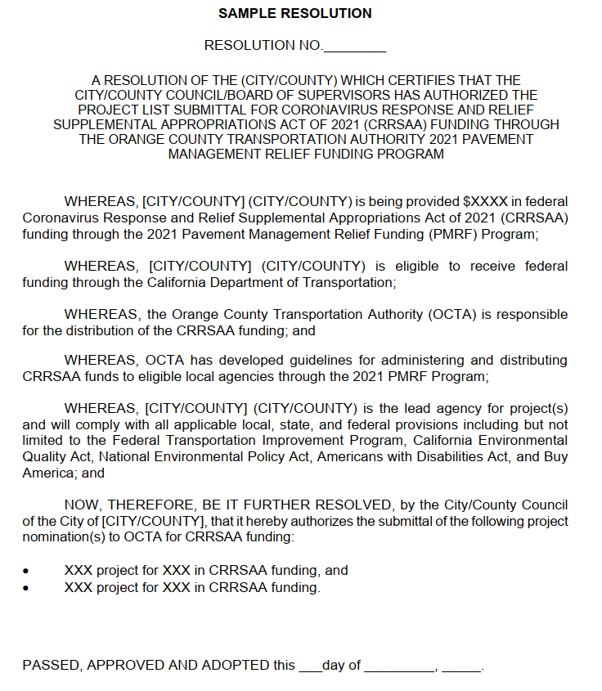
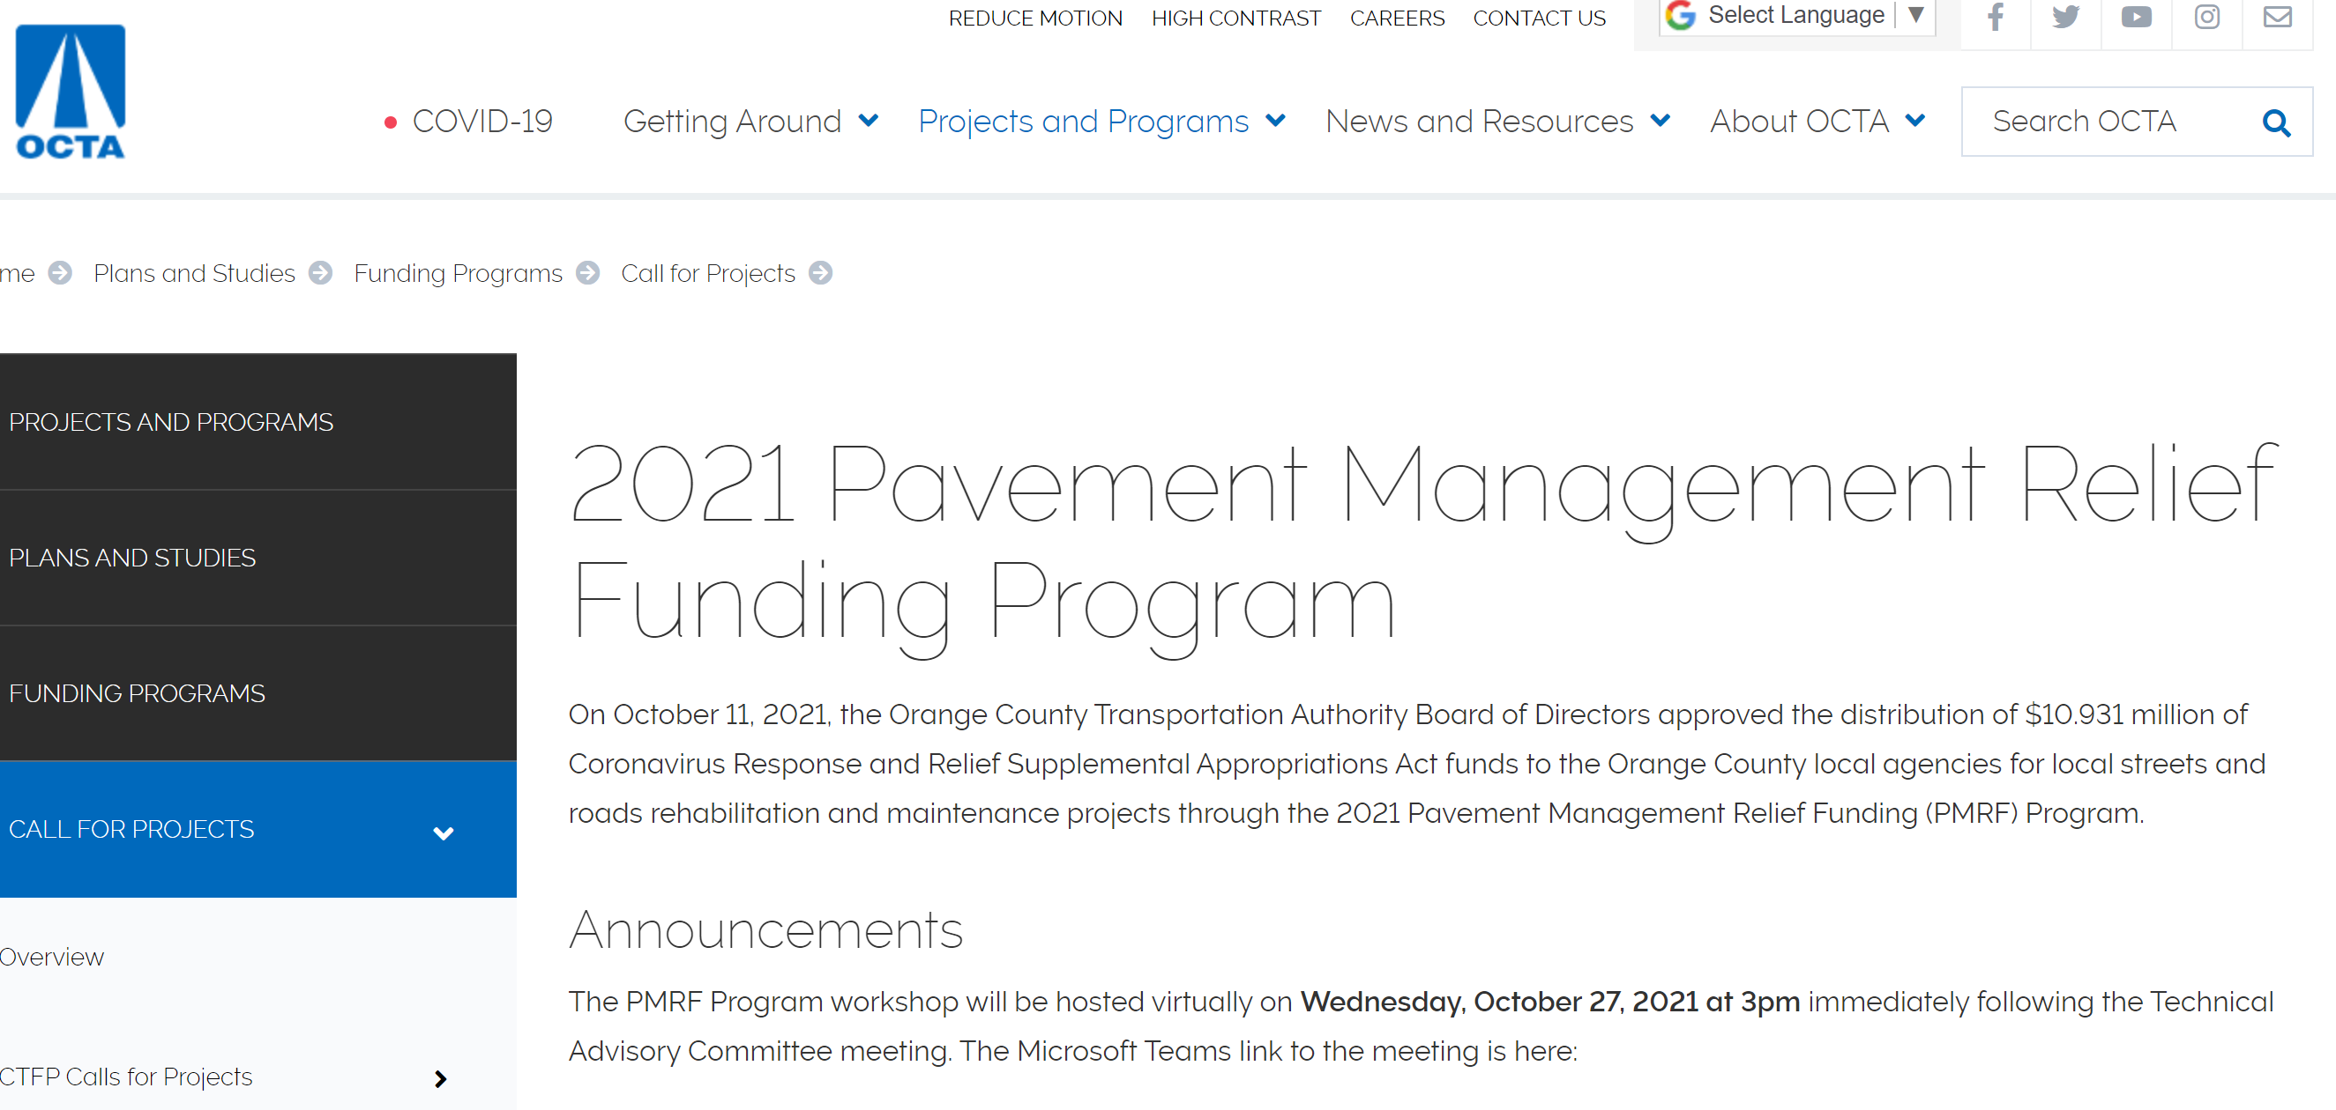
2021 PMRF GUIDELINES AND Resources
OCTA PMRF Program Website: Call for Projects - PMRF Call For Projects (octa.net)
Caltrans CRRSAA Website: Process for CRRSAA Program Projects | Caltrans
Caltrans LAPM Chapter 3 for Authorization Request forms: Local Assistance Procedures Manual (LAPM) Forms | Caltrans

Slide 13
Q & A

Slide 14
CONTACTS
Name | Title | Phone | Email
Heidi Busslinger, OCTA | Senior Transportation Funding Analyst | 714-560-5098 | hbusslinger@octa.net
Ben Ku, OCTA | Section Manager, Formula Funding | 714-560-5473 | bku@octa.net
Feel free to contact us if you have any questions

