Slide 1
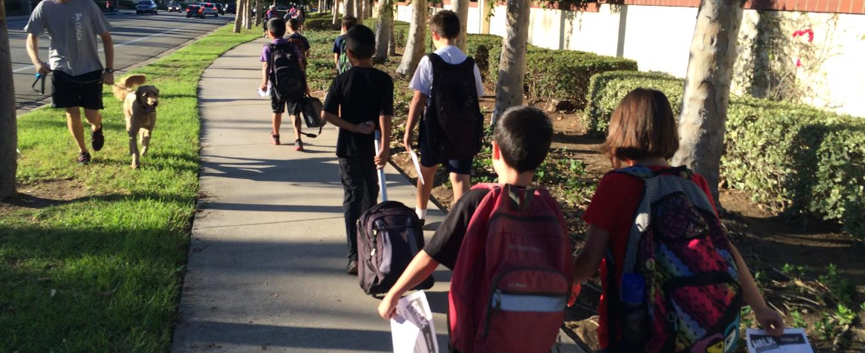
Safe Routes to School Update
CAC Bicycle/Pedestrian Subcommittee, March 26, 2019

Slide 2
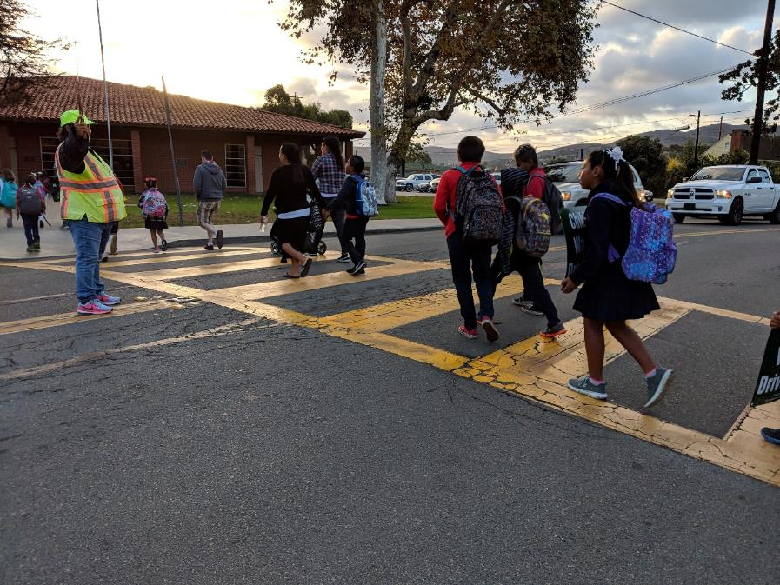
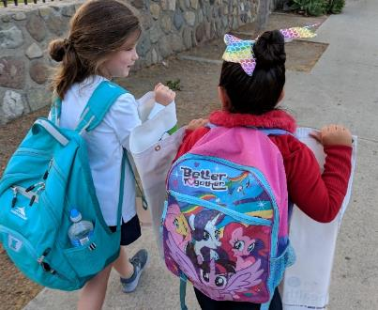
Recent OCTA Efforts
Walk to School Day Promotion
2017: 3 schools in Costa Mesa
2018: 5 schools
La Habra
Rossmoor
San Juan Capistrano
Santa Ana
Tustin

Slide 3
Safe Routes to School Action Plan
Countywide Action Plan
Grant funded by Caltrans
Empirical ranking of all public schools
Demonstration efforts at 10 Schools:
Walk Audits
Walk to School Day
Determine current & future actions
Establish roles & responsibilities
Understanding 5 E’s
Engineering
Education
Encouragement
Enforcement
Evaluation

Slide 4
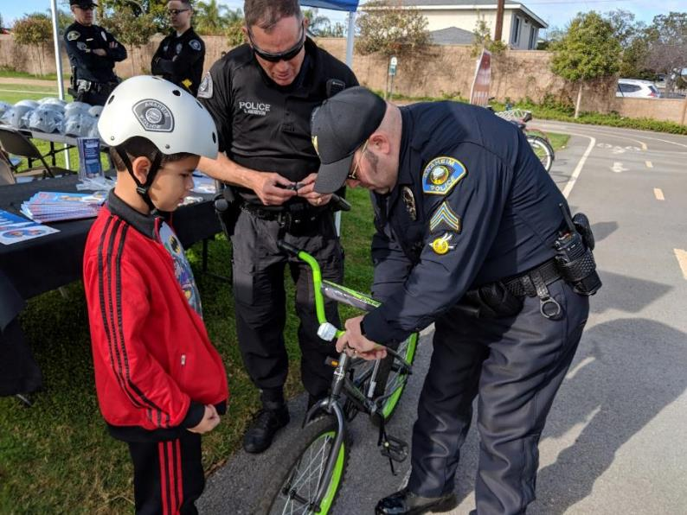
Safe Routes to School Action Plan
Broad Collaboration
OCTA Groups:
Technical Advisory Committee
Citizens Advisory Committee
Collaboration with Partners
Caltrans
Orange County Health Care Agency
Community Advocates
Cities, county, schools, school districts
Police departments

Slide 5
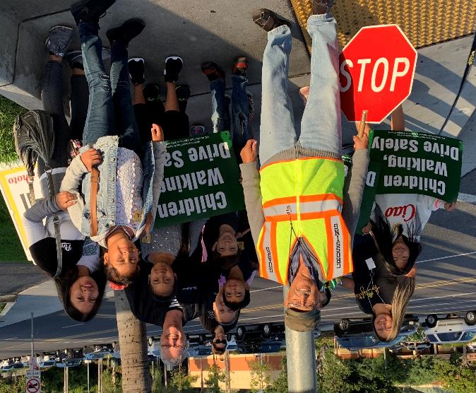
Safe Travels Education Program (STEP)
Countywide Campaign
Pending grant from California Transportation Commission & Caltrans
Partner with Orange County Health Care Agency & Law Enforcement
Education & encouragement efforts at 25 Schools
Establish local champions

Slide 6
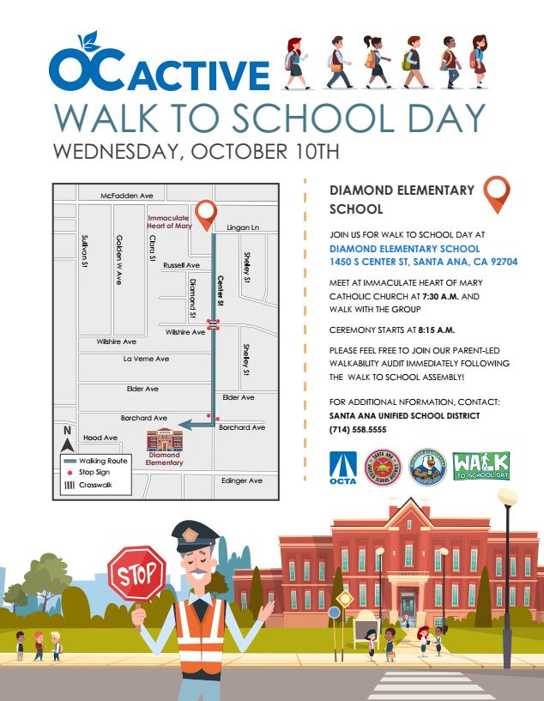
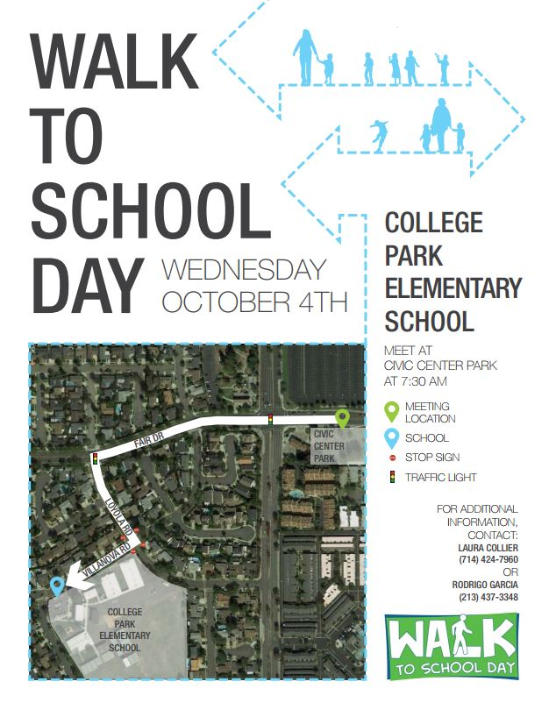
Safe Travels Education Program (STEP)

Slide 7
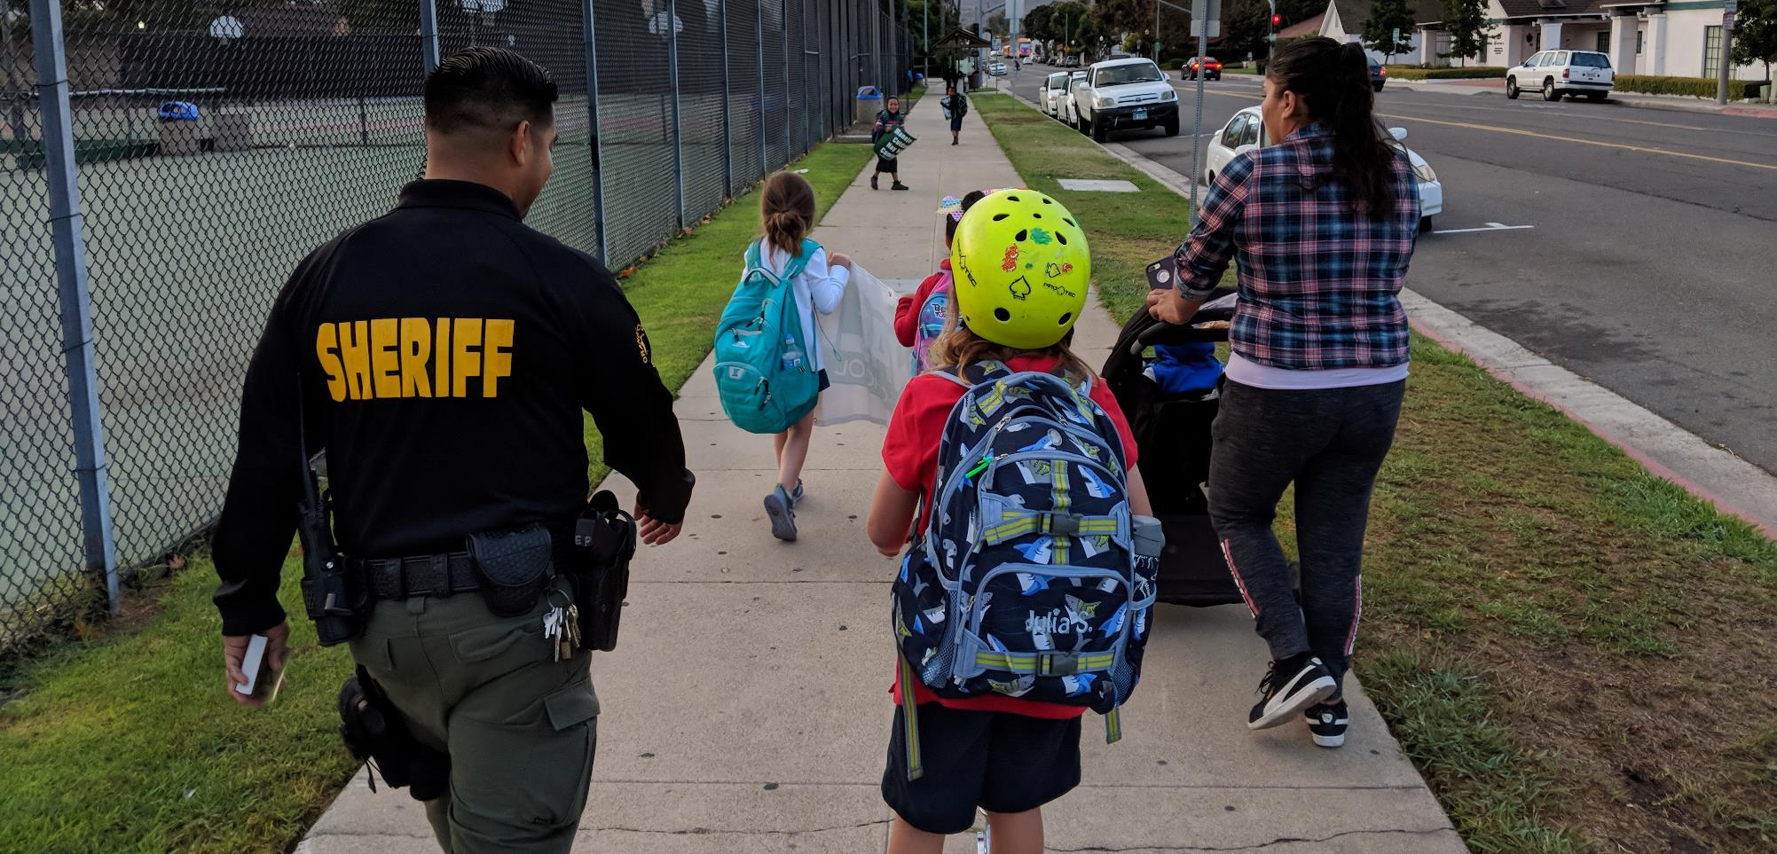
Safe Travels Education Program (STEP)

Slide 8
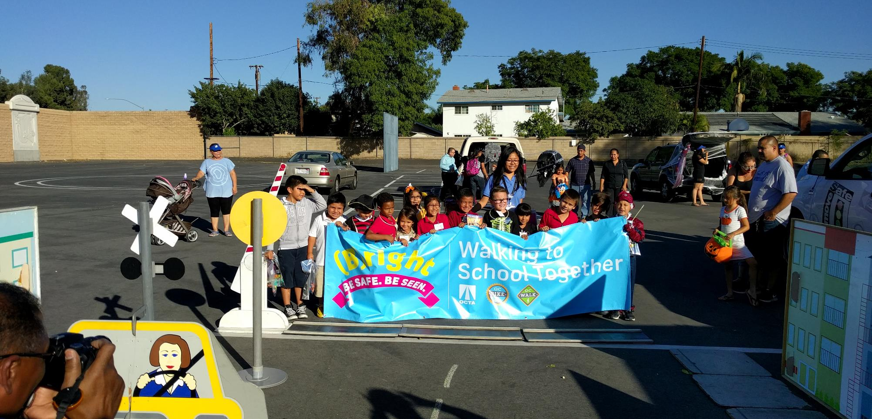
Safe Travels Education Program (STEP)

Slide 9
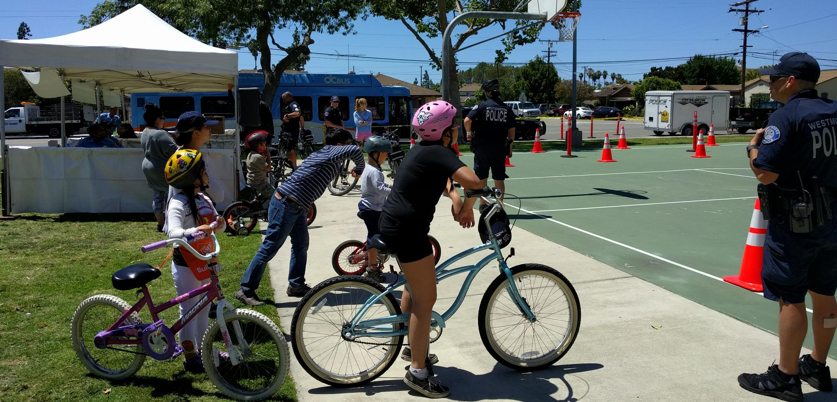
Safe Travels Education Program (STEP)

Slide 10
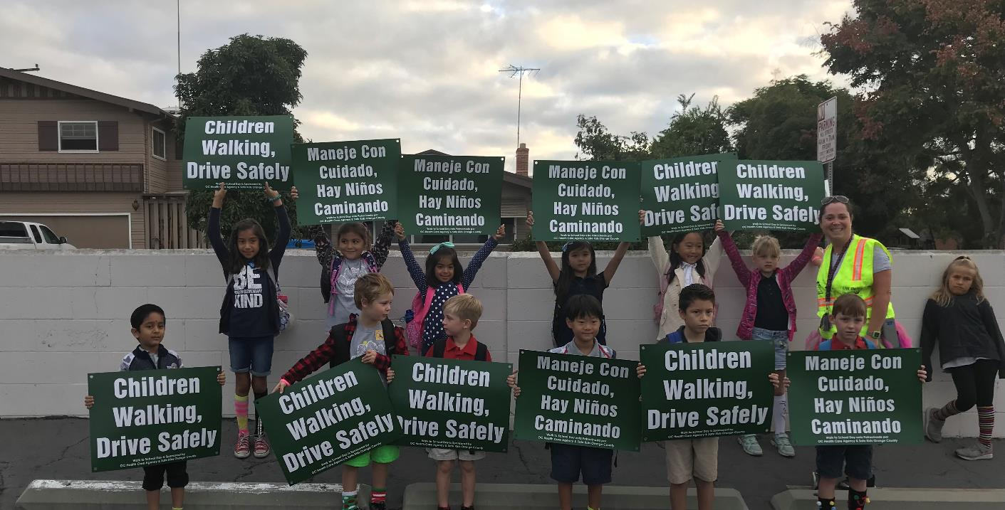
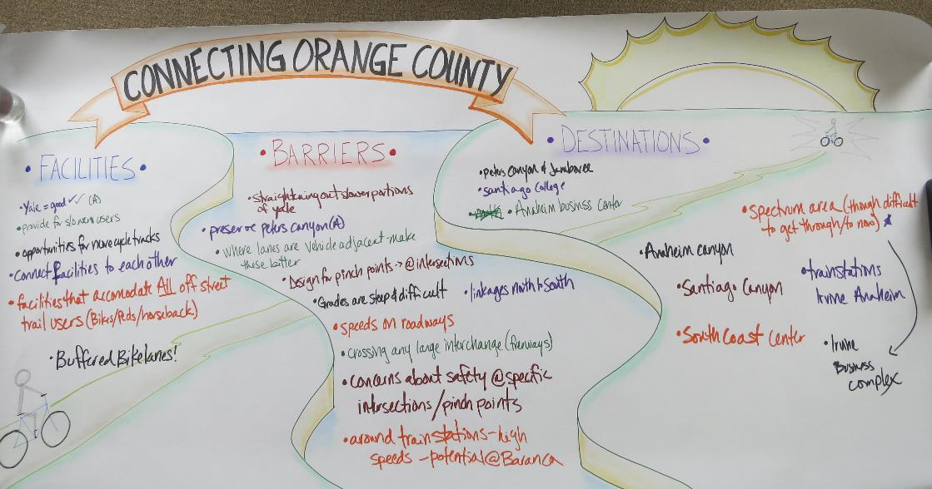
Thank You!
Paul Martin
OCTA Active Transportation Coordinator
(714) 560-5386
pmartin@octa.net
www.octa.net/ocactive

