Slide 1

Update on Interstate 5 Improvement Project from State Route 55 to State Route 57

Slide 2

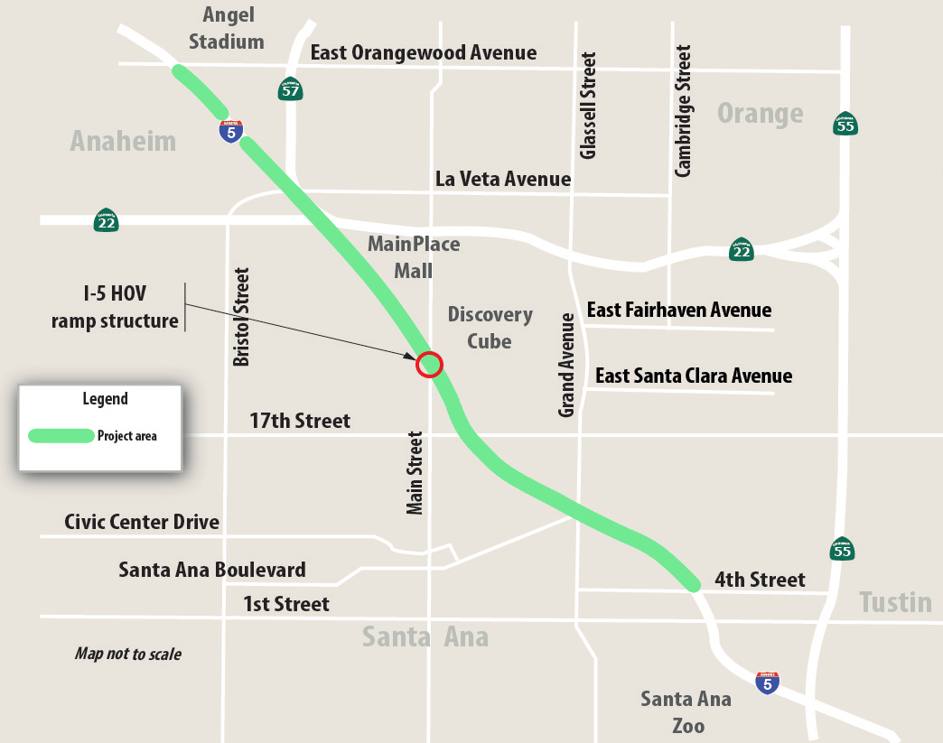
Project Limits and Background
Within cities of Santa Ana and Orange
Project A in Measure M2 (M2)
Adds second high-occupancy vehicle (HOV) lane on Interstate 5 (I-5) between State Route 55 and State Route 57
Increase HOV lane capacity
Eliminate bottlenecks at HOV merge points
Reduce congestion/delay and improve air quality
Cost is $41.5 million
Congestion Mitigation and Air Quality Program funding
Surface Transportation Block Grant Program funding
M2 funding
Construction phase has started

Slide 3
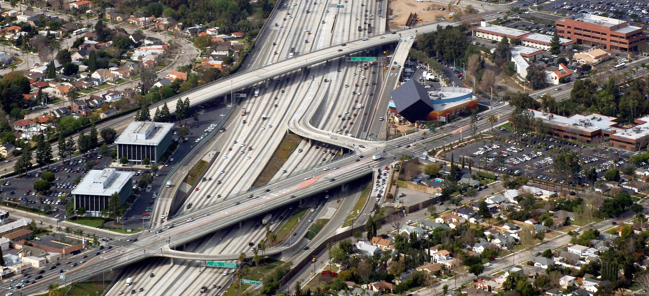
I-5/Main Street HOV Ramp

Slide 4

Project Construction Schedule
 | 2018 | 2019 | 2020 | 2021
Construction
Contract approval
First working day
HOV ramp closure
HOV ramp demolition
Project complete
December 28, 2018
February 20, 2019
Early April
Early Summer
Early 2021

Slide 5
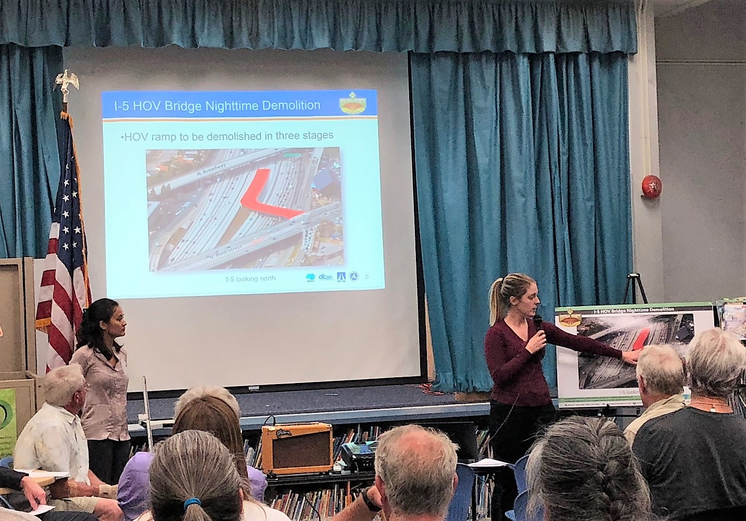
Engagement Strategies
City Council updates
Key stakeholder briefings
Stakeholder Working Group meetings
Neighborhood meetings
Civic organization and neighborhood association presentations
Chambers of Commerce and business presentations
Community events

Slide 6
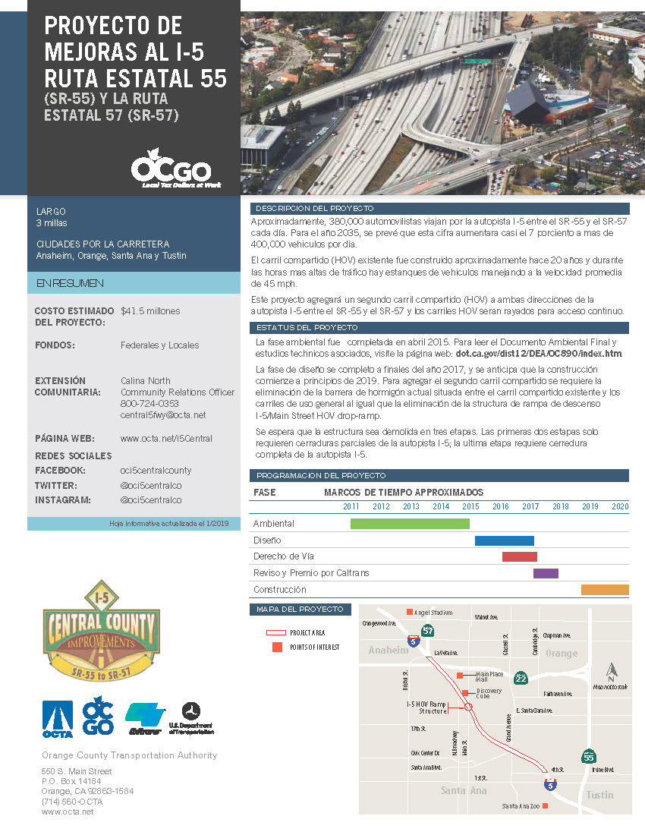
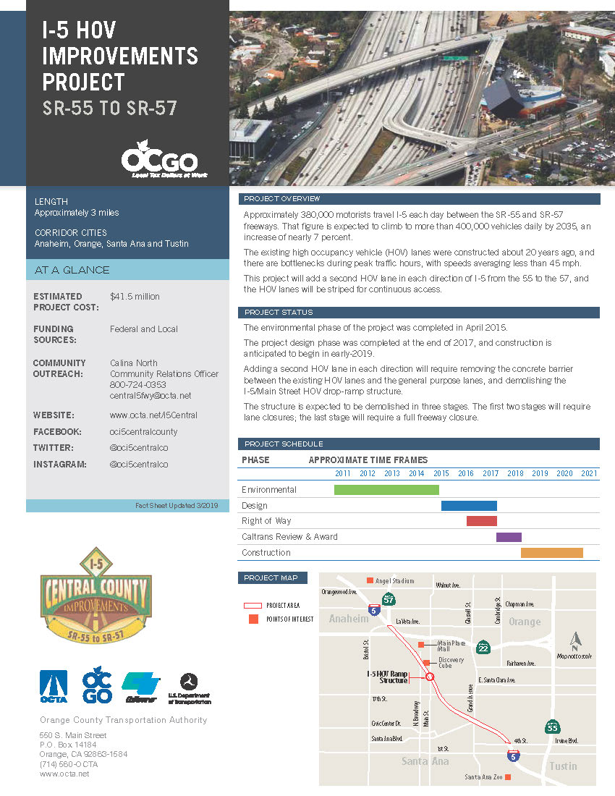
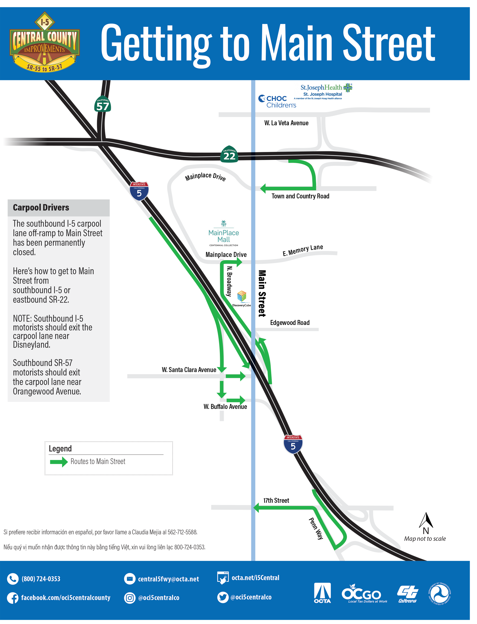



Public Outreach
Collateral with project branding
Weekly email construction alerts
Interactive closures and detours map
Text alerts
Social media

