Slide 1
Bristol Street Transit Corridor Study - Purpose and Need Update
Notes:
Good morning Chairman Do, Members of the Transit Committee.
I’m Eric Carlson, Senior Transportation Analyst, Strategic Planning.
Today, I have an update on the Bristol Street Study Purpose and Need.

Slide 2
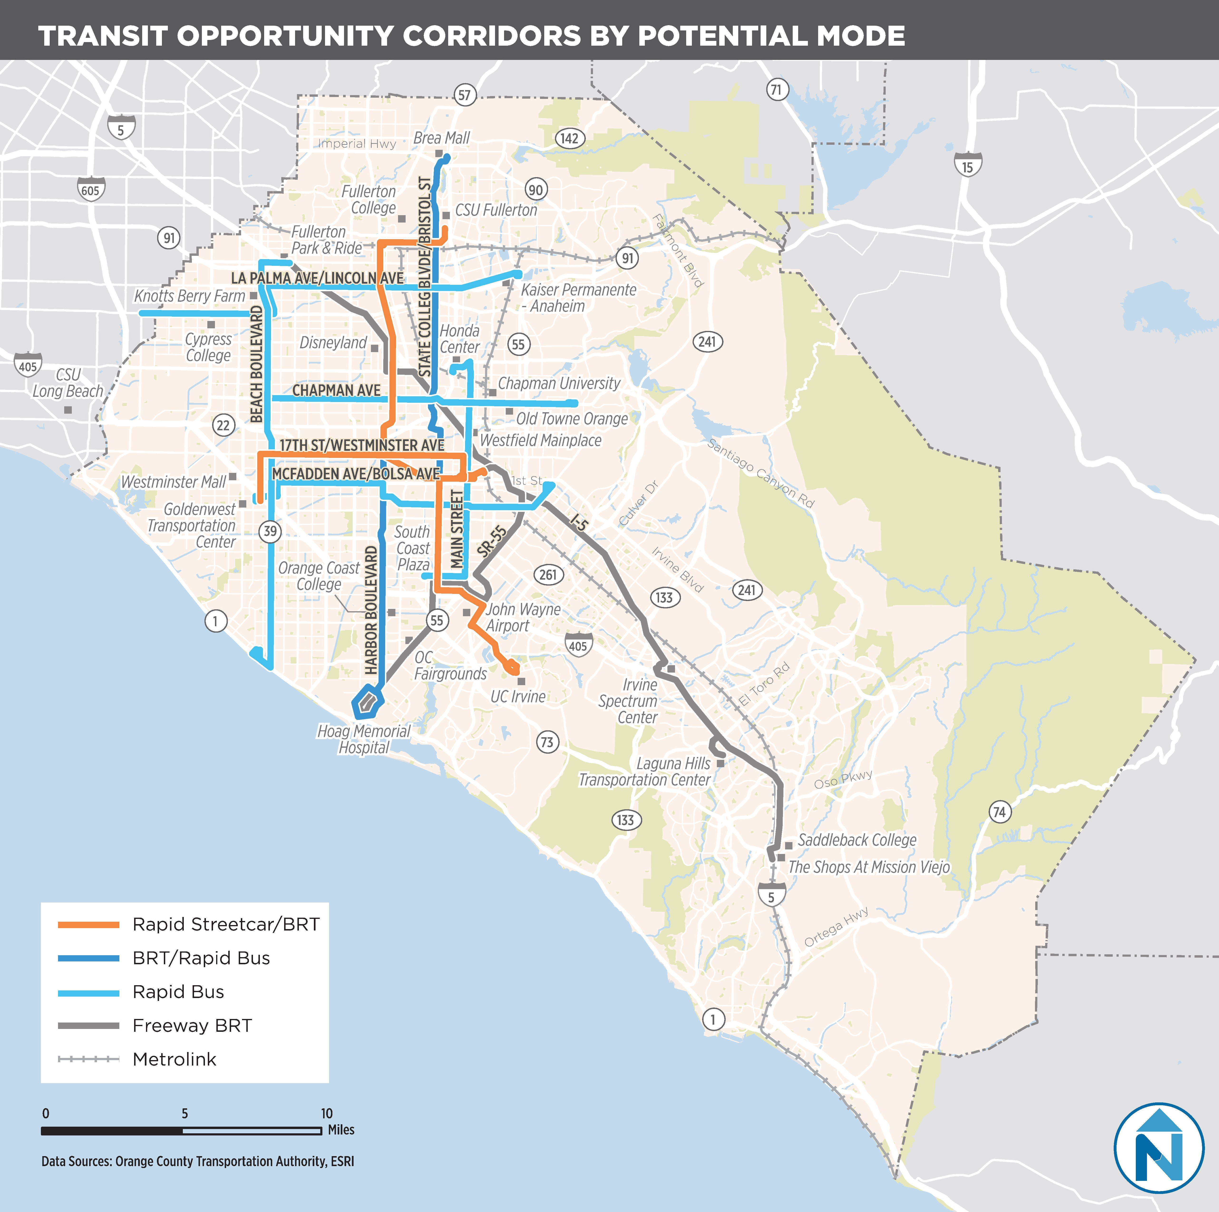
Study Overview
Transit Master Plan
Short-term action plan
High-priority corridor
Part of a larger corridor
Notes:
In 2018, OCTA completed the OC Transit Vision, a 20-year transit master plan, which identified 11 “opportunity corridors” for further study. The Bristol Street Transit Corridor Study was identified as one of the priorities for the short-term action plan – due its ridership, special trip generators, and potential to provide benefits to the corridor and overall transportation system.
The 8-mile corridor which this study focuses on is part of a larger travel corridor (which extends from the Goldenwest Transportation Center to the UC Irvine campus via Westminster Avenue and Bristol Street). However, this is the first segment that was selected for study.

Slide 3
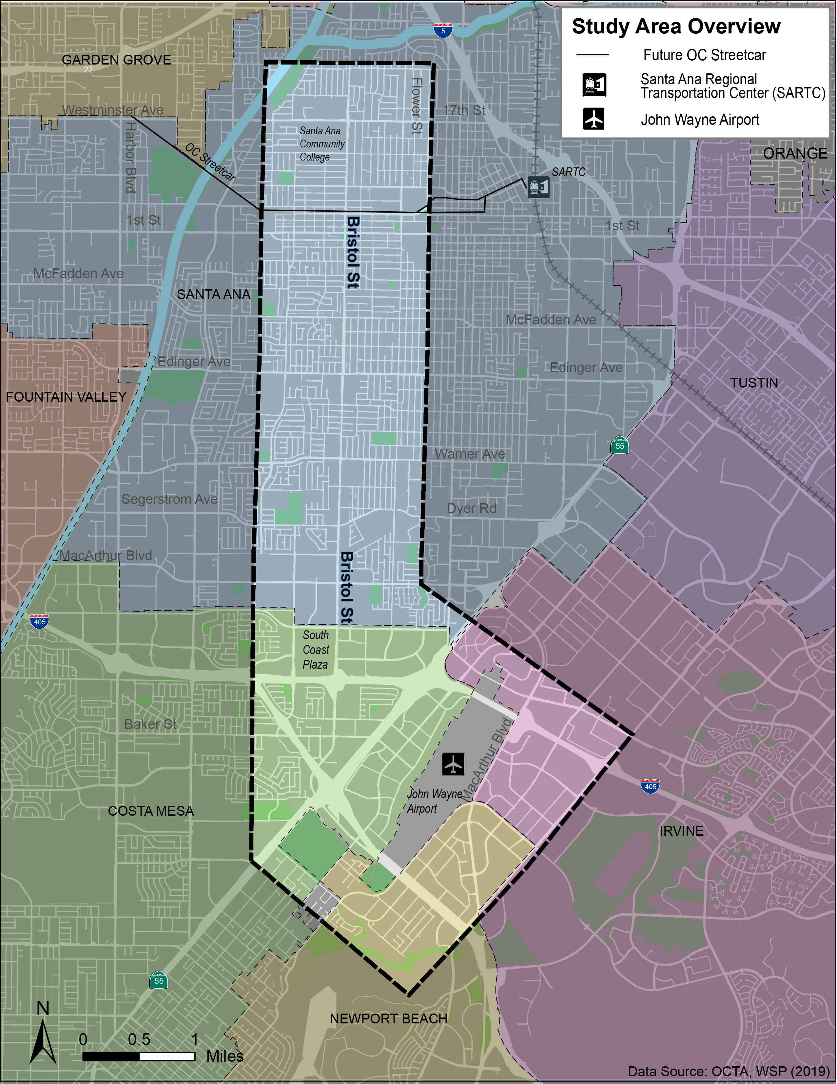
Study Scope
Study limits: 17th Street to Baker Street and John Wayne Airport
Includes cities of Costa Mesa, Irvine, Newport Beach, and Santa Ana
Identify options for improving transit service
Various modes and alignments: bus, bus rapid transit, and streetcar
Evaluate alternatives based on performance and community support
Ridership, cost, environmental benefits and impacts, system connectivity, and community input
Collaborate throughout; work with project development team, stakeholder working group, and public
Final report
Notes:
The study limits extend from 17th Street (near Santa Ana College) and Baker Street (south of I-405) and over to John Wayne Airport. The study area includes the cities of Santa Ana, Costa Mesa, Irvine and Newport Beach. The study will identify and evaluate options for improving transit including various alignments and technologies (Bus, BRT, Rapid Streetcar).
The alternatives will be evaluated based on technical performance and community support.
We will continue to use the monthly Project Development Team meetings to coordinate closely with the local jurisdictions and agencies; and we will also hold stakeholder workshops, open houses, and use surveys and social media to solicit input from the stakeholders and public.

Slide 4
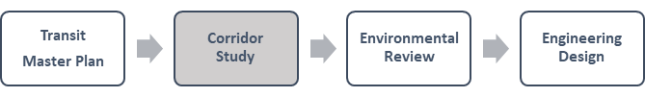
Process and Schedule
Study Phase | Description | Timeline
I. Purpose and Need | Corridor Definition and Mobility Needs | April 2019
II. Alternatives Development | Develop six conceptual transit alternatives | Summer 2019
III. Alternatives Evaluation | Evaluate ridership, cost, environmental benefits, and community support | Winter 2020
IV. Final Report | Present report findings and community input received | Summer 2020
Notes:
Regarding the study process and schedule:
We completed the Transit Master Plan last year and we’re now at the Corridor Study step. This is the precursor to an environmental review. In this study we will evaluate a range of alternatives and screen them down to a few of the best performing ones which also have wide community support. At the conclusion of this study the OCTA Board will have its first opportunity to select a few of the alternatives for advancement into a environmental review process or to make other recommendations.
Within the Corridor Study step, there are four distinct phases:
Purpose and Need – April 2019
Alternatives Development – Summer 2019
Alternatives Evaluation – Winter 2020
Final Report – Summer 2020
We will return to the TC and Board with an update after each phase.

Slide 5
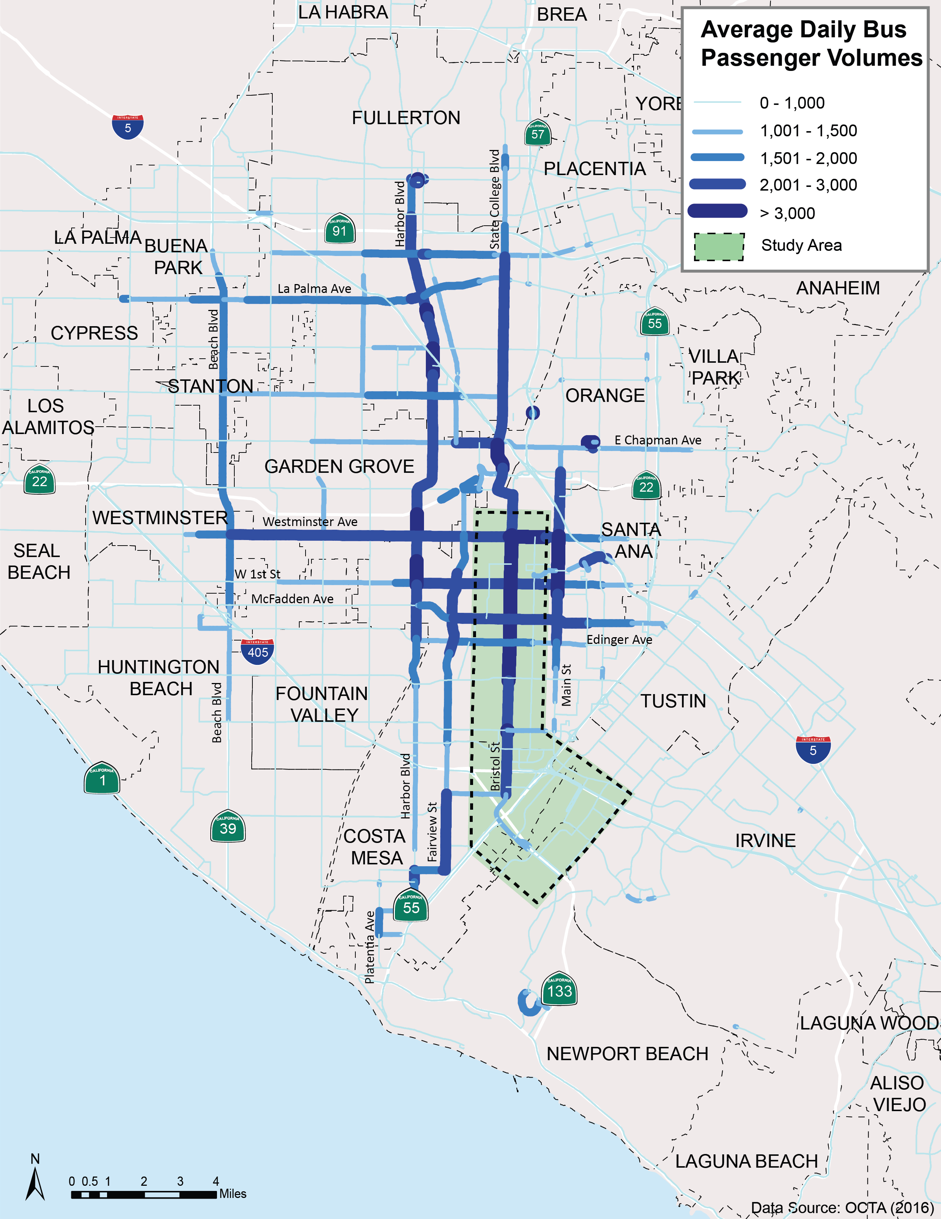
Bristol Corridor Context
Highest transit usage area
Major trip generators
Irvine Business Complex
John Wayne Airport
Santa Ana Civic Center
Santa Ana College
South Coast Metro
Regional connections
Five High Quality Transit Routes
OC Streetcar
Santa Ana Regional Transportation Center
Notes:
To provide some context of the Bristol Street corridor, this map shows the heaviest bus passenger volumes on the OCTA system. (The darker the blue color the higher the passenger volumes.) The study area appears in the green shading. This illustrates that some of the highest transit usage in the county occurs in the study area along Bristol Street. And on several of the connecting east-west routes in the norther part of the study area.
Some factors contributing to this are the major trip generators in the area including:
Santa Ana College
Santa Ana Civic Center
South Coast Metro area
Irvine Business Complex and
John Wayne Airport
The corridor also provides connections to High quality bus routes and the SARTC; and will provide a connection to the OC Streetcar.

Slide 6
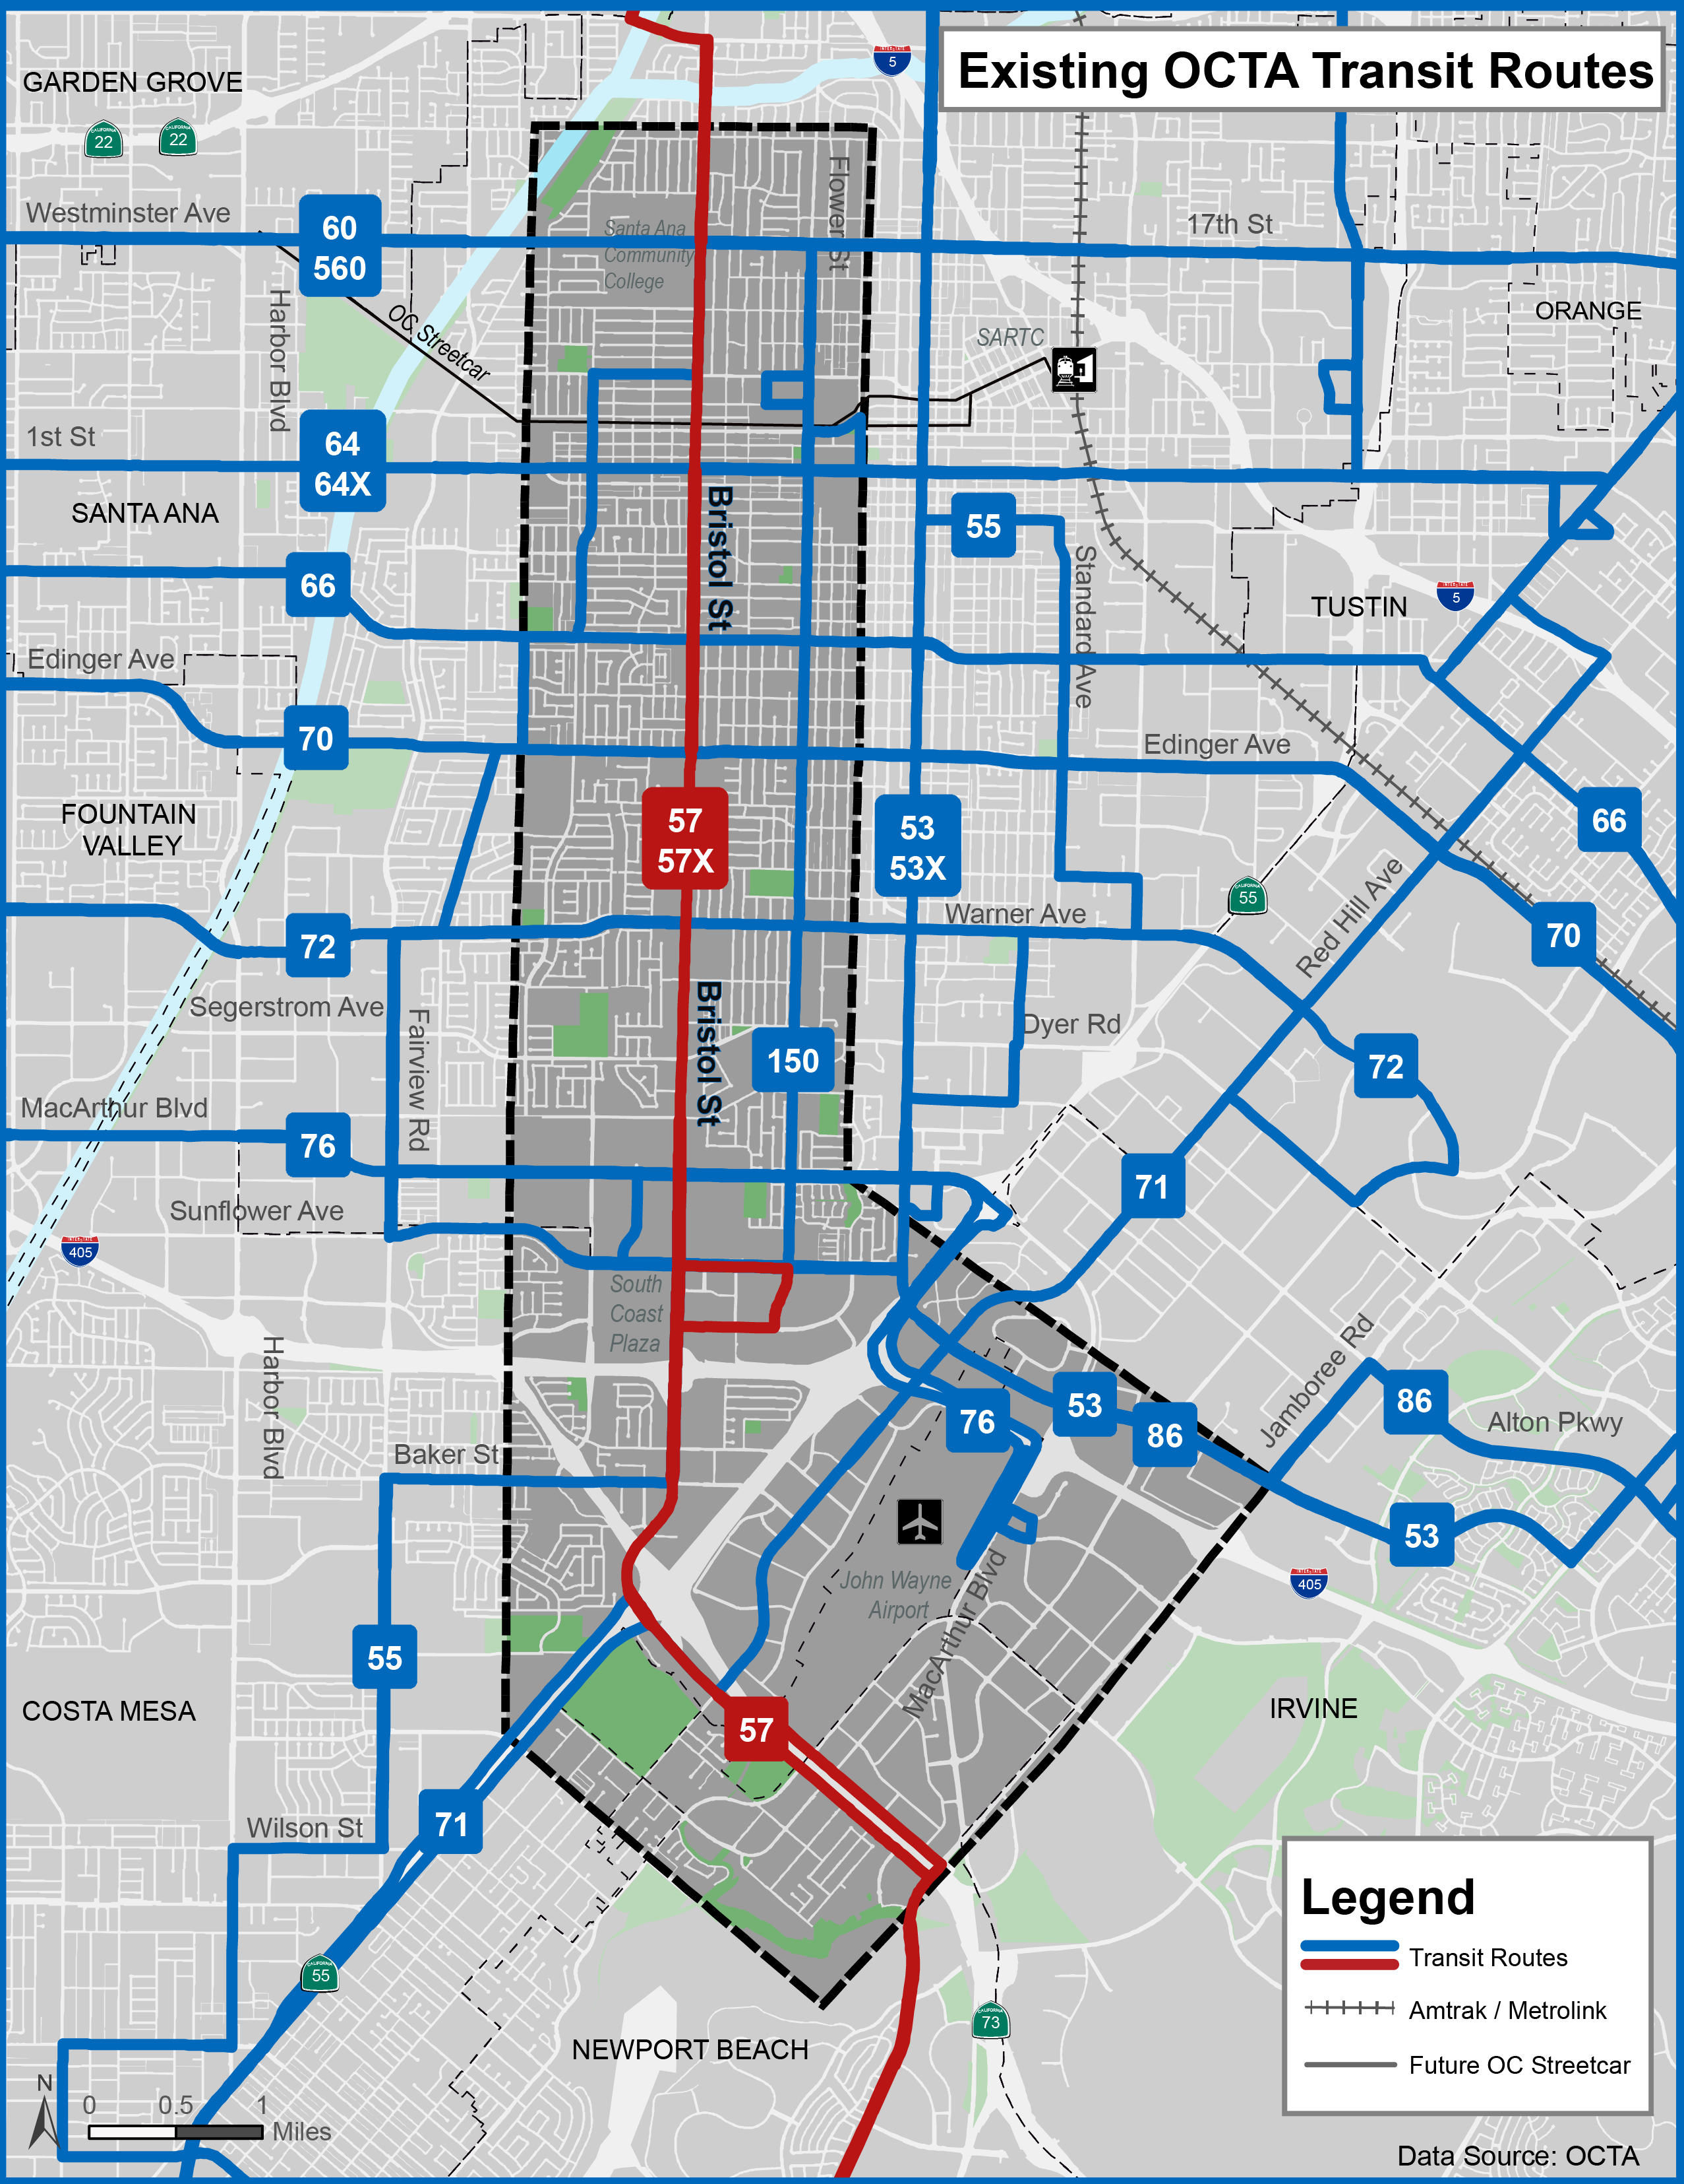
Existing Transit Service
Served by Route 57/57X
Brea to Newport Center
Frequency: 12 to 24 minutes
High transfer rates to crosstown corridors
Connections to 13 routes
High ridership: 10,600 weekday boardings (eight percent of systemwide total)
Notes:
This map shows existing transit service – it identifies some of the key OCTA routes which serve the study area. Routes 57 and 57X which operate on Bristol Street are in red. These routes offer a combined frequency along most of the study area of 12 minutes during busiest periods of the day, between 6:30am and 7:30pm.
The study area provides connections to several crosstown routes and accounts for 8% of daily boardings.

Slide 7
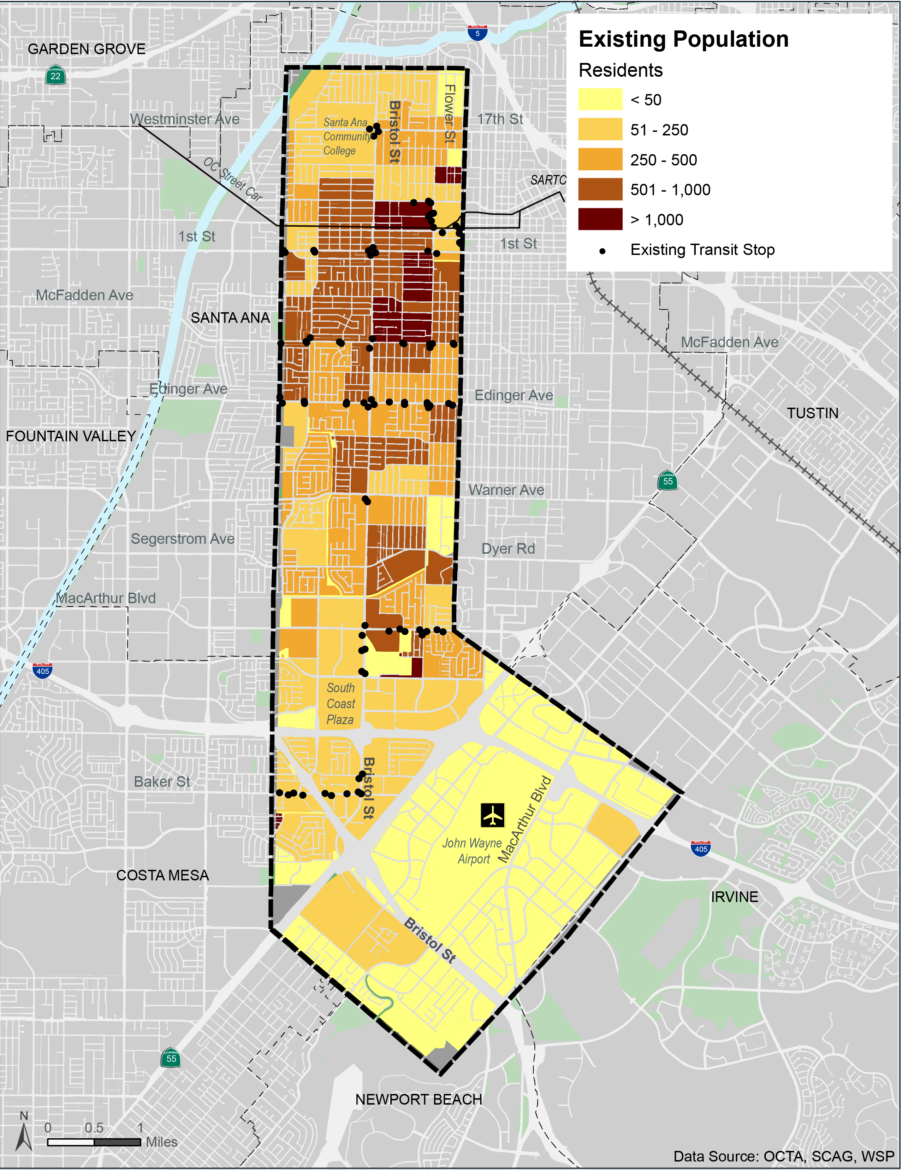
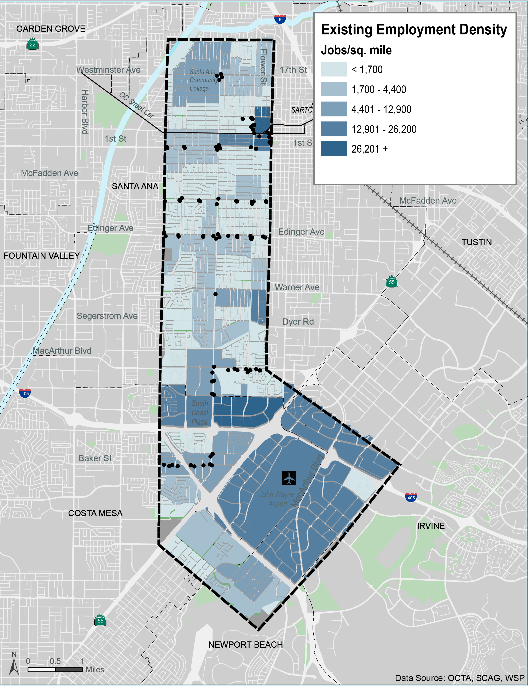
Existing Population and Employment
Population density
Employment density
Local land use
Increased density and mixed-use development planned
7
Notes:
Two other important factors for transit service are Population density (where people live) and Employment density (where people work). The population density is high relative to the rest of the county, averaging 12,600 residents/sq. mile – with the highest concentration of residents in the northern part of the study area.
The employment density is also relatively high at 10,400 jobs per sq. mile – with the greatest concentration being in the South Coast Metro area, Irvine Business Complex, and John Wayne Airport.

Slide 8
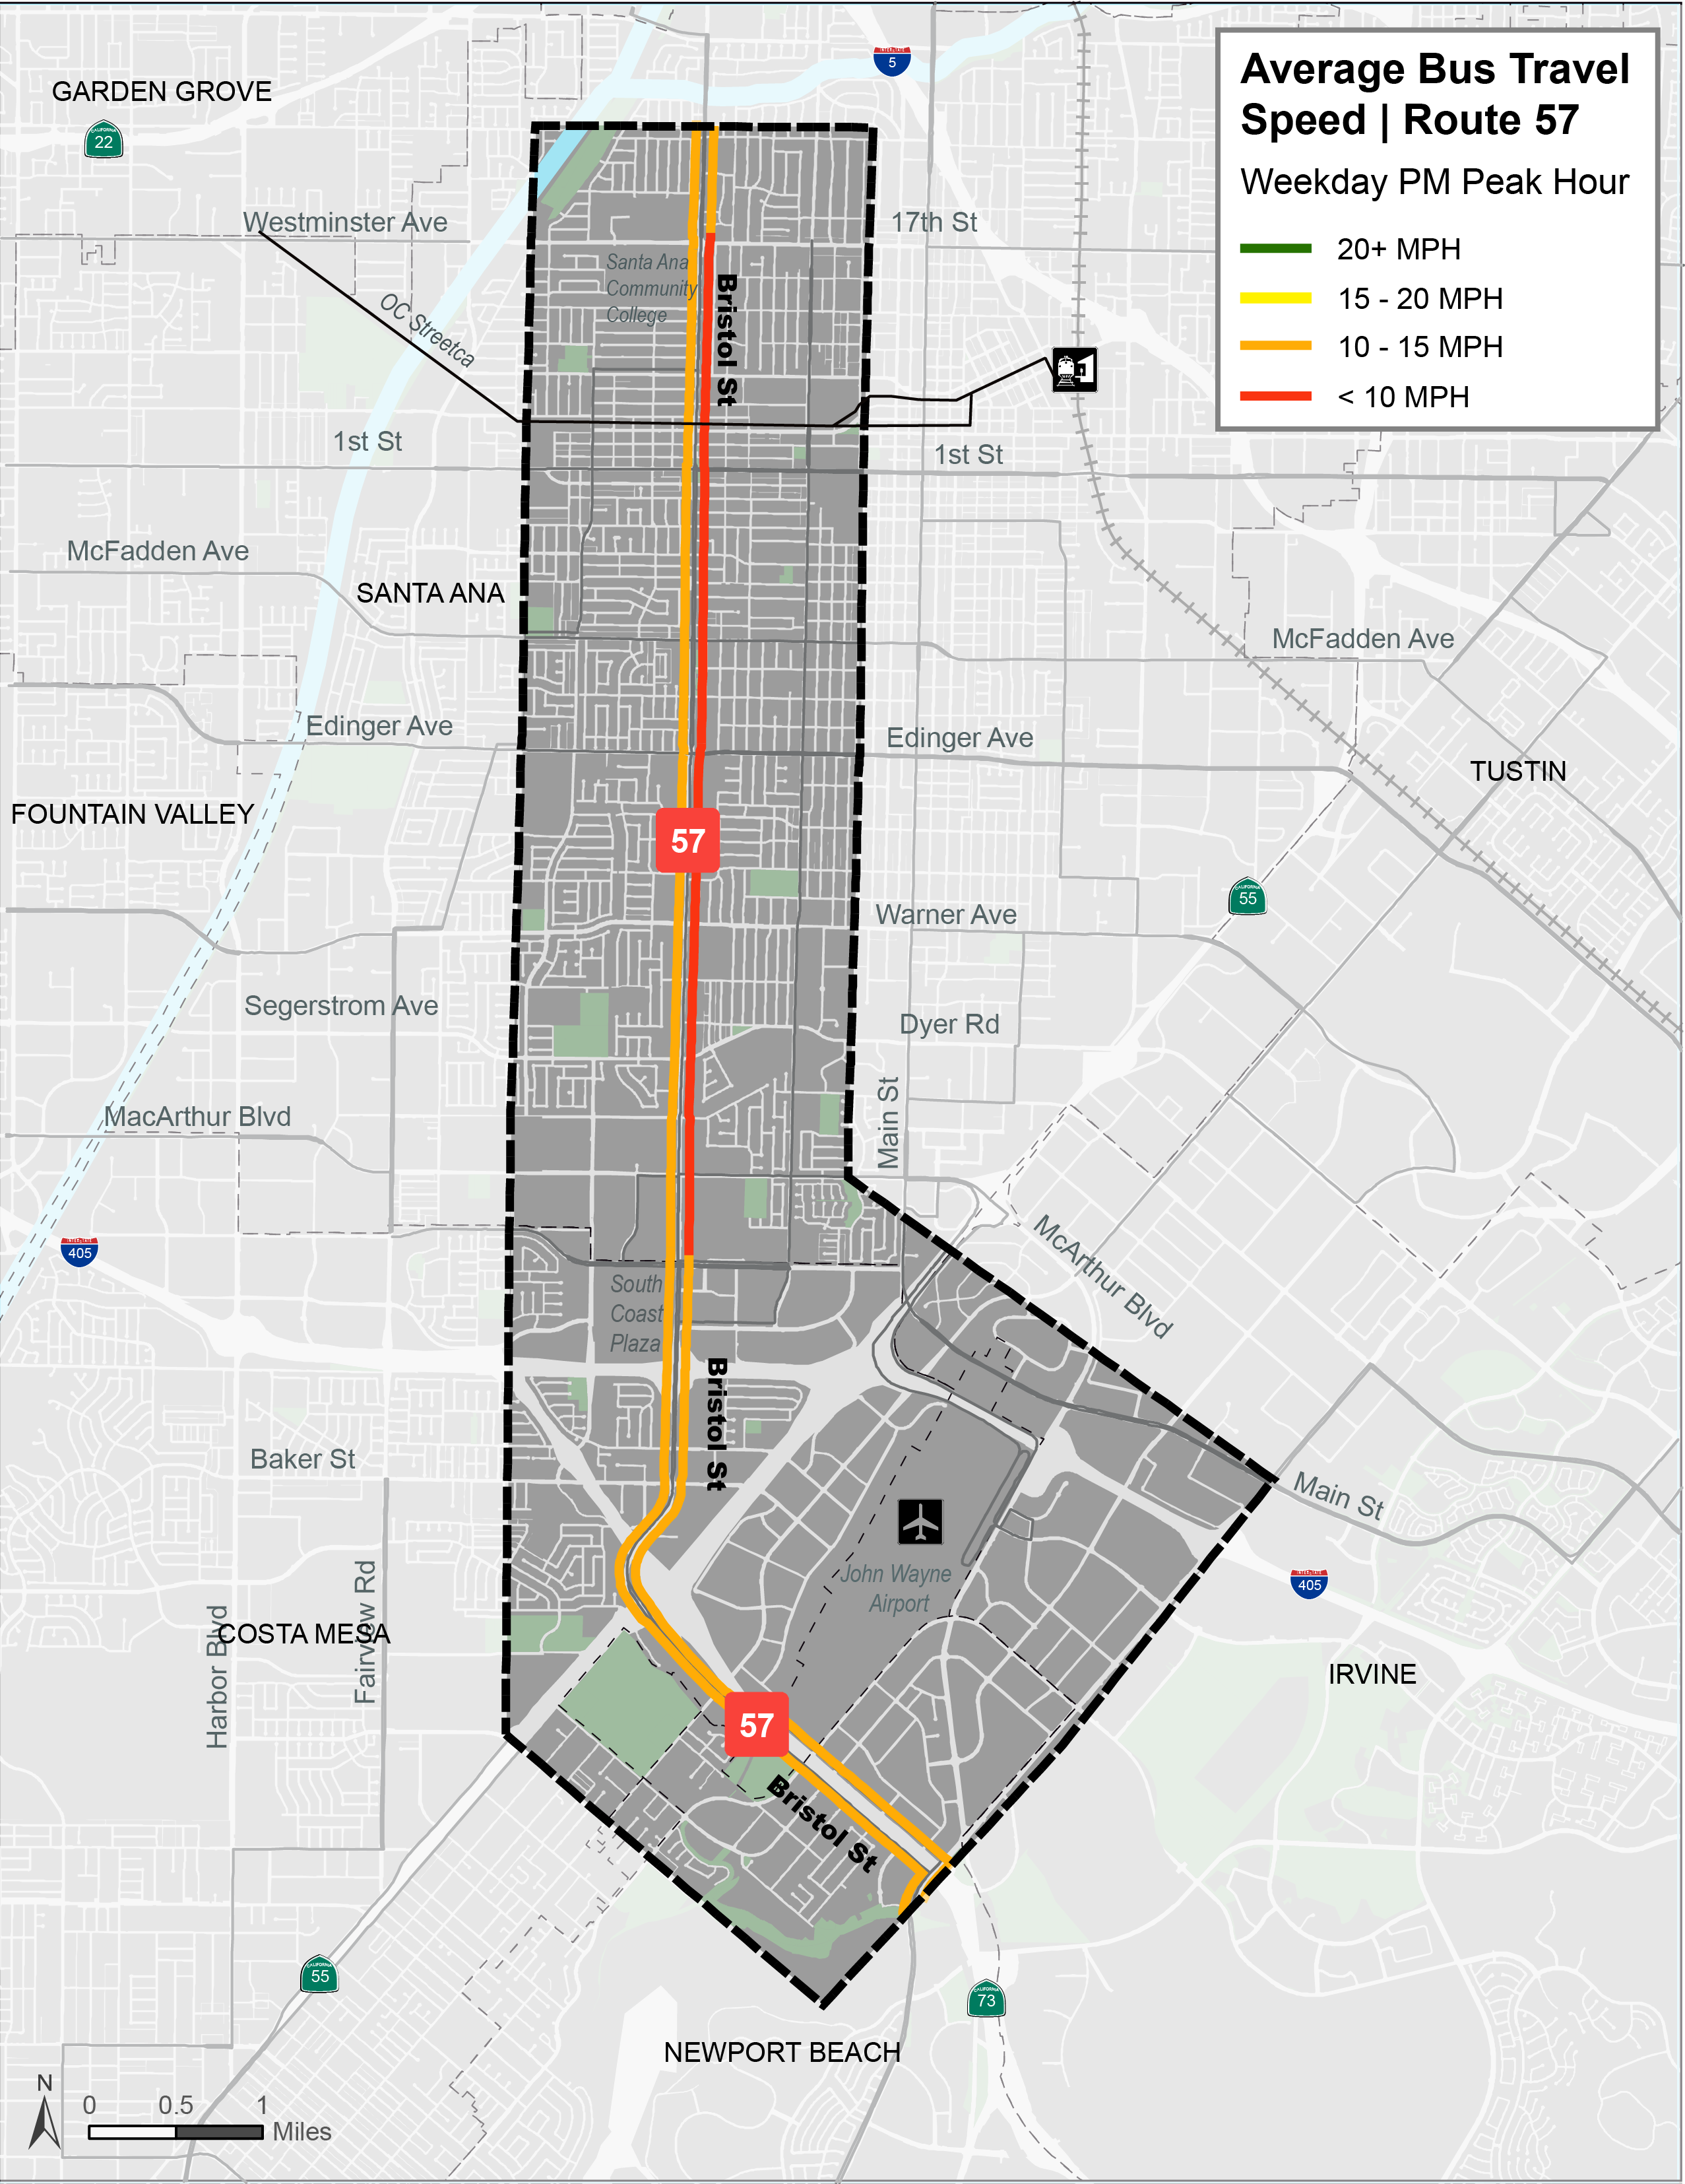
Transit Performance
Average Bus Travel Speeds
Less than ten mph during PM peak
Operating in mixed-flow traffic
High passenger loads (long dwell times)
mph – miles per hour
Notes:
Regarding transit performance, this slide illustrates the average transit speeds in the study area during the PM peak period (3-6pm). The graphic indicates that Route 57 averages less than 15mph, and northbound service in particular averages less than 10mph during this period. This is due to both the traffic conditions that the buses are operating in, and long passenger boarding times. These are two areas we will look to address during the alternatives development.

Slide 9
Mobility Needs
Enhance transit mobility to local activity centers
Improve speed and reliability
Improve connectivity with crosstown routes
Support land-use planning
Enhance the customer experience and convenience
Notes:
The project team has identified 5 mobility needs. These are described in greater detail in Attachment B of the staff report – which is the draft Purpose and Need Statement.
They are the following…
The project team will aim to address these needs with the draft alternatives that are developed; and these will also form the basis of some of the evaluation criteria.

Slide 10
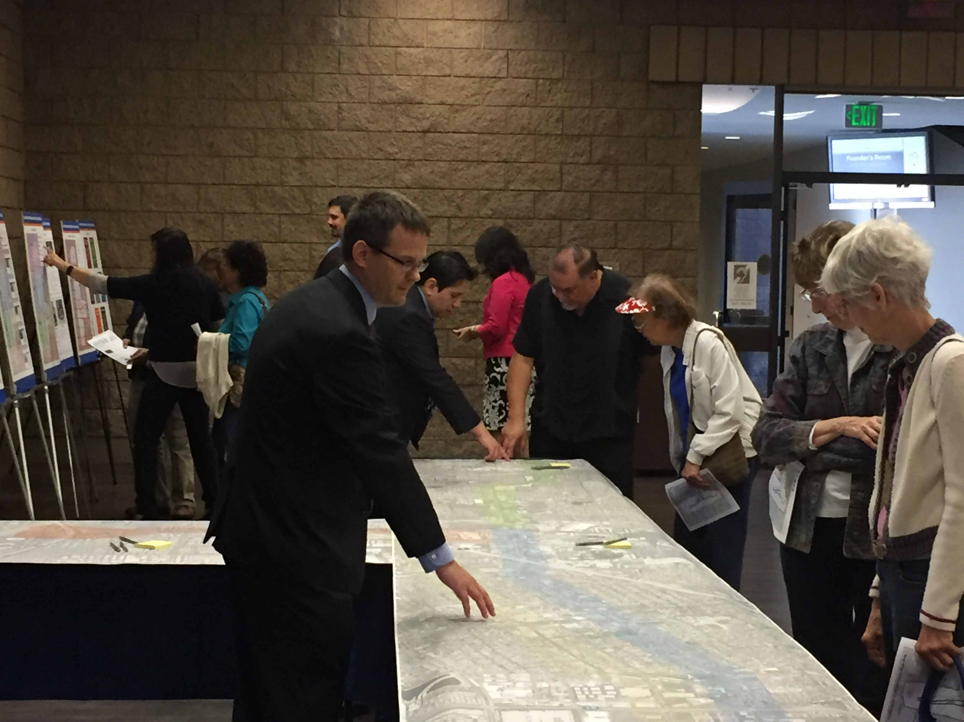
Stakeholder and Public Participation
Stakeholder engagement
Project development team meetings
One-to-one agency meetings
Stakeholder workshops (3)
Open houses and community events
Online survey and social media
Translations for engaging diverse communities
Outreach Phases
Corridor definition and mobility needs – April 2019
Alternatives development – Summer 2019
Alternatives evaluation – Winter 2020
Notes:
To ensure regular input and coordination with the local agencies, the project development team meets on a monthly basis and includes technical staff from each of the local jurisdictions and from Caltrans and John Wayne Airport. We will also hold three stakeholder workshops to solicit input from representatives of local businesses, school districts, hospitals, major employers and homeowner associations. Additionally, we will hold open houses and provide info at community events, provide an online survey and social media posts, and use translations to engage a wide audience.
We will also provide city council updates to solicit input from the local jurisdictions.
The outreach phases will correspond with the OCTA Board updates, on the following schedule…

Slide 11
Next Steps
Conduct initial round of outreach
Hold one-to-one agency meetings
Develop conceptual alternatives
Return to Board of Directors in late summer with draft alternatives
Bristol Study webpage:
www.octa.net/bristol
Notes:
The next steps include conducting the initial round of outreach, holding one-to-one agency meetings, developing six draft conceptual alternatives …and then returning to this committee and the Board in late summer with another update.
This concludes the presentation.
I’m happy to answer any questions.

