Slide 1

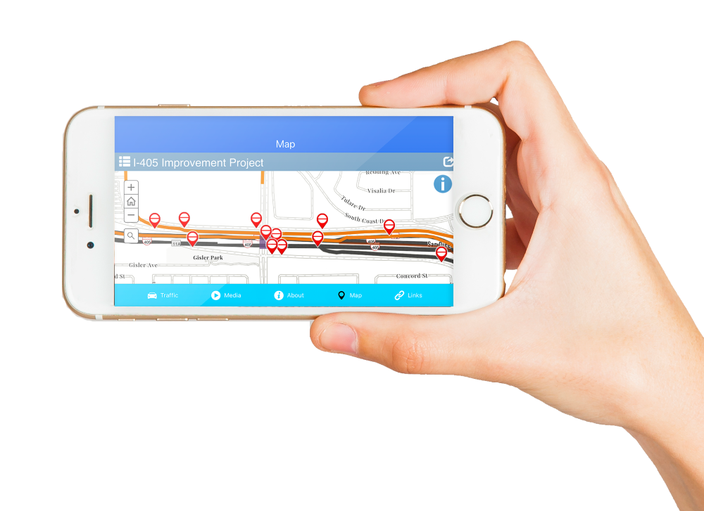
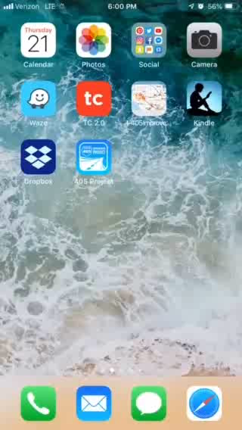
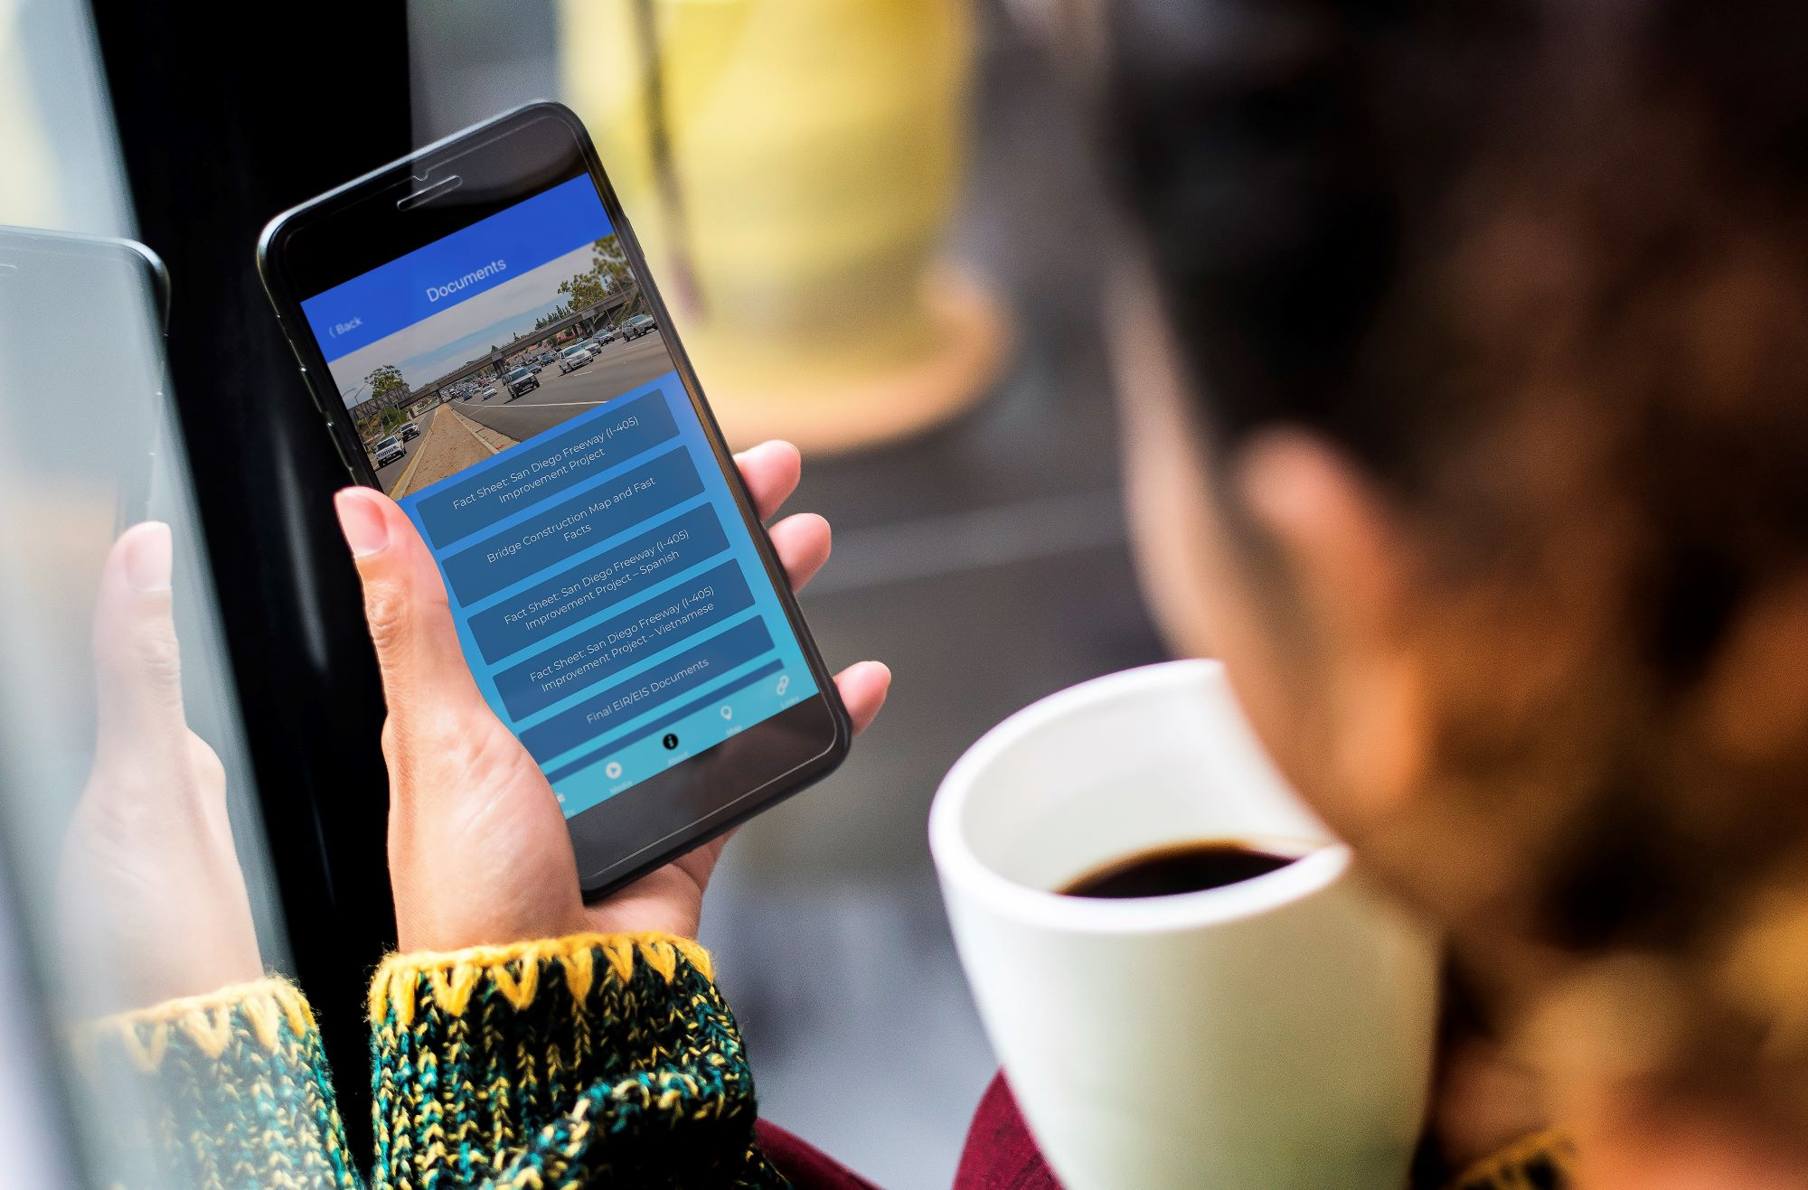





Mobile App
Quick access to current traffic conditions, closures, and detours
Audio project updates
Time-lapse videos
Links to interactive map and Waze app
Direct connection to Outreach Team
1

