Slide 1

October 20, 2020
Citizens Advisory Committee

Slide 2
Background
Multimodal Transportation Studies
OCTA conducts multimodal studies to develop a vision for the transportation system to address long-term needs within the study area
Once the LPS is determined through OCTA Board approval, study recommendations can be considered in the LRTP for implementation
OCTA LRTP
SCAG RTP/SCS
FTIP
Four-year cycle
20+ year plan
Four-year cycle
20+ year plan
Two-year cycle
Six-year funding program
LPS: locally preferred strategy | LRTP: Long-Range Transportation Plan | SCAG RTP/SCS: Southern California Association of Governments Regional Transportation Plan/Sustainable Communities Strategy | FTIP: Federal Transportation Improvement Program

Slide 3
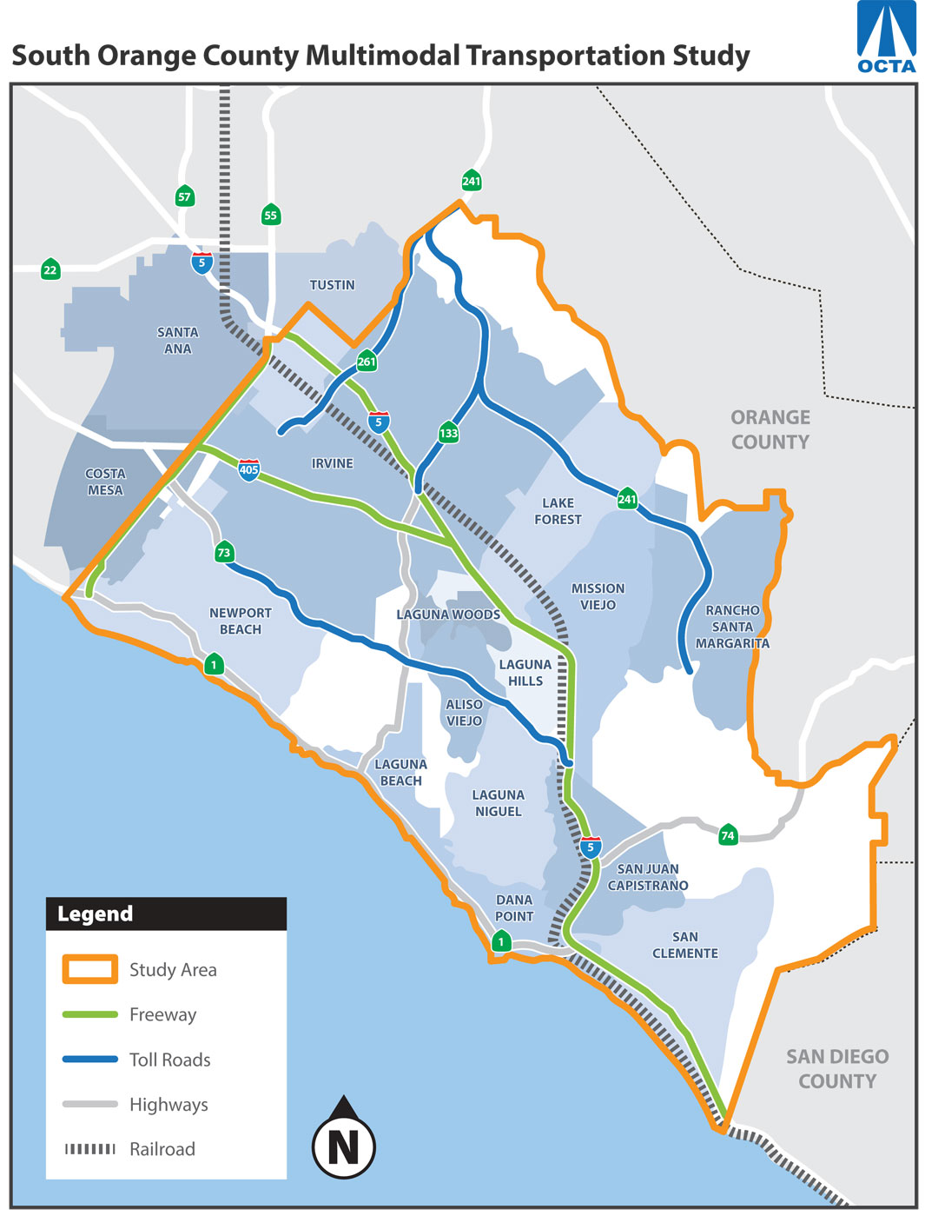
Study Objectives
Develop consensus on a set of multimodal transportation improvements
Update to 2008 South Orange County Major Investment Study (SOCMIS)
Reflect progress and latest planning assumptions

Slide 4
Study Scope Highlights
Phase 1
Phase 2
Phase 3
Identify Issues and Opportunities
Develop Purpose and Need Statement
Develop Initial Alternative Strategies
Screening Alternative Strategies
Select Reduced Set of Alternative Strategies
Analysis of Reduced Set
Recommend a Locally Preferred Strategy
2020
2021

Slide 5
Existing and Future No-Build Conditions
Documents existing and future demographic, land use, and multimodal transportation system conditions
Helps identify and understand transportation issues and opportunities
Existing & Future (2045) No-Build Conditions
Demographics and Land Use
Transit
Active Transportation
Arterials
Travel Patterns
Highways and Toll Roads
Transportation Demand Management

Slide 6
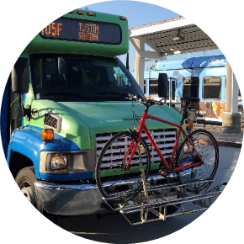
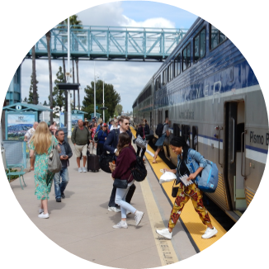

Context for Study Goals
Long-range transportation plans at the county, regional, and statewide levels
Study area transportation issues and opportunities

Slide 7
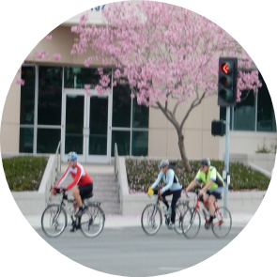
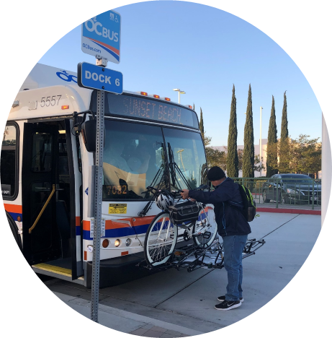

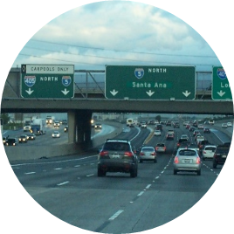
Draft Study Goals
Improve System Performance
Expand System Choices
Support Sustainability
Enhance Equity and Quality of Life

Slide 8
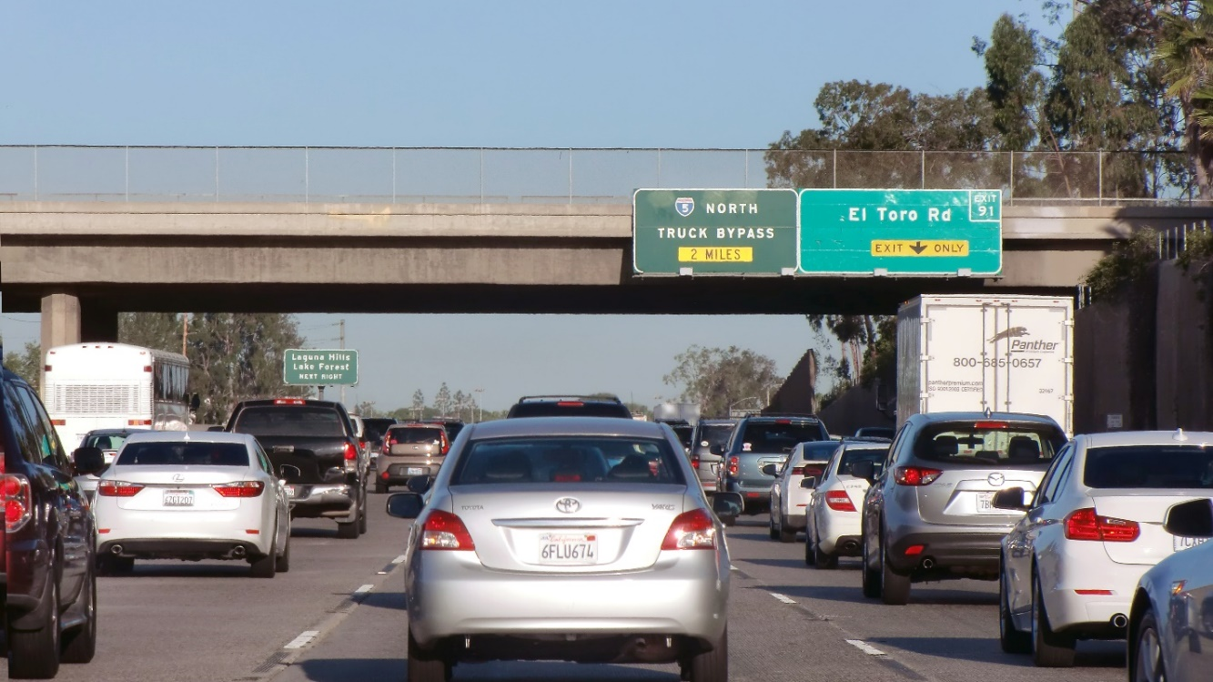
Transportation Issues and Deficiencies
Highways, Toll Roads, Arterials
Weekday, weekend, and seasonal congestion
Low travel time reliability (expected delays)
Critical bottlenecks on I-5 and I-405
Dependence on east-west arterials

Slide 9
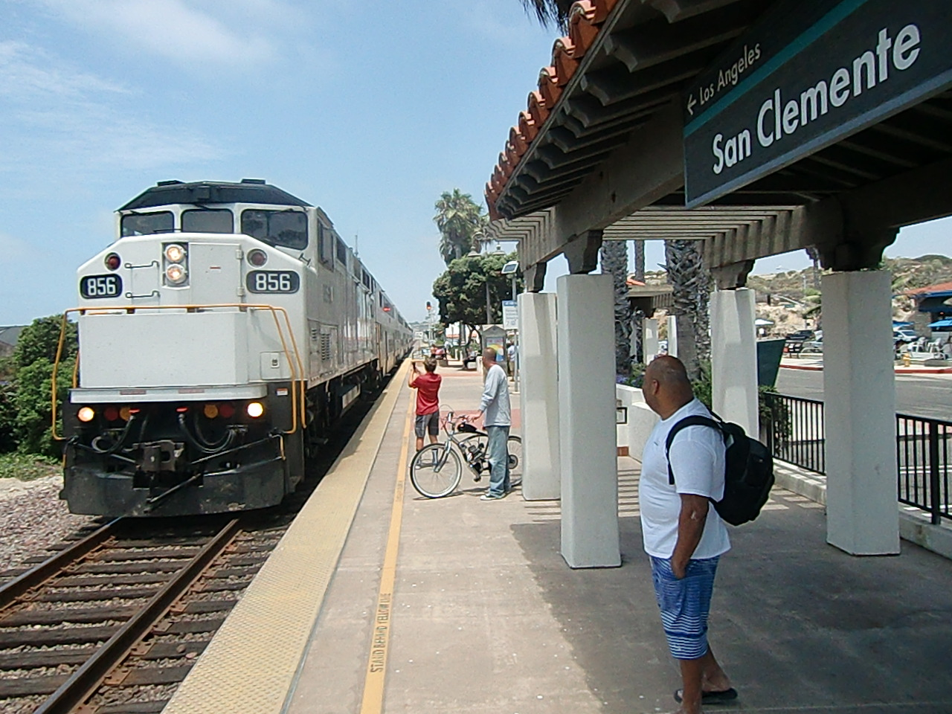
Transportation Issues and Deficiencies
Transit
Limited transit accessibility attributable to low-density land use patterns
Infrequent service, inconsistent reliability
Less convenient than driving (wait times, transfers)

Slide 10
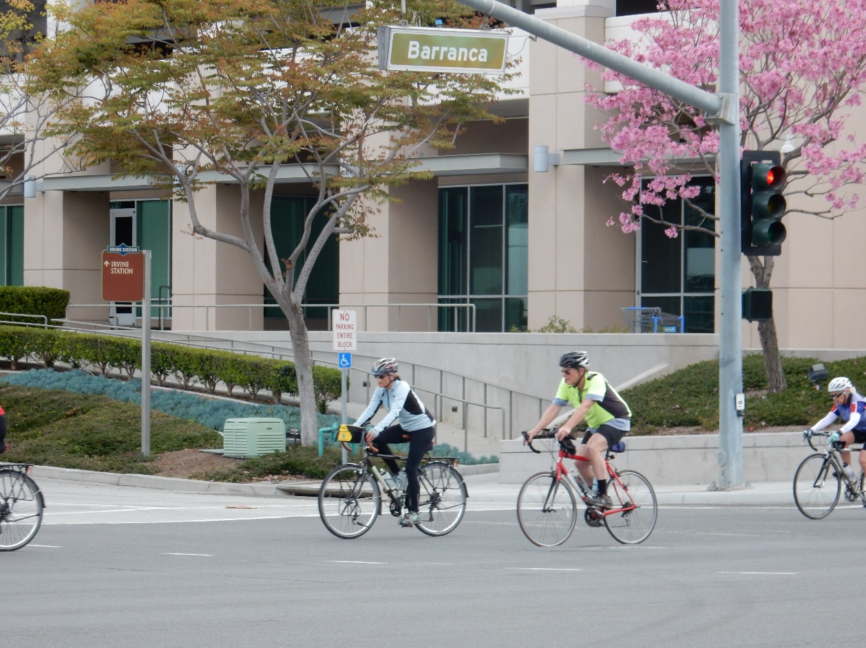
Transportation Issues and Deficiencies
Active Transportation
Gaps in the active transportation network
Low usage due to circuitous road network, long trip distances
Safety concerns for pedestrians and bicyclists

Slide 11

Transportation Issues and Deficiencies
Transportation Demand Management (TDM)
Long-distance, peak period commute trips to North OC and other counties (especially LA)
Low transit mode share in South OC

Slide 12
Zoom Poll – Question 1
What are the most important issues concerning transportation in south Orange County?
Traffic congestion on local streets and roads
Traffic congestion on freeways/highways
Greenhouse gases (addressing climate change)
Safety
Land use planning (coordinating new development with transportation)
Not enough transportation choices (bus, rail, or on-demand microtransit service)

Slide 13
Zoom Poll – Question 2
Which set of transportation solutions is most important to you?
Express bus, commuter rail, vanpool and freeway bus rapid transit
Local bus, on-demand transit service, and trolleys
Pothole repairs, signal synchronization, and intersection improvements
Freeway maintenance, on- and off-ramp enhancements, and projects to improve overall traffic flow
Bike lanes, bike networks, and pedestrian pathways

Slide 14
Next Steps
September
October
November
December – January 2021
February
Partner and Public Input
Goals & Objectives
Purpose & Need
Identify Conceptual Strategies
Package into
Conceptual Alternatives
Initial Screening
Update to OCTA Board

Slide 15
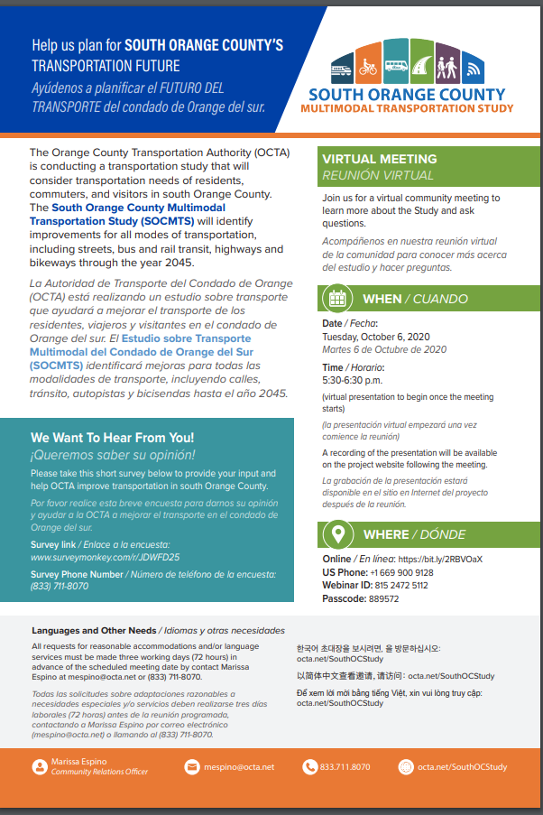
Stay Involved
Online survey open until Oct. 30
SouthOCStudysurvey.com
Hotline
(833) 711-8070
Public Webinar
Recording and FAQ available on
octa.net/SouthOCStudy

