Slide 1
Fullerton Park-and-Ride Joint Development Study

Slide 2
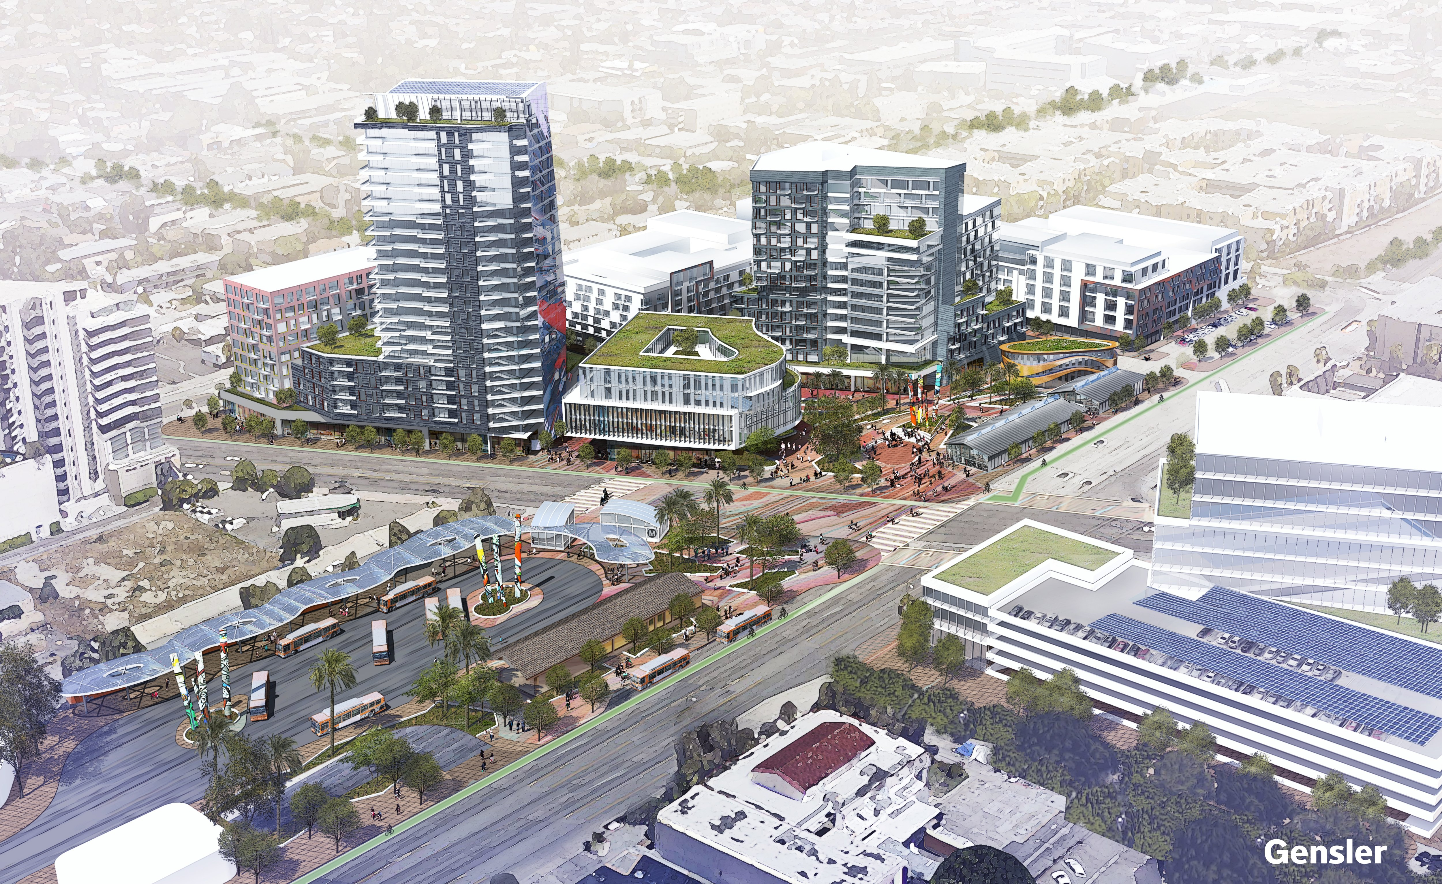
Background
“Joint development” – an OCTA asset or project co-located with land-use development
Partnership opportunities for public, private, and/or non-profit development
Promoted by FTA
OCTA – Orange County Transportation Authority
FTA – Federal Transit Administration

Slide 3
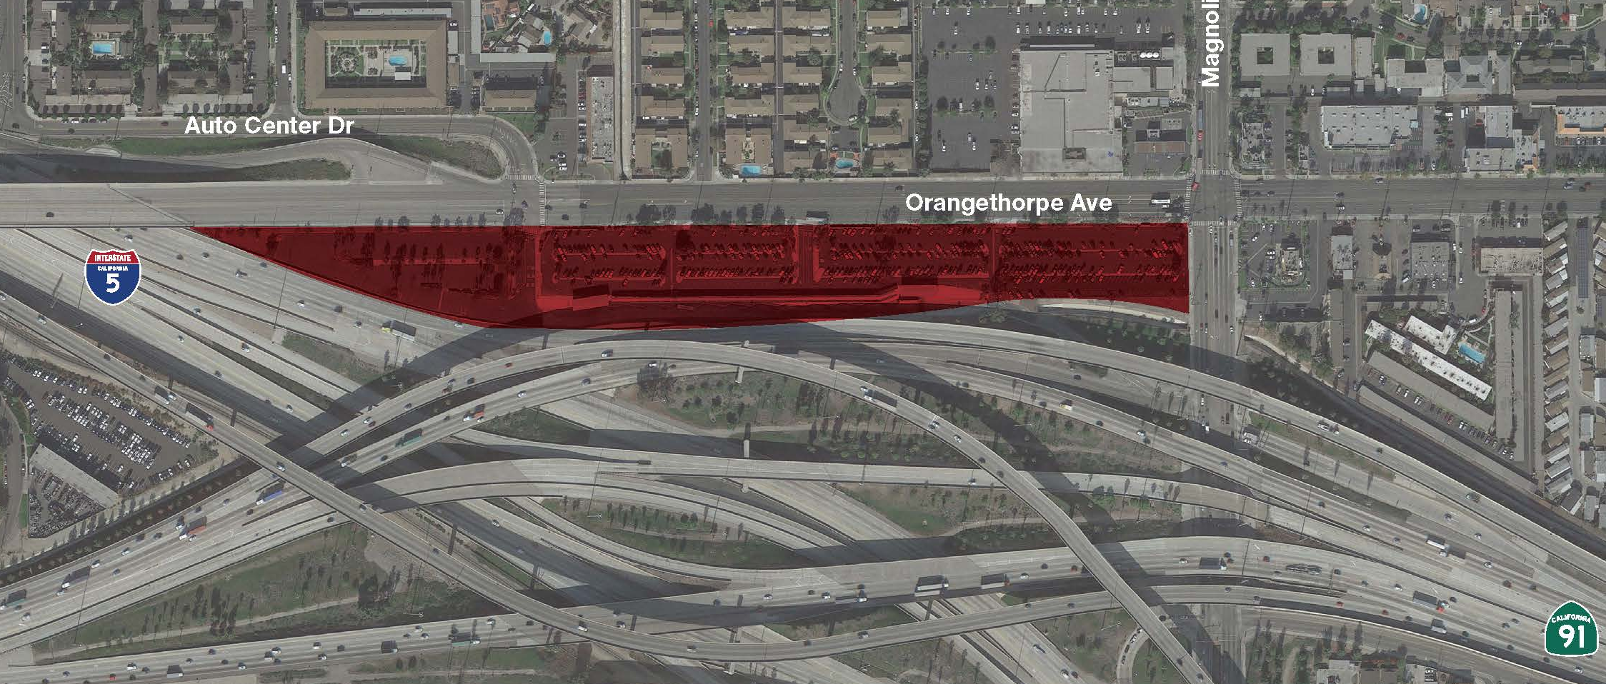
Site History: Fullerton Park-and-Ride
11.1-acre site
Acquired with FTA grant
Opened in 1974
Primarily served commuters to LA
Metrolink service reduced site demand
Continues to serve carpoolers and express bus users
LA – Los Angeles

Slide 4
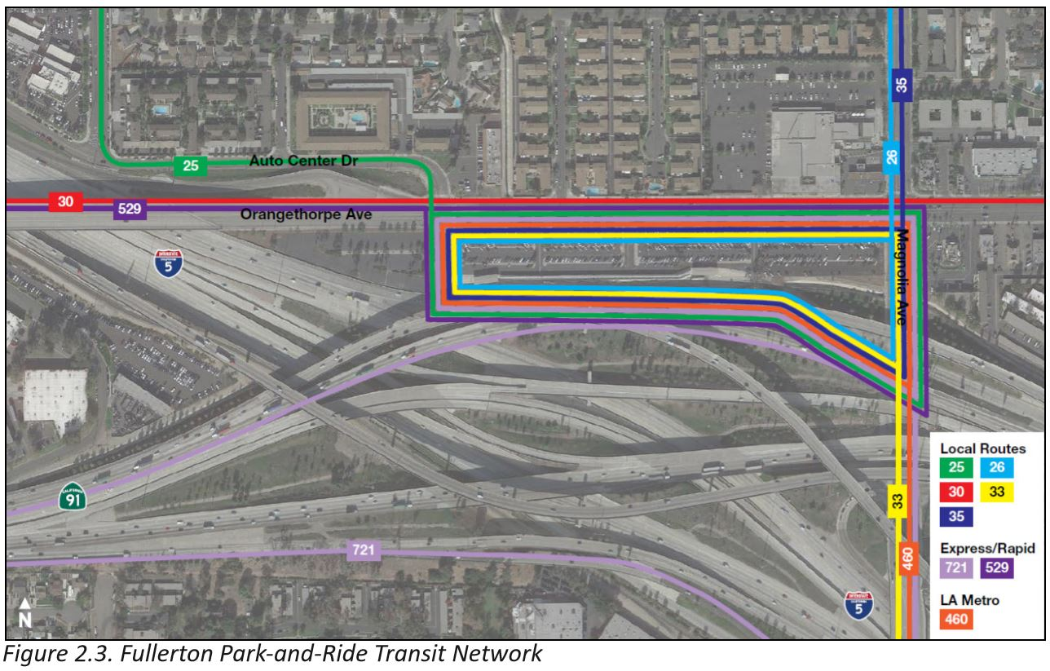
Current Conditions
Transit
14 bus docks
Eight bus routes (OCTA and LA Metro)
Key transfer location
Parking
745 public parking spaces
Up to 55 percent utilized on weekdays
20 percent on weekends
LA Metro – Los Angeles County Metropolitan Transportation Authority

Slide 5
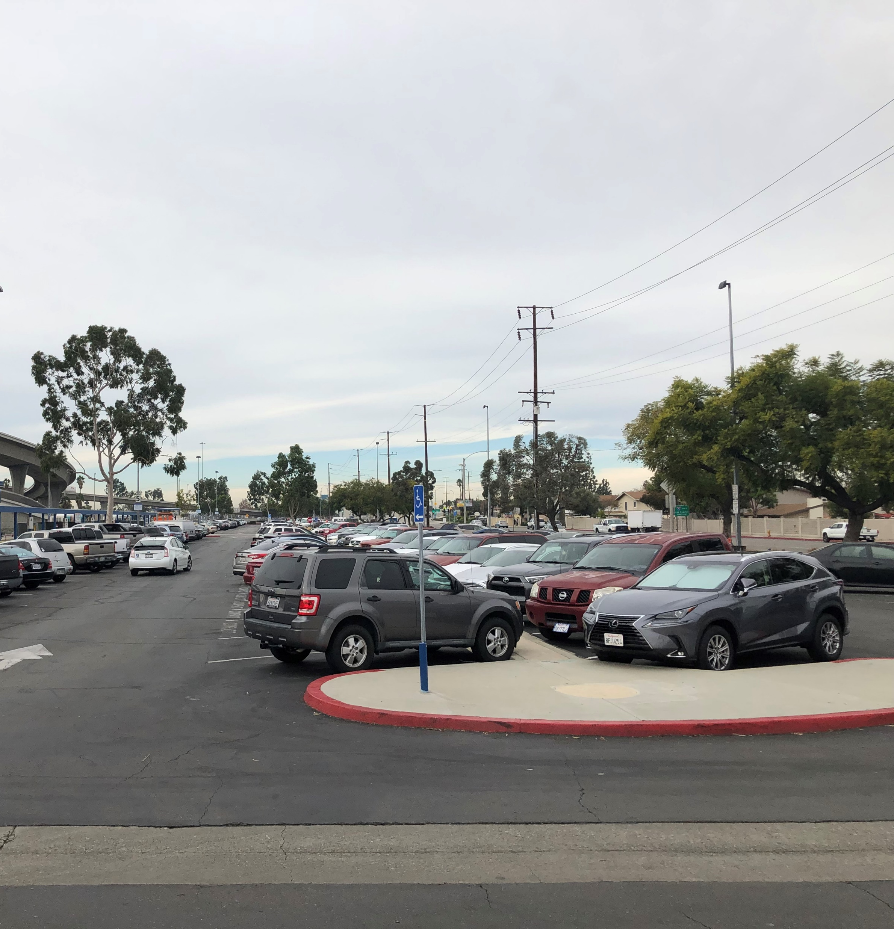
Site Opportunities and Constraints
Opportunities
Over 300 spaces (45 percent) of excess capacity
Large site
Good access and visibility
Nearby land uses compliment commercial and residential opportunities
Constraints
Maintain transit and park-&-ride functions
Confined site

Slide 6
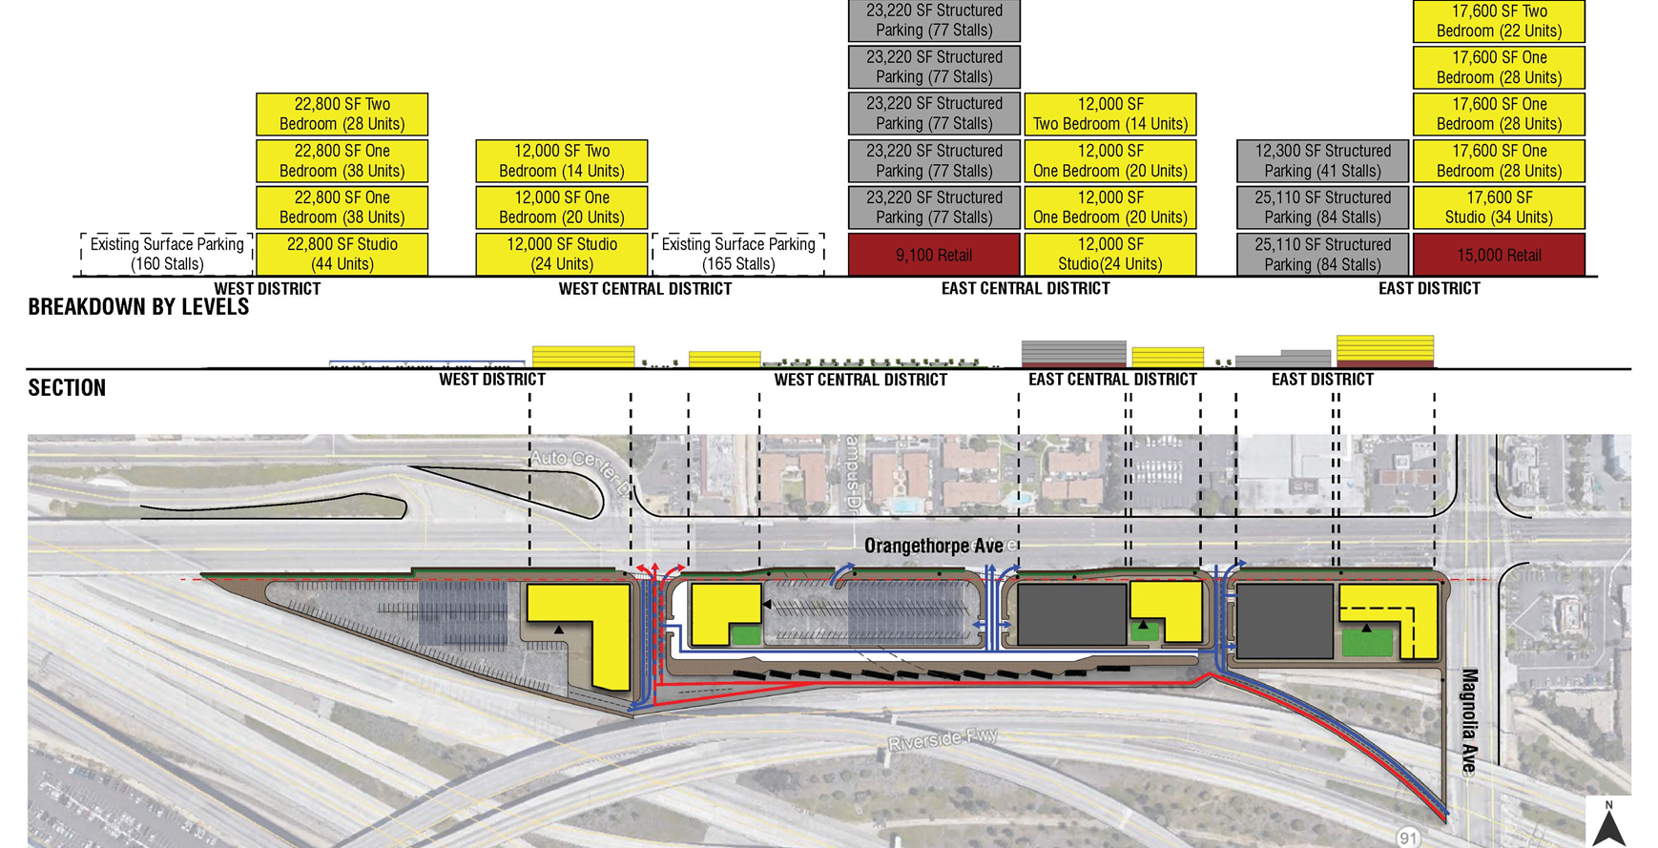
Development Concepts
Analyzed various:
Land-use mixtures
Housing types
Site layouts
Densities
Included pro forma reports
Net present value used to determine site merit
Explored physical, financial, and operational possibilities

Slide 7
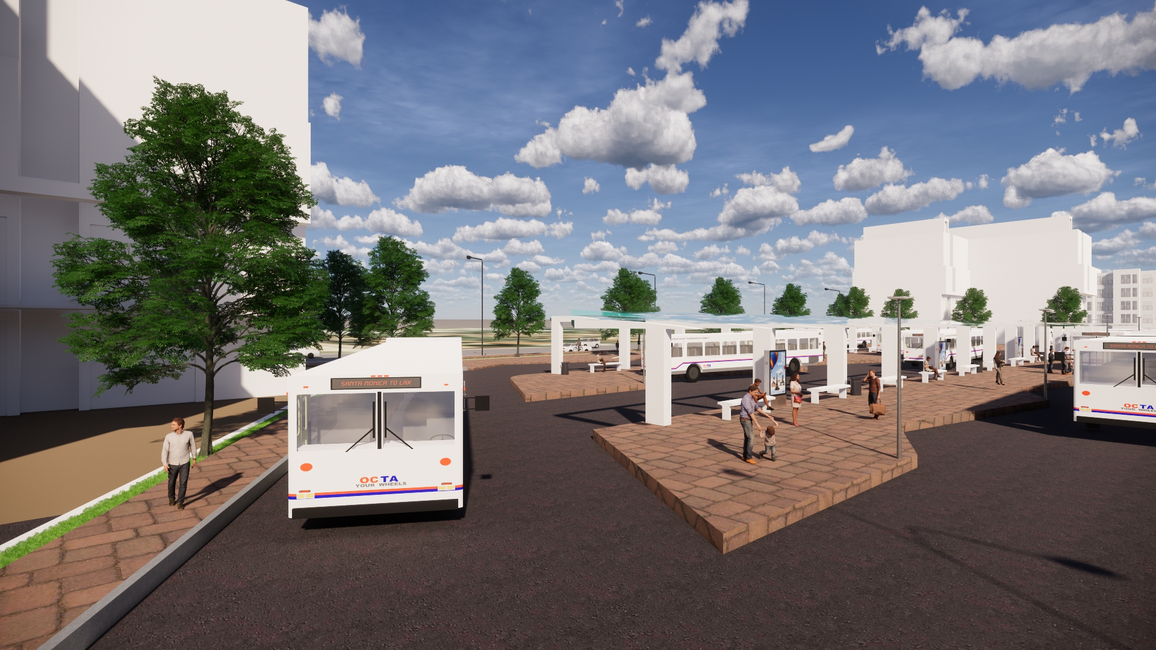
Findings
Joint development is feasible and could provide significant value
Scenarios with limited or no structured parking perform best financially based on initial assumptions
Notes:
Structured parking is costly
Generally offsets benefits of more dense development
Challenges ROI and interest from developer

Slide 8
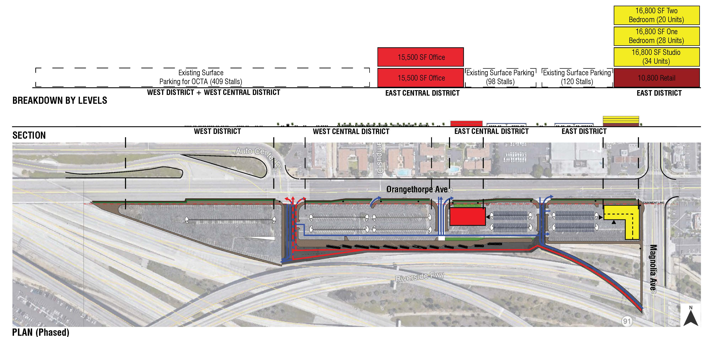
Phased Option (Conceptual Example)
Leverages existing surface parking supply
Attractive ROI for developer
Immediate ROI for OCTA at no cost
Improves:
Transit propensity
Land value
Community appeal
User experience
ROI – Return on Investment

Slide 9
Next Steps
Phase 1
(2018-2020)
Evaluate conceptual scenarios
Determine merit for Phase 2
Phase 2
(2021-2023)*
Establish site goals, objectives, options
Engage developers
Phase 3
(2023-2026)*
Update land-use zoning
Prepare project environmental documents
Developer selection
Establish site plan
Phase 4
(2026-20XX)*
Construction
Prepare joint development project guidelines
Determine merit for Phase 3
Prepare draft/conceptual development agreement
Invitation for bids
Board policy direction/action
Board policy direction/action
Board policy direction/action
*Dates are approximations

