Slide 1
OC FLEX Update
Notes:
Good morning.
Mr. Chair, Members of the Transit Committee

Slide 2
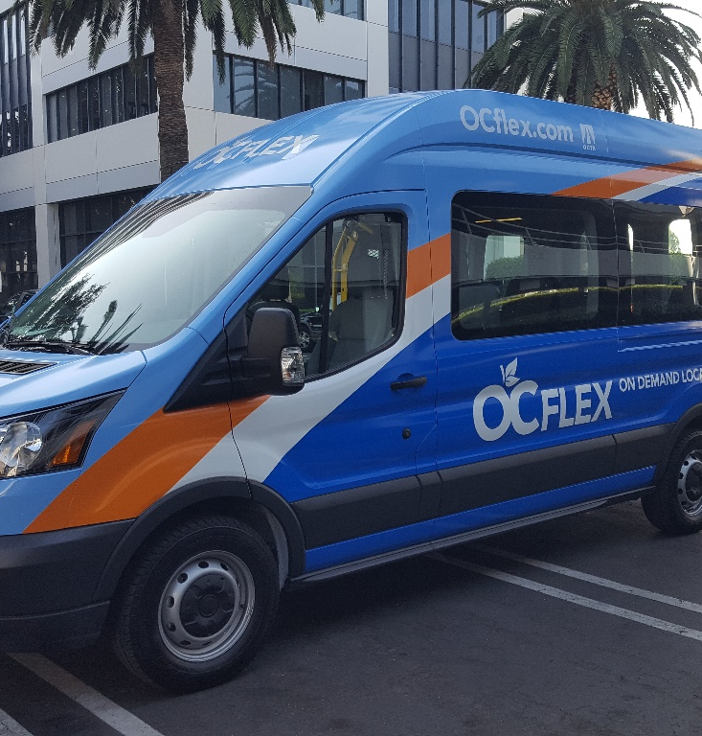
OC FLEX – Service Background
An on-demand service to be offered as a one-year pilot in select areas
A service operated under contract
A service operated with a new vehicle type
A service that is testing new rider markets
A part of the OC Bus 360° Program
Identify opportunities to improve productivity by matching resources to demand
Filling a service gap between regular fixed-route service and ride-hailing options (TNCs)
Notes:
Beginning with some background
OC FLEX is an on-demand micro-transit service to be operated under a 1-year pilot in select areas that, to date, have been unable to productively support fixed-route bus service
The service will be operated under a contract, awarded by the OCTA Board in March 2018
Will introduce a new vehicle type, which we had on site this afternoon and
Will test new rider markets, consistent with actions taken under the OC Bus 360 Program to realign service with post-recession travel patterns and match resources to service demand
We see this on-demand service as a possible solution to a service gap by offering a on-demand, curb-to-curb service with accessible vehicles, operated by certified drivers, for anyone 13 years or older.

Slide 3
OC FLEX – On Demand Service
Operates on:
Monday – Thursday: 6am – 9pm (11pm on Fridays)
Saturdays: 9am – 11pm
Sundays: 9am – 9pm
Allows customers to request rides to/from anywhere inside the zone
Will serve key destinations within zones (hubs)
Offers first/last mile connections for riders entering or leaving zones
Performance to date:
Steady incremental growth week to week
Typical for a new service
Starting to see some trends with respect to demand

Slide 4
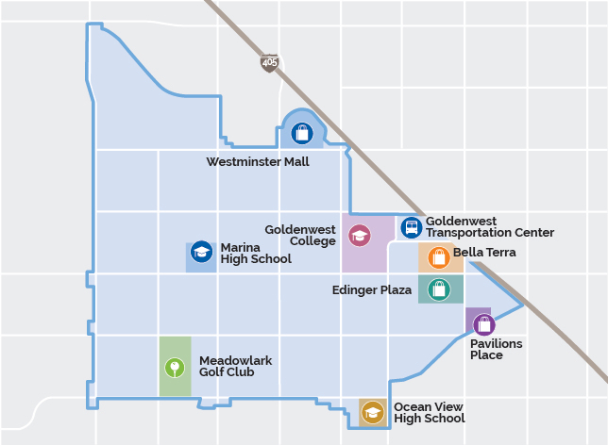
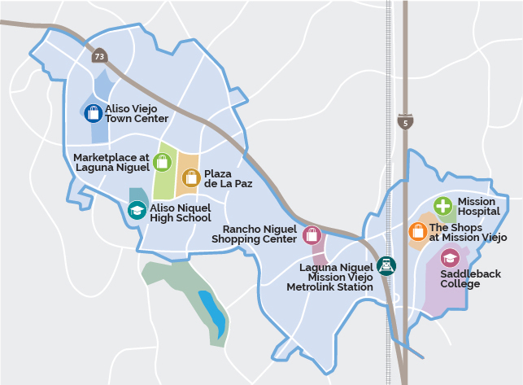
OC FLEX – Pilot Zones
Huntington Beach – Westminster (HB-WM)
Aliso Viejo-Laguna Niguel-Mission Viejo (AV-LN-MV)
Notes:
OC FLEX service will be available in two areas, as pictured here.
One southwest of the core in the Huntington Beach/Westminster Area area
The service will be available everyday, operating from 6am to 9pm Monday through Thursday and up till 11pm on Fridays.
Saturdays and Sundays, the service will be available starting at 9am and end at 11pm and 9pm, respectively.
The OC FLEX service is designed to:
Allow customers to request rides to origins and destinations within the designated zones, including key destinations called hubs; and
Provide first/last mile connections for riders entering or leaving the designated zones via connections to the OC Bus or rail network.

Slide 5
OC FLEX – Upcoming…
Continue to track performance
Five Performance Targets
Conduct Customer Surveys
Customer profile, demand markets
Refine service as needed to maintain/improve customer satisfaction
Software Parameters
Promotions
Reporting
6-Month update to Board
Final Report and Recommendation

