Slide 1

Microtransit Pilot Project: 12-Month Update

Slide 2

Boardings
Total Boardings: 36,789
Weekly*: ~850
Daily Highest: 178
Zone trends
Blue: Static
Orange: Positive trend, increasing month over month

Slide 3
Performance Criteria
Provide public transit mobility in lower-demand areas
As measured by boardings per revenue vehicle hour (B/RVH): 6 B/RVH
Reduce total operating and capital costs
As measured by subsidy per boarding: $9.00 per boarding
Reduce Vehicle Miles Travelled (VMT)
As measured by percent of bookings sharing a vehicle: 25% Shared Rides
Extend reach of OC Bus and Metrolink services
As measured by percent of trips to/from transit hubs: 25% transfer trips
Meet customer needs
As measured by customer satisfaction: 85% of riders “likely”/“very likely” to recommend OC Flex

Slide 4
Productivity (B/rvh)
Target: 6 B/RVH
System: 2.3 B/RVH
Blue: 1.79 B/RVH
Orange: 2.58 B/RVH
Trend: Positive

Slide 5
Subsidy per boarding
Target: $9/Boarding
System: $20.14
Blue: $27.60 B/RVH
Orange: $17.69 B/RVH
Trend: Positive

Slide 6
Subsidy per boarding – All modes (Q1 FY2019-20)
ADA – Americans with Disabilities Act

Slide 7
Shared Rides
Target: 25%
System: 37.2%
Blue: 22.3%
Orange: 42.2%
Trends:
Blue: Below target
Orange: Exceeded target every month since January
High volume of trips to/from Metrolink station

Slide 8
Connected Trips
Target: 25%
System: 32%
Favorable trend:
Above 25% target for transfers
High transfer rate in the Orange Zone is due to high volume of trips to and from the Laguna Niguel-Mission Viejo Metrolink Station
First/Last mile connections to points east and west of station

Slide 9
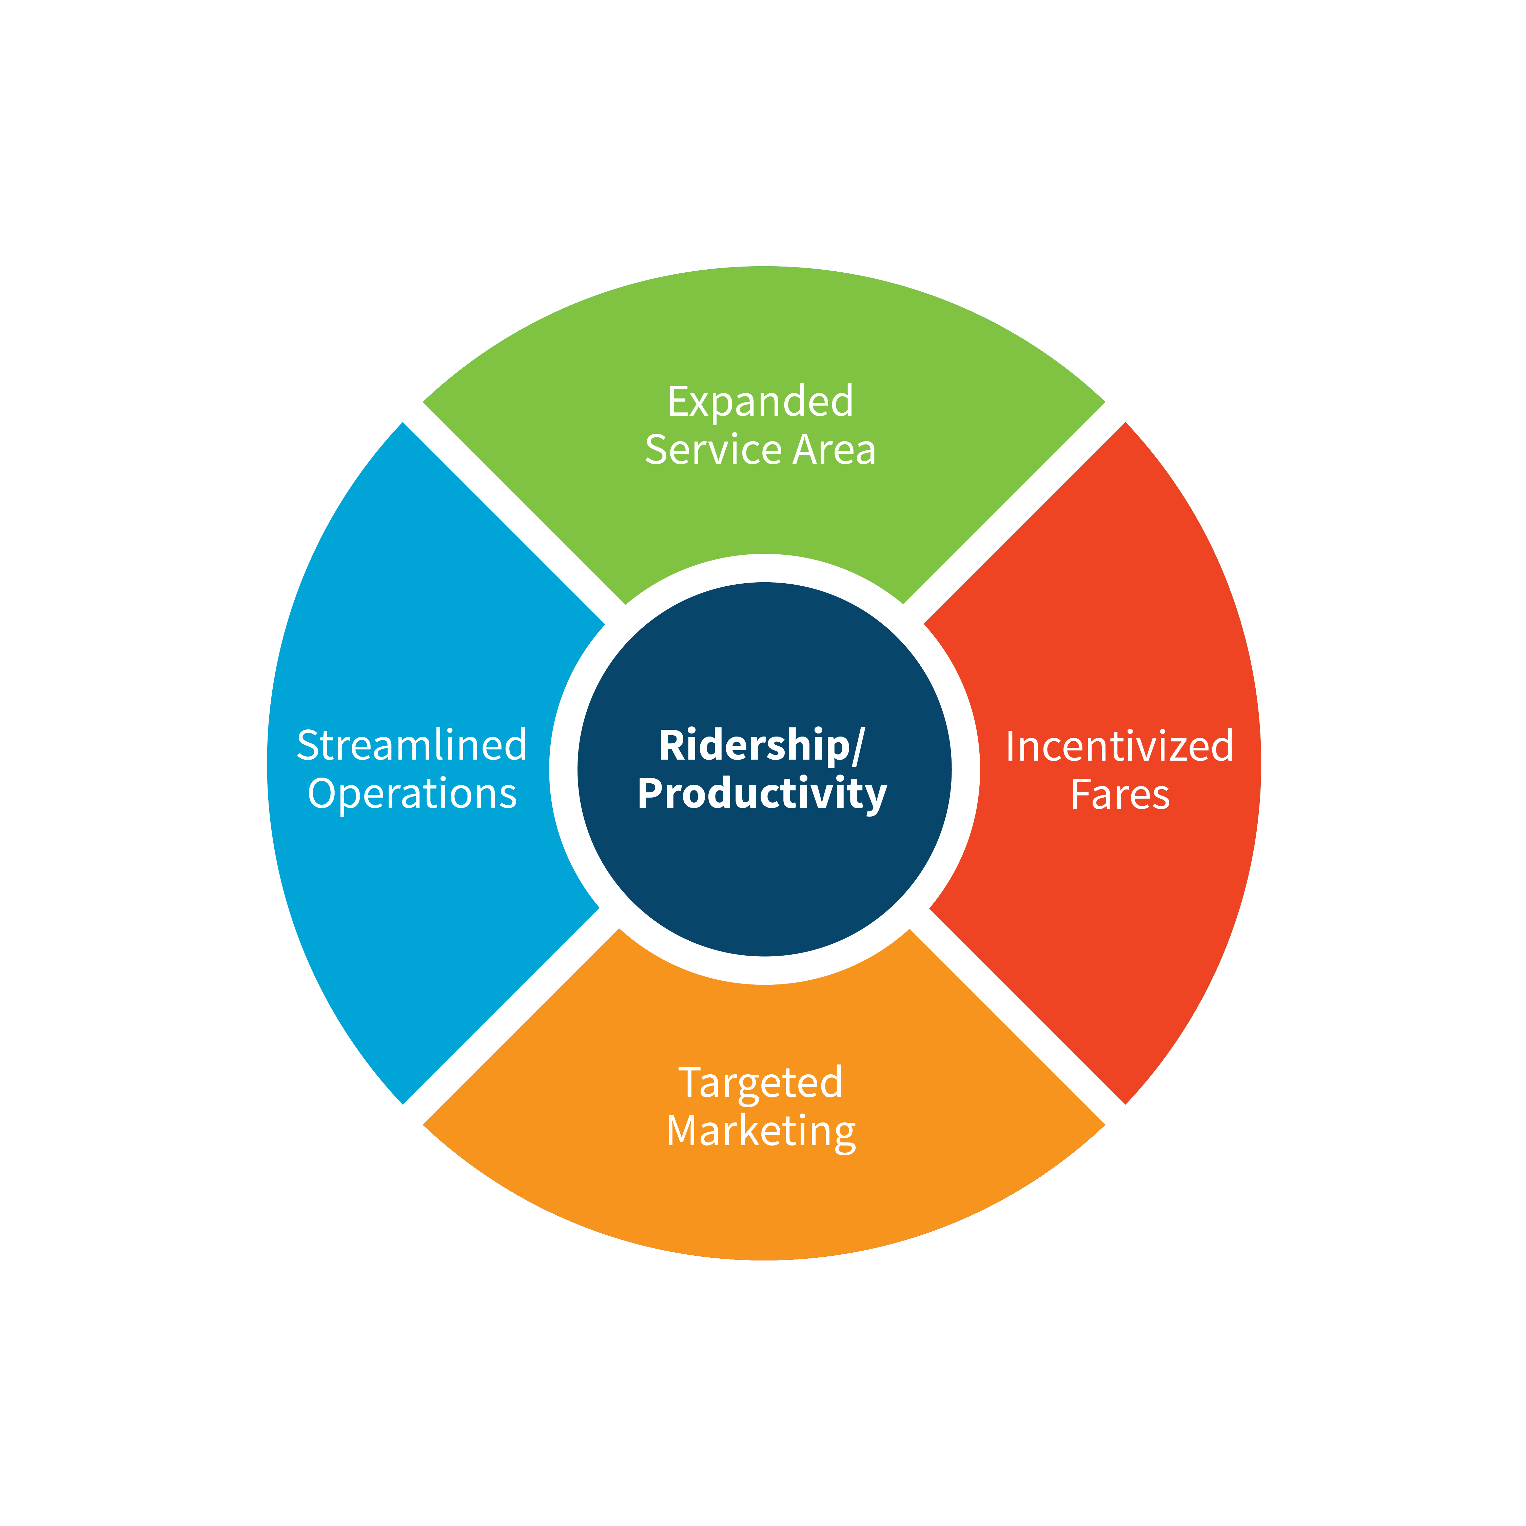
Staff Recommendations
Extend Pilot through October 2020
Maintain service continuity
Test strategies considered to improve performance
Allow time for the procurement of a new service contract beyond October 2020 as approved.
Strategies for Improvement
Zone Changes
Operational Improvements
Fare/Pass Considerations
Promotions

Slide 10
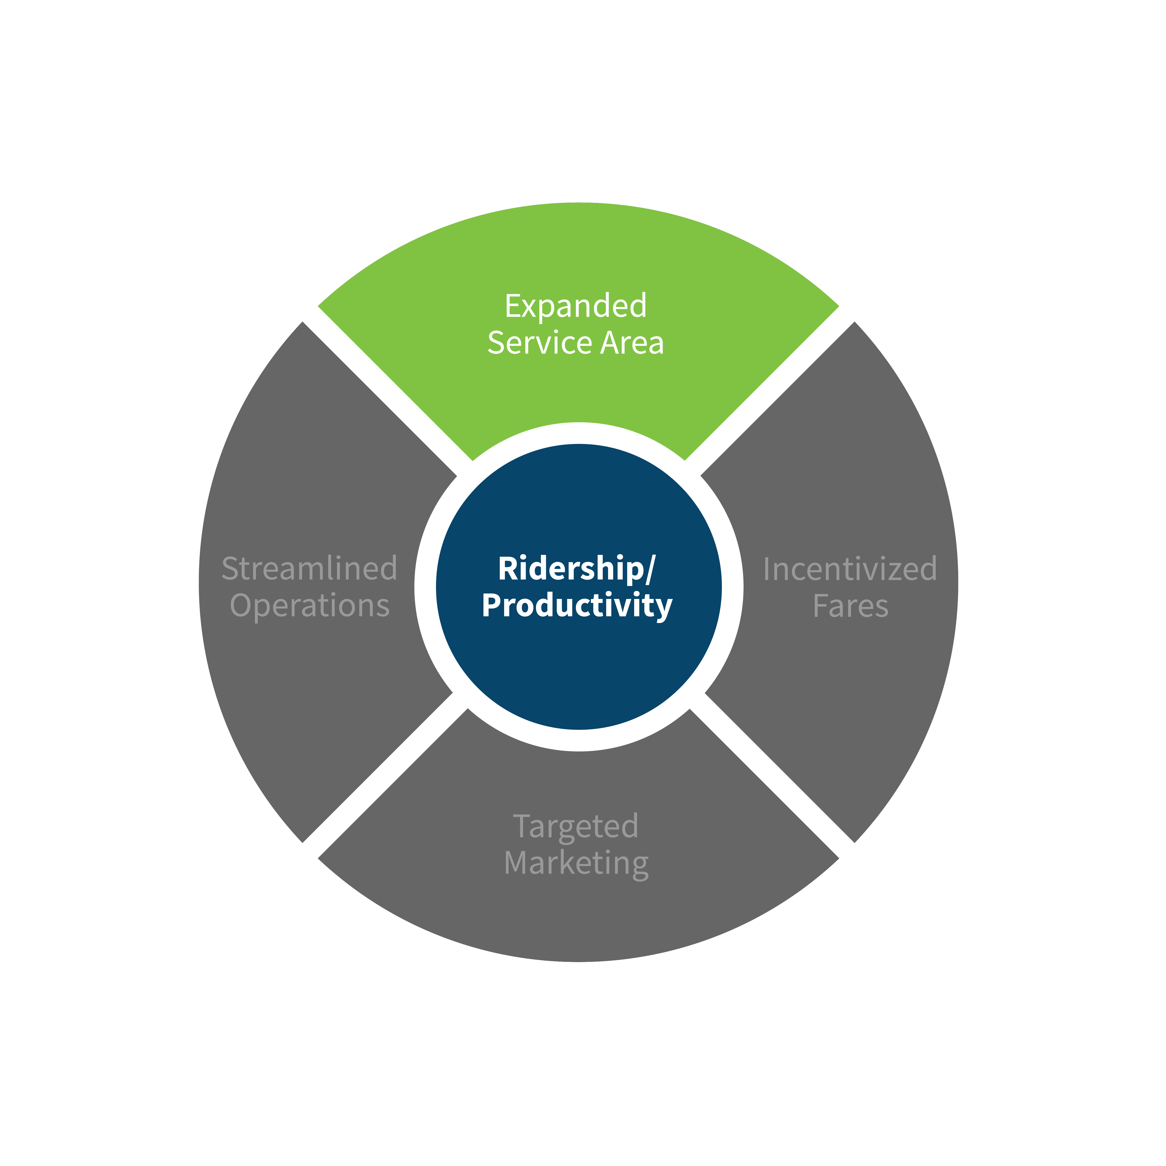
Expanded Service Area
GIS Zone Travel Analysis
Trip Activity
Home-Work Trips
Added Adjacent High Demand Areas
Removed Some Lower Demand Areas
Anticipate Increase in Demand and Wait Time
Notes:
https://drive.google.com/open?id=1Ue86RZ2I02nSkDwFULQ0_-ogKwtM4uSG&usp=sharing

Slide 11
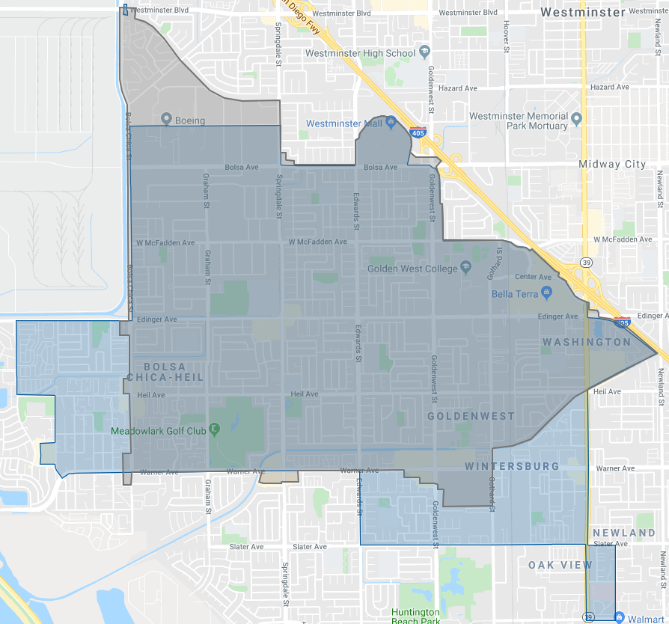
Huntington Beach / Westminster ZONE
Zone Size
Increased from 6.45 to 7.51 square miles (+16.4%)
New Areas
High-density trip area west of zone
High-density trip area south to Slater Avenue
Huntington Beach Hospital area
Reduced Areas
Area north of Boeing
New “Island” for connection to Route 60/560
Minor changes at edges
Notes:
https://drive.google.com/open?id=1Ue86RZ2I02nSkDwFULQ0_-ogKwtM4uSG&usp=sharing

Slide 12
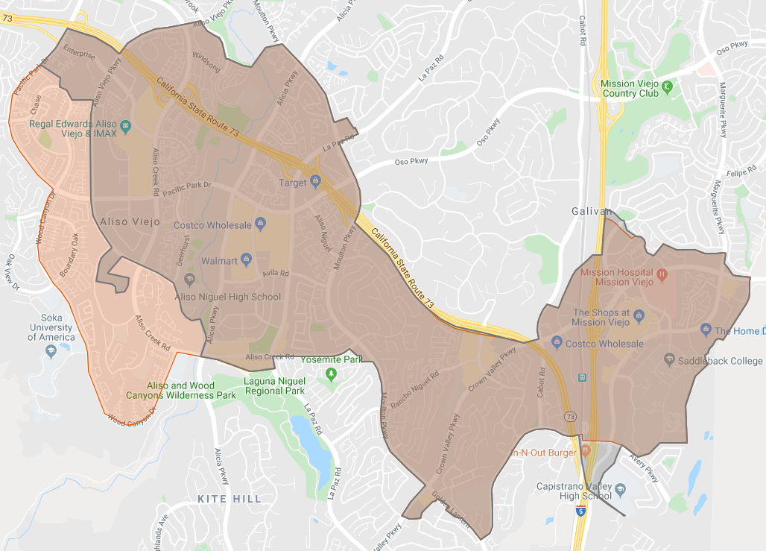
Aliso Viejo / Laguna Niguel / Mission Viejo ZONE
Zone Size
Increased from 6.16 to 7.22 square miles (+17.2%)
New Areas
High-density trip area west of zone
Adjacent to SOKA Campus
Reduced Areas
South of Avery to Capistrano Valley High School
Notes:
https://drive.google.com/open?id=1Ue86RZ2I02nSkDwFULQ0_-ogKwtM4uSG&usp=sharing

Slide 13
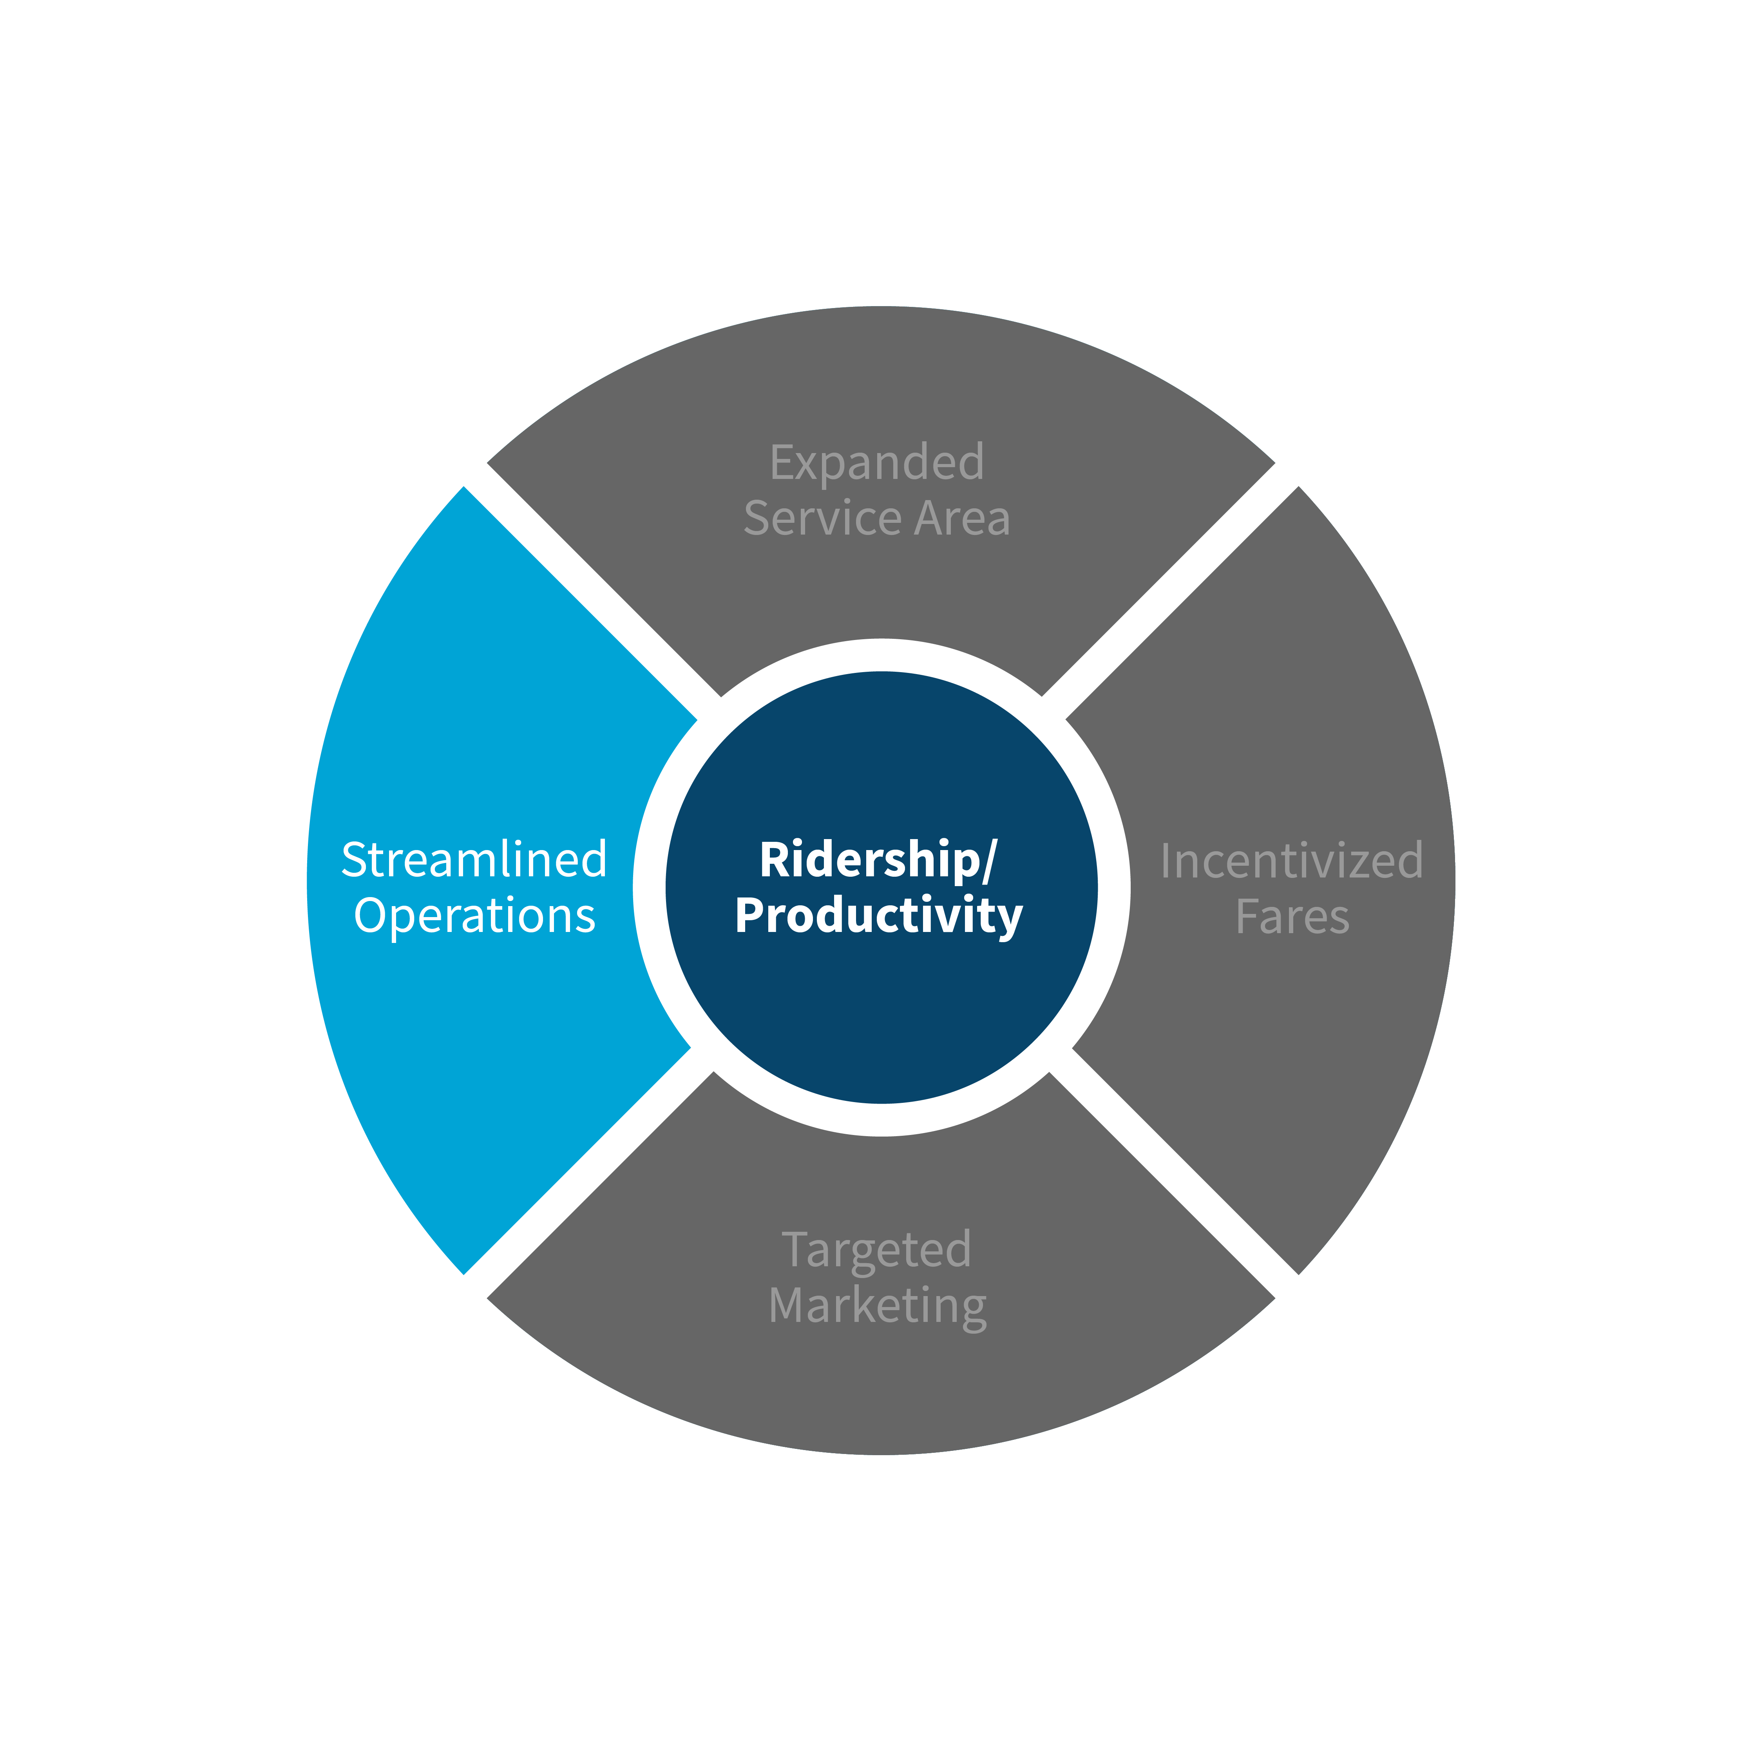
Streamlined operations
Goals
Improve productivity
Maintain quality of service
Proposed Changes
Reduce span of service hours due to low ridership (stop earlier)
Monday thru Friday: 6 AM to 9 PM
Saturday and Sunday: 9 AM to 9 PM
Increase the number of Virtual Stops to maintain and/or improve service response time
Increase revenue vehicle hours in the Blue Zone during anticipated peak hours of service to accommodate zone changes and other efforts
Notes:
Virtual Stops are predetermined pick-up points within walking distance where customers are directed to board OC Flex vehicles. This allows for quick and efficient shared trips without lengthy detours.

Slide 14
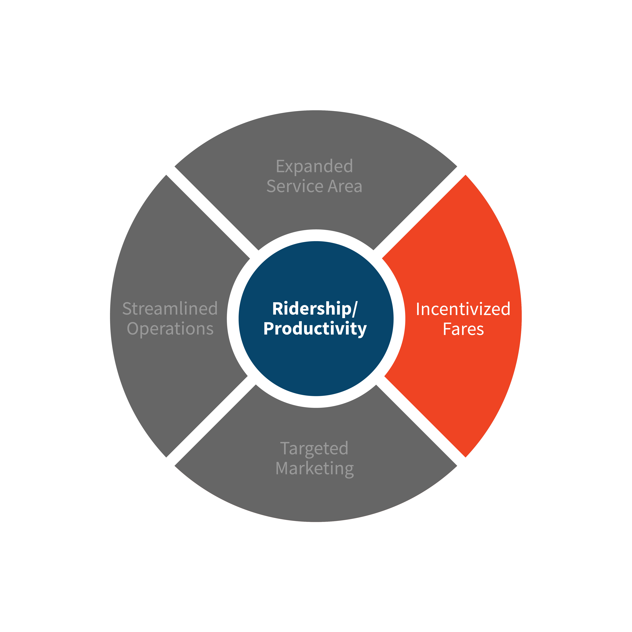
PASS CONSIDERATIONS
Goals:
Increase ridership
Encourage shared rides
Proposed Changes
Introduce “Train Buddies” program
Metrolink riders to use transfer passes so multiple riders can be scheduled together
Expand current weekend BOGO program to all days
Allow free transfers for OC Bus 30-day passholders

Slide 15

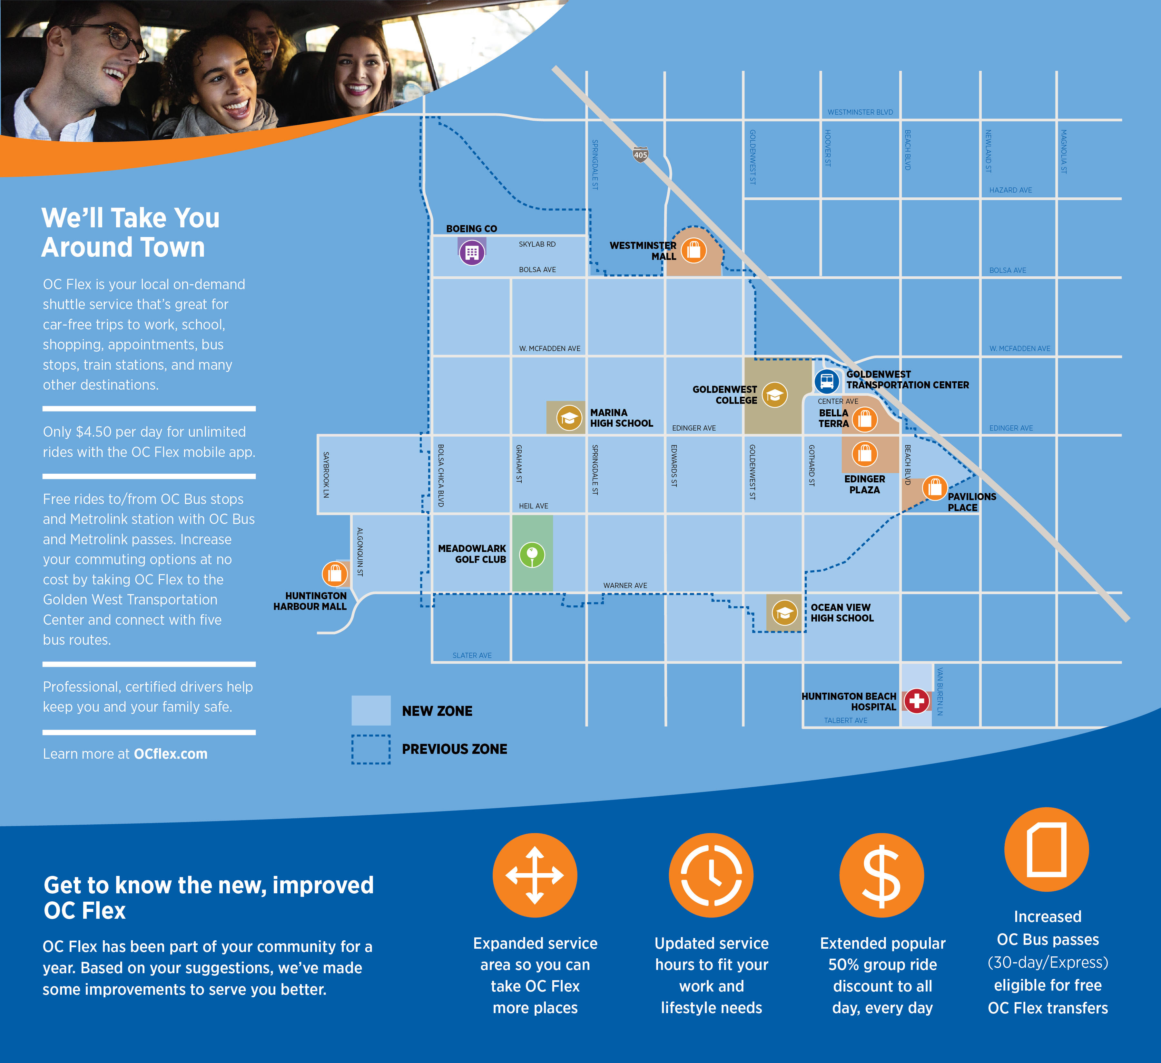
targeted Marketing
Target Audiences and Tactics
Zone residents
Promote new enhancements
Direct mail/digital ads/outreach
Gather feedback from non-users (survey link)
Business and schools
New organizations in the expanded areas
Promote new enhancements
In-person meetings
OC Flex business cards with promo codes

Slide 16
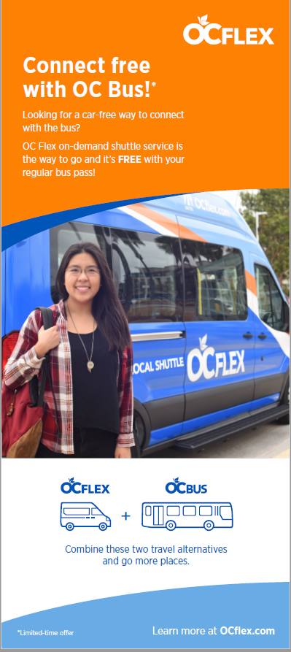

targeted marketing
Current OC Bus and Metrolink customers
Position OC Flex as part of OC transit family, providing easy connections to/from bus and trains
Promote NEW free transfers via regular OC Bus passes
Potential off-peak users
50% off group ride fare (at all times)
Seniors, stay-at-home parents, students
Free hands-on group travel training/tours
Current customers
Promote new enhancements
Communicate benefits of changes
Remind of referral promotion
Inactive account holders
Try us now, FREE!

Slide 17
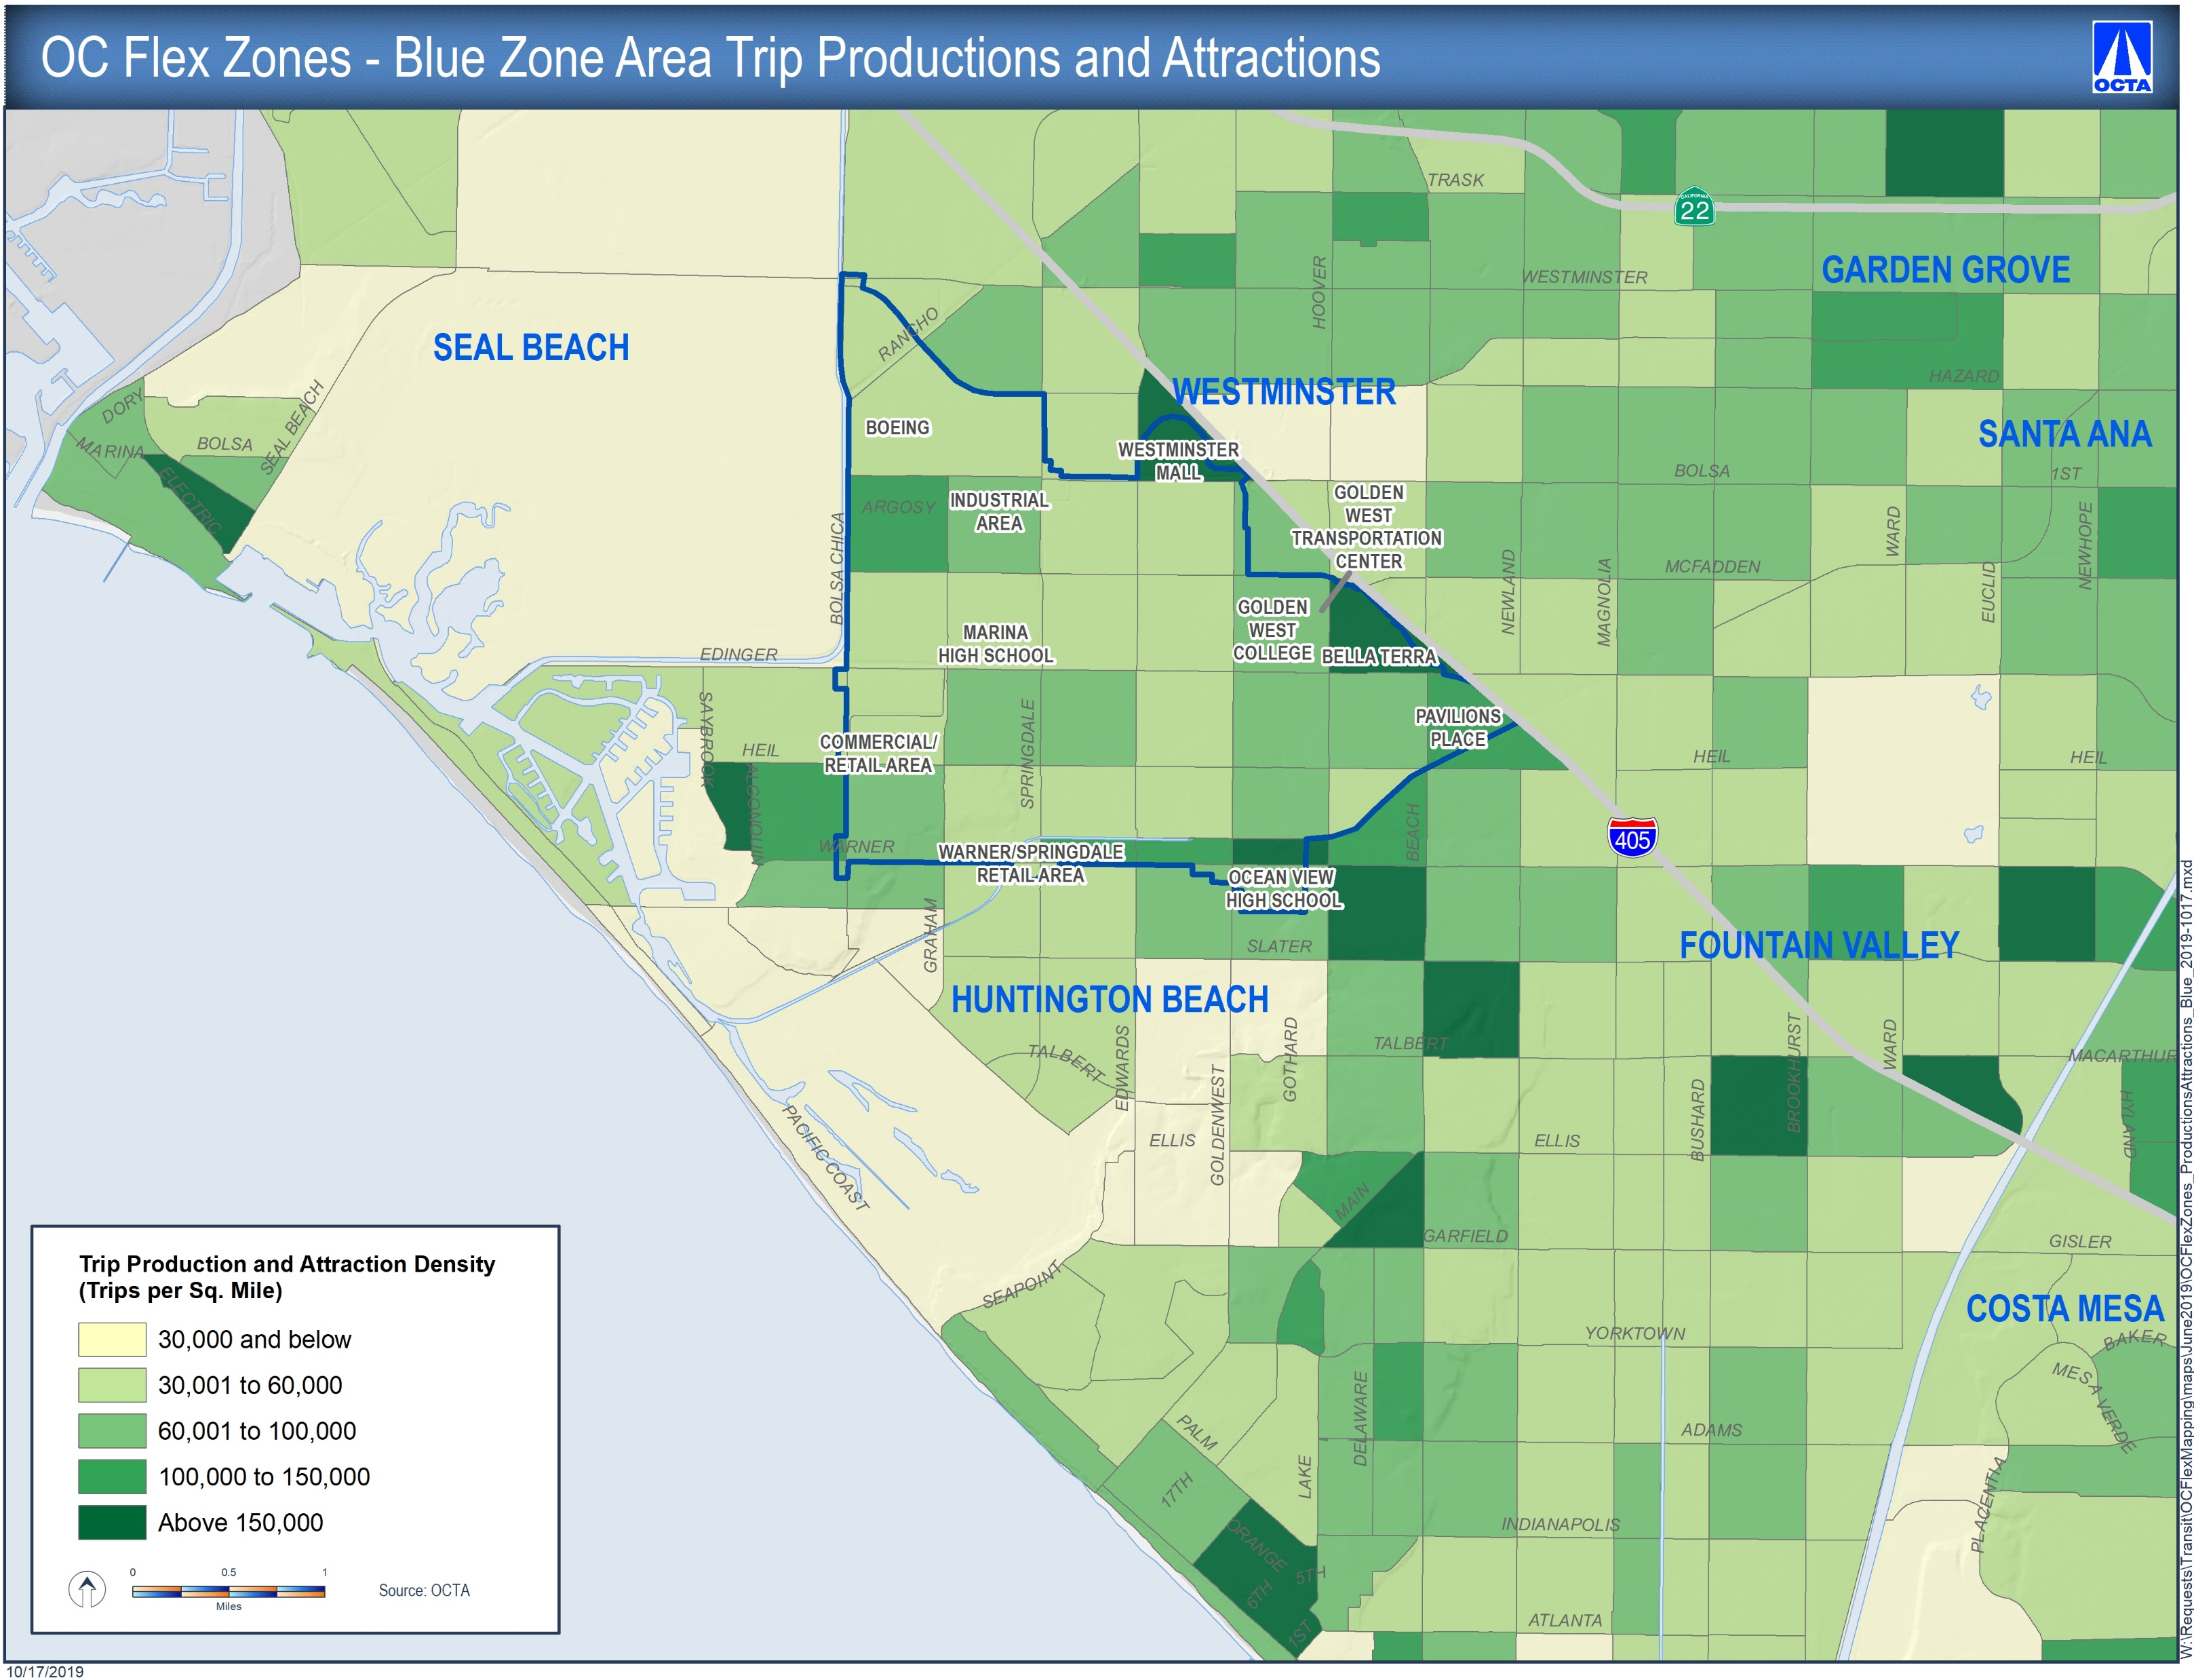
Blue Zone Productions and Attractions Combined

Slide 18
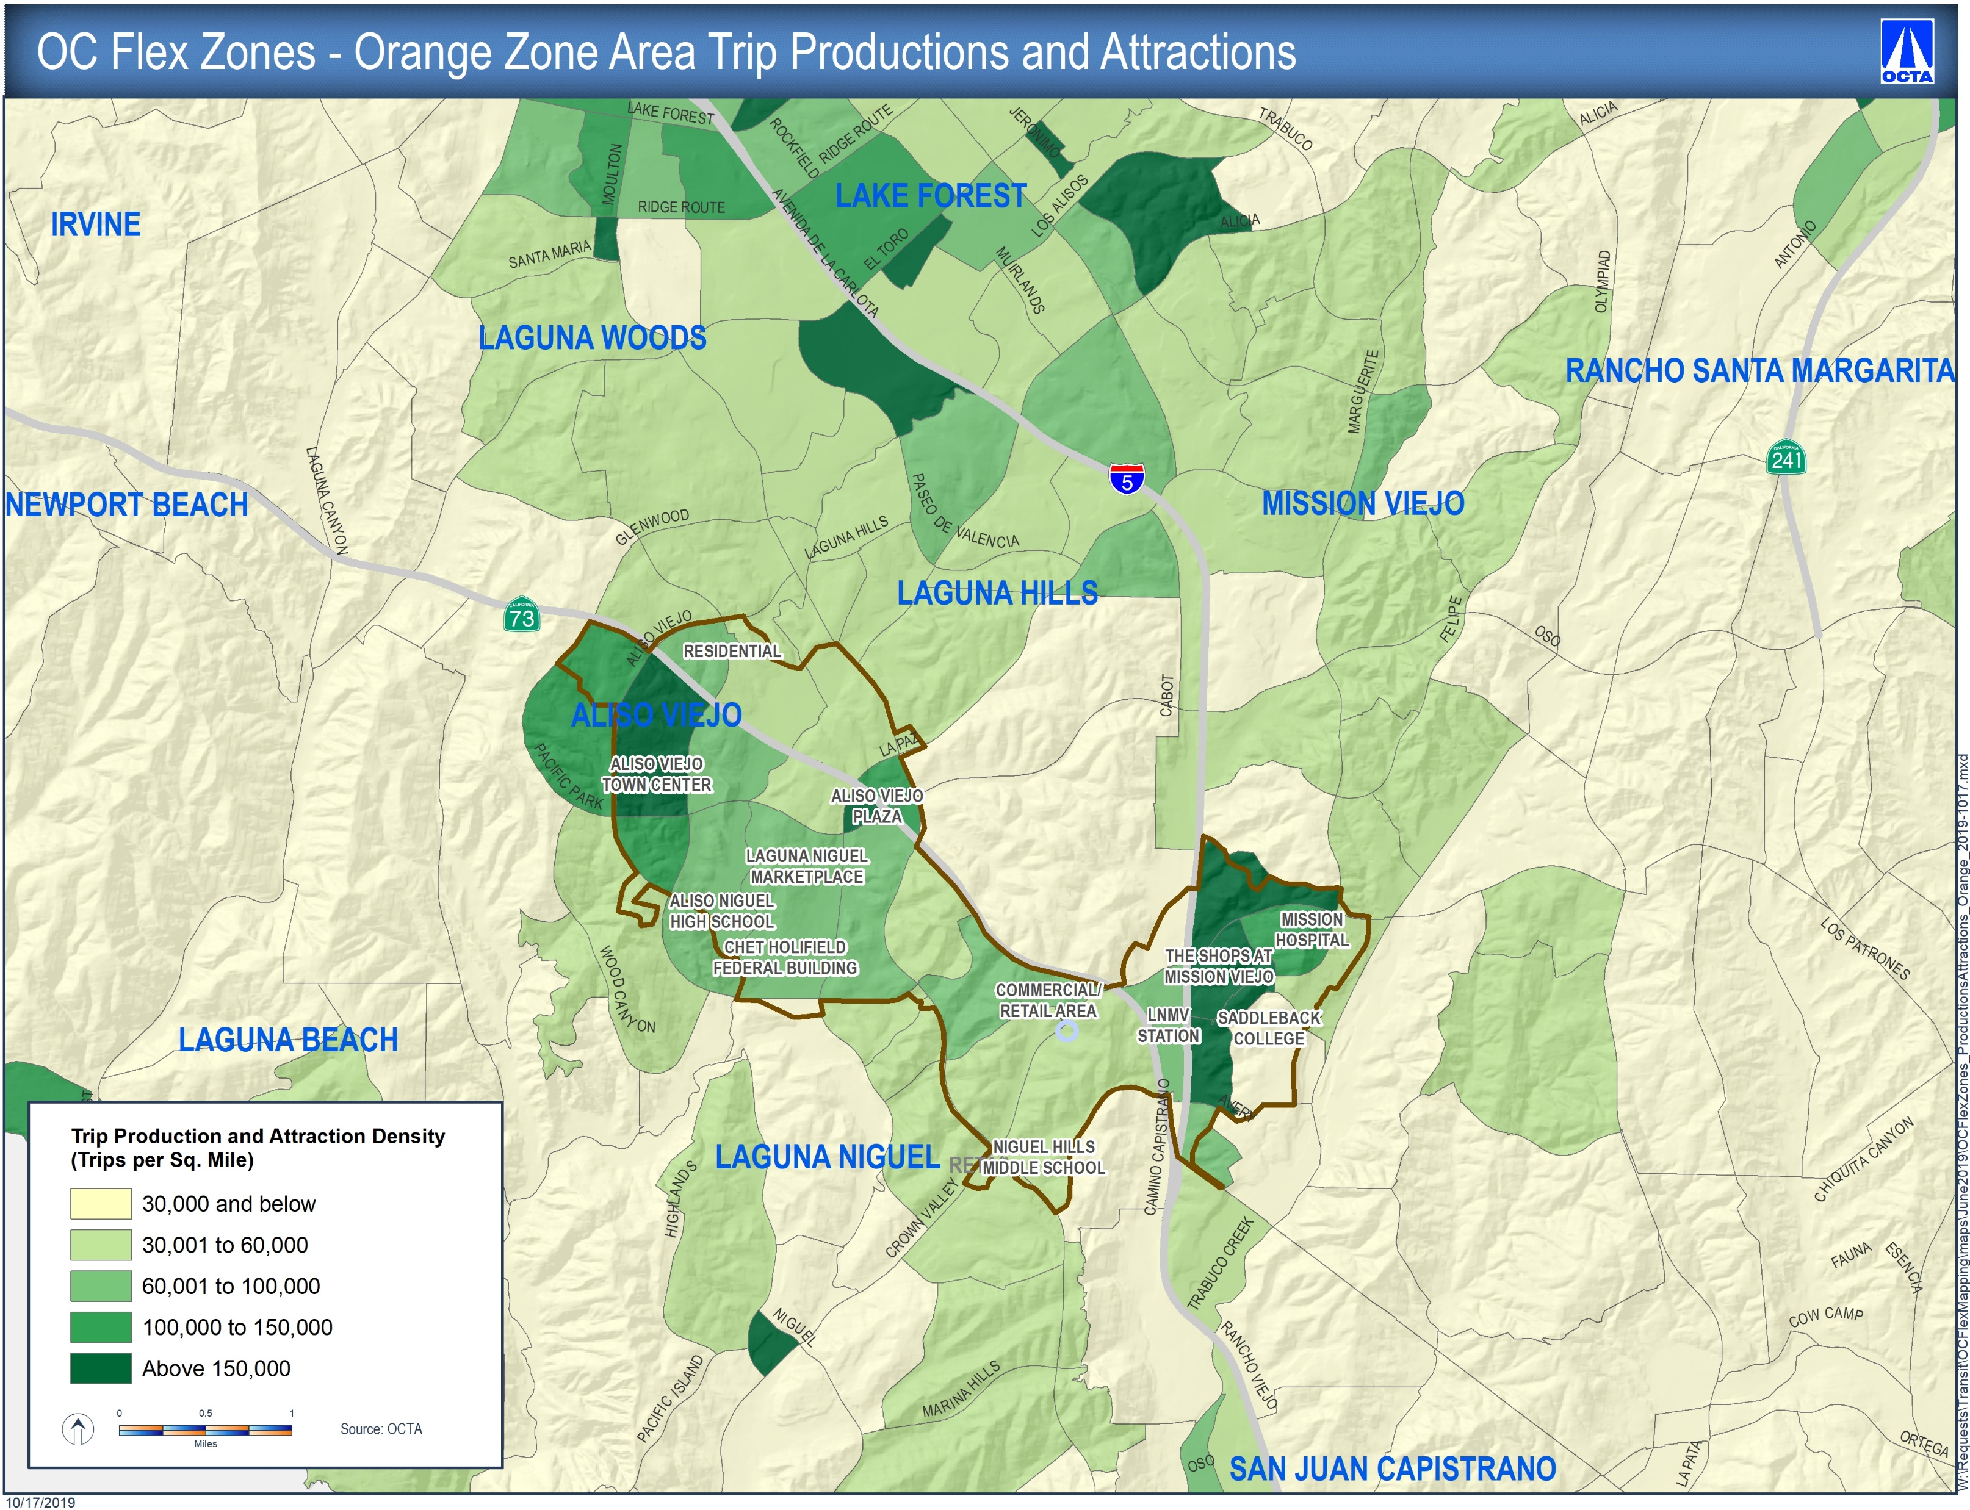
Orange Zone Productions and Attractions Combined

Slide 19
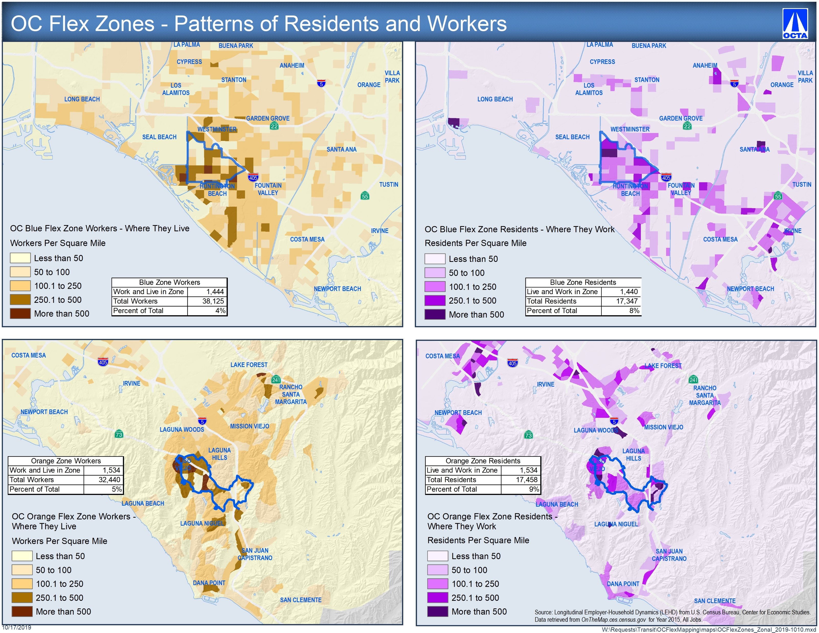
Patterns of Workers and Where They Live
Notes:
Overall patterns of work who live or work in the Flex zones for reference
Indicator of flows to, from, and within zones
Residential patterns are distributed, while employment patterns more concentrated
Some live and work within each zone (about 6% more persons in AV)

Slide 20
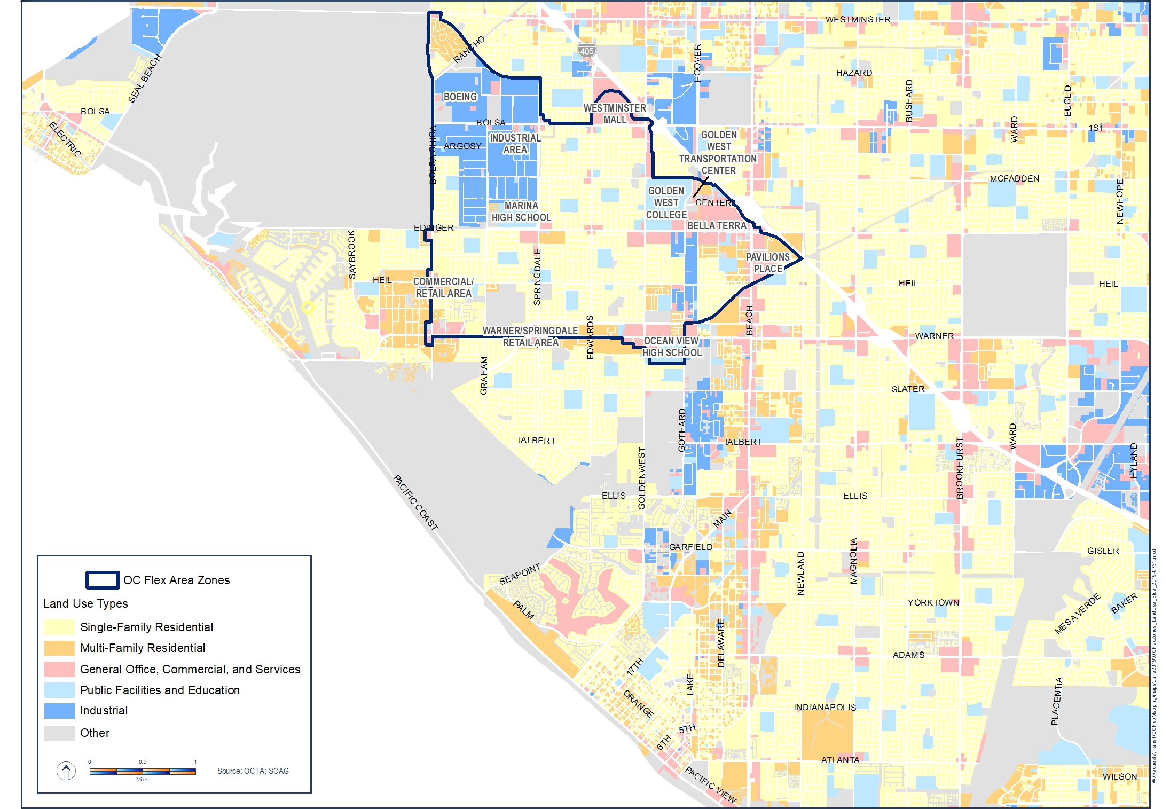
Blue Zone Land-Use
Notes:
Note the majority of developed land area is Single-Family Residential and Industrial properties – both lower end of density
A corridor of more intensive land-uses does extend down Beach Bl

Slide 21
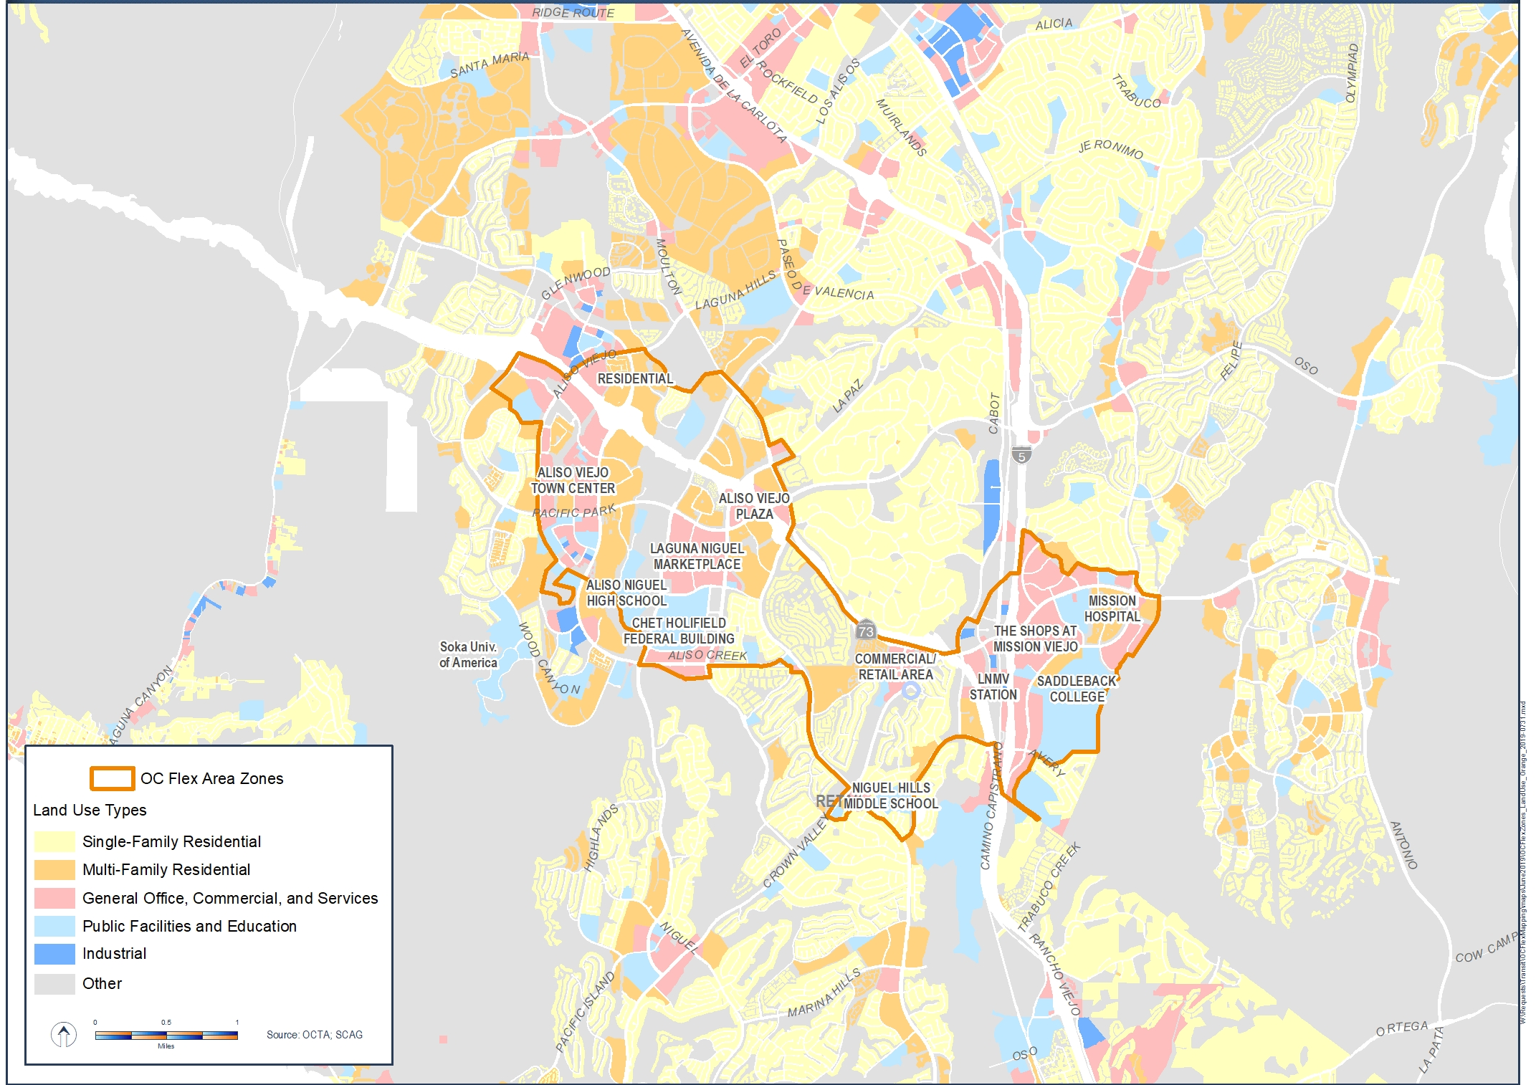
Orange Zone Land-Use
Notes:
Higher intensity land-uses, and appears well-mixed –roughly equal amounts of each land-use

Slide 22
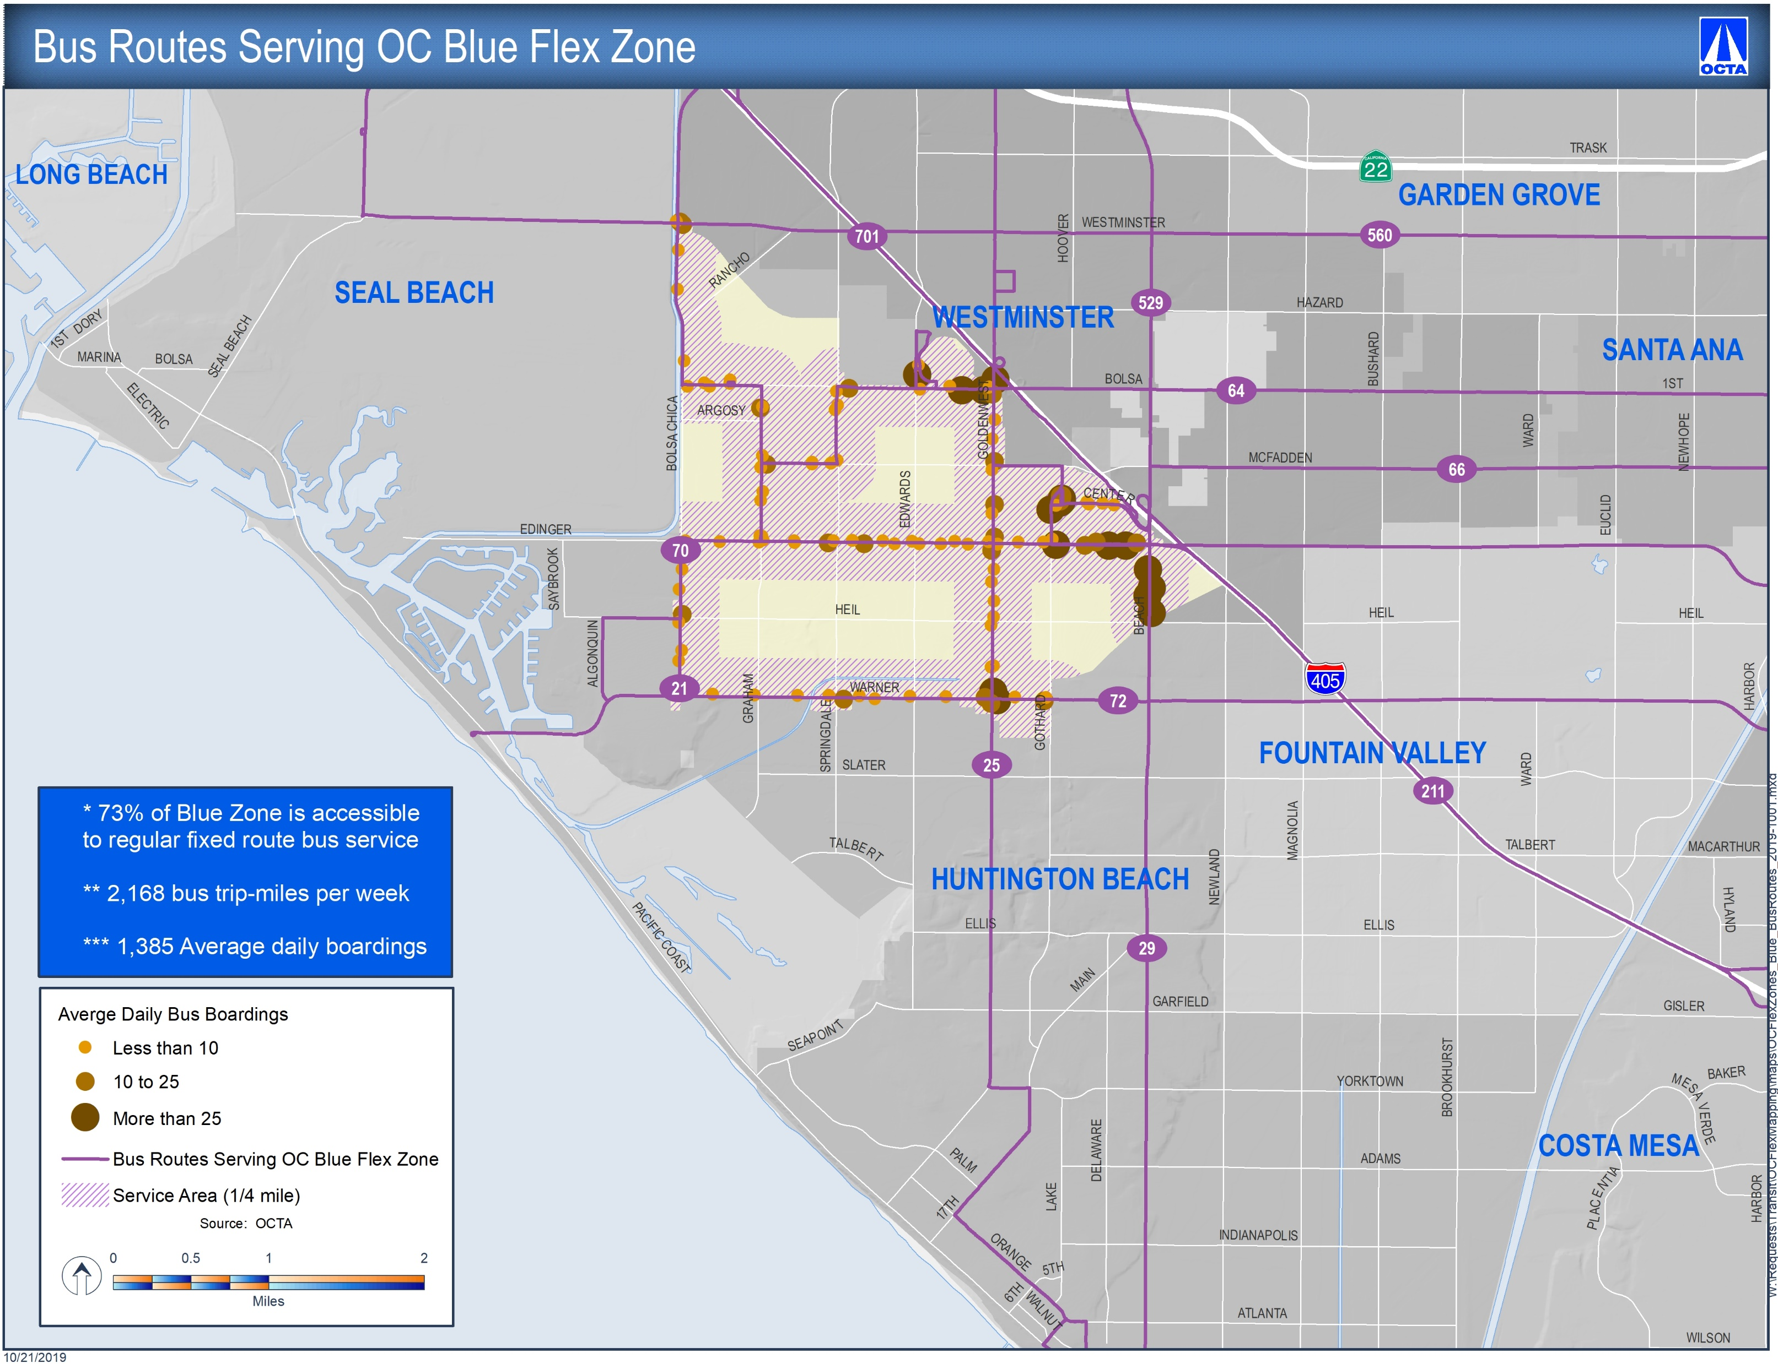
Blue Zone Regular Fixed Bus Service
Notes:
Within Blue Zone, OCTA runs 2,168 trip-miles of service per week (148% more service than in the Orange Zone)
0.64 boardings per bus-mile
Does OCTA want OC Flex to compete with regular fixed route bus service? Policy question…

Slide 23
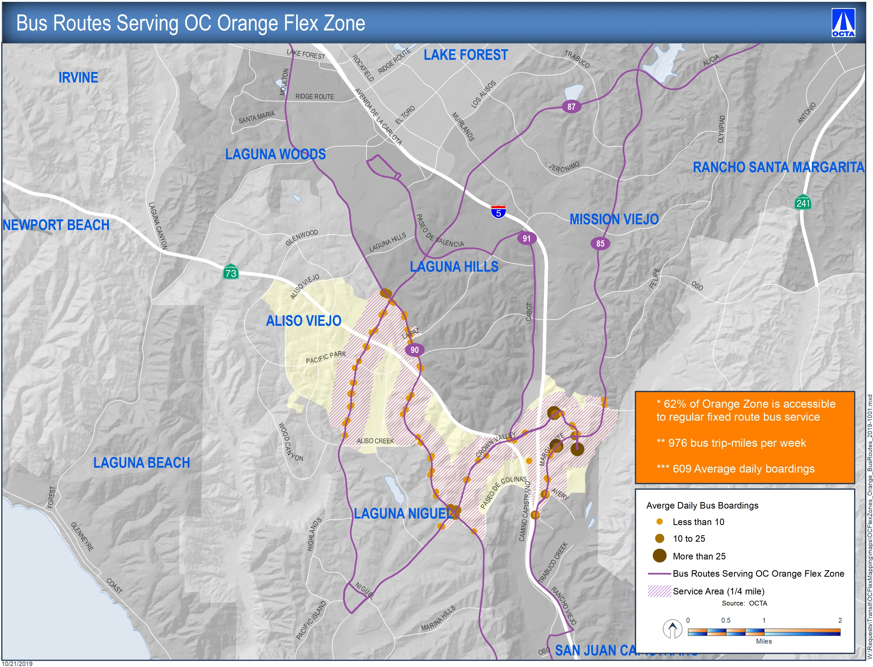
Orange Zone Regular Fixed Bus Service
Notes:
Less of the Orange Zone is accessible to regular fixed bus service (62% vs 73%) in Blue Zone, much of the areas not accessible are higher density areas
Within Orange Zone, OCTA runs 976 trip-miles of service per week (60% less service than in the Blue Zone)
0.62 boardings per bus-mile
Orange Zone bus boardings only about 40-45% of those in the Blue Zone

