Slide 1
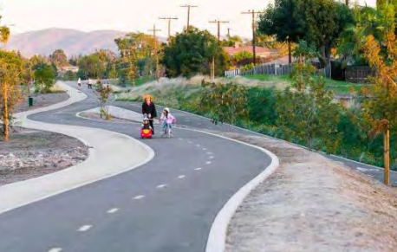
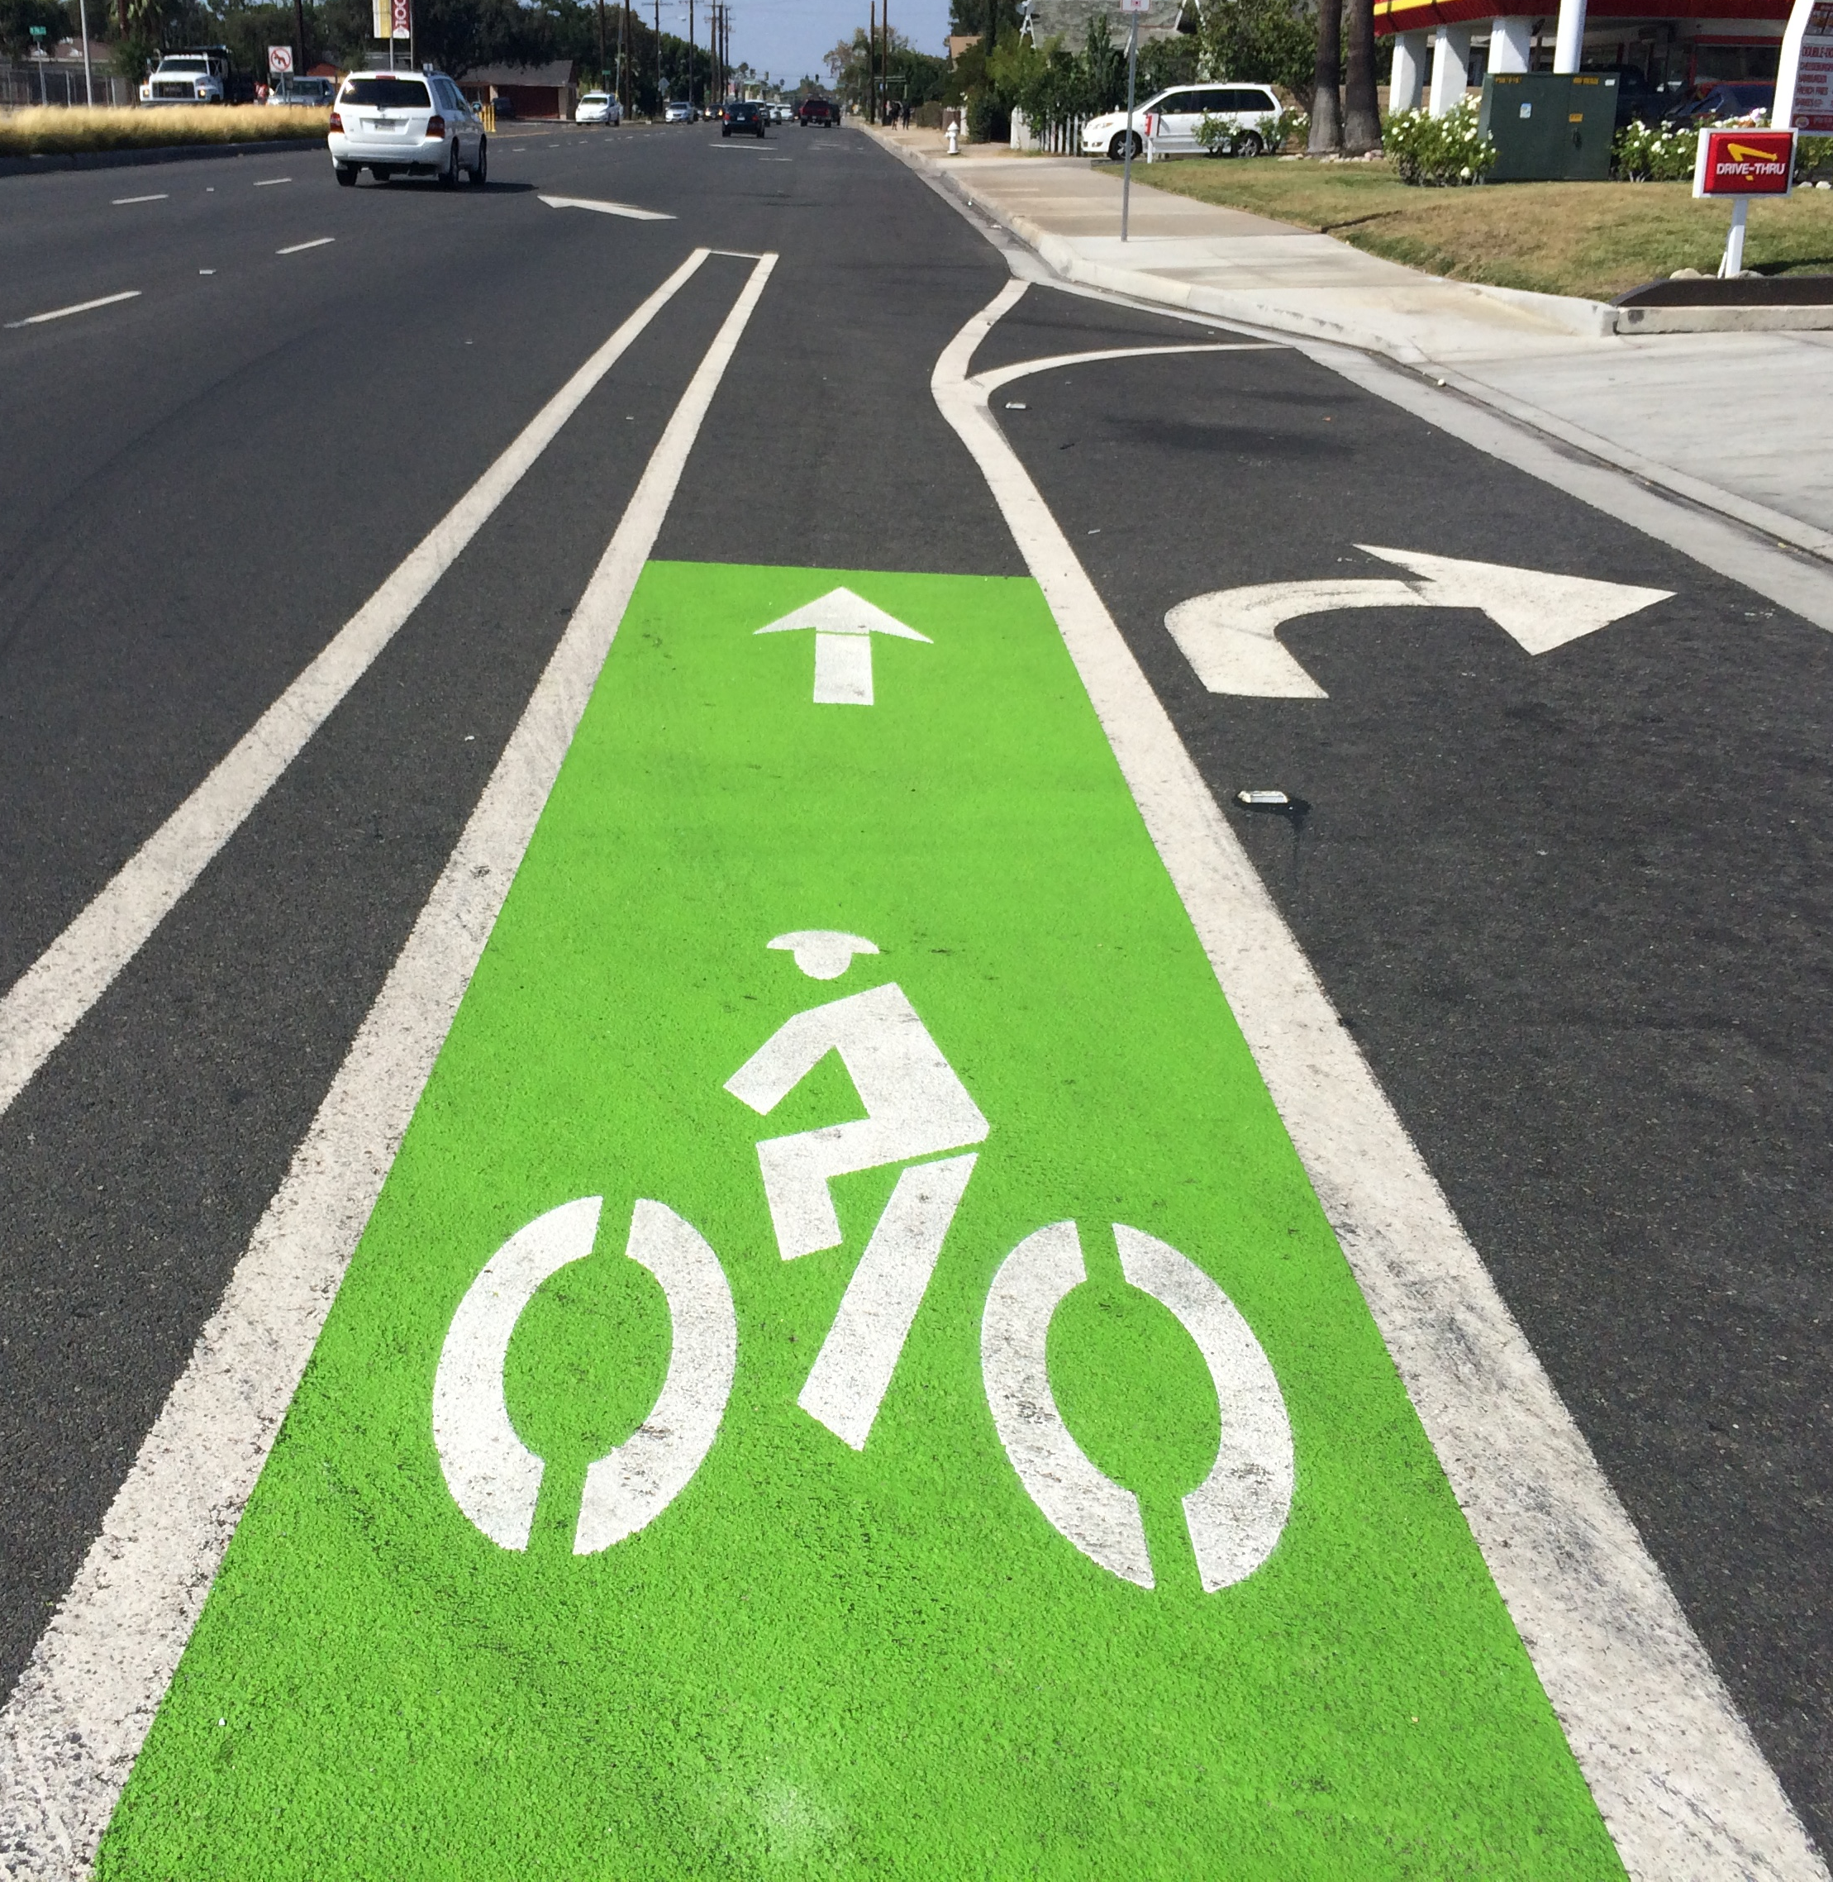

Active Transportation Program and Funding Update
Orange County Transportation Authority
September 2020
Notes:
Introductions

Slide 2
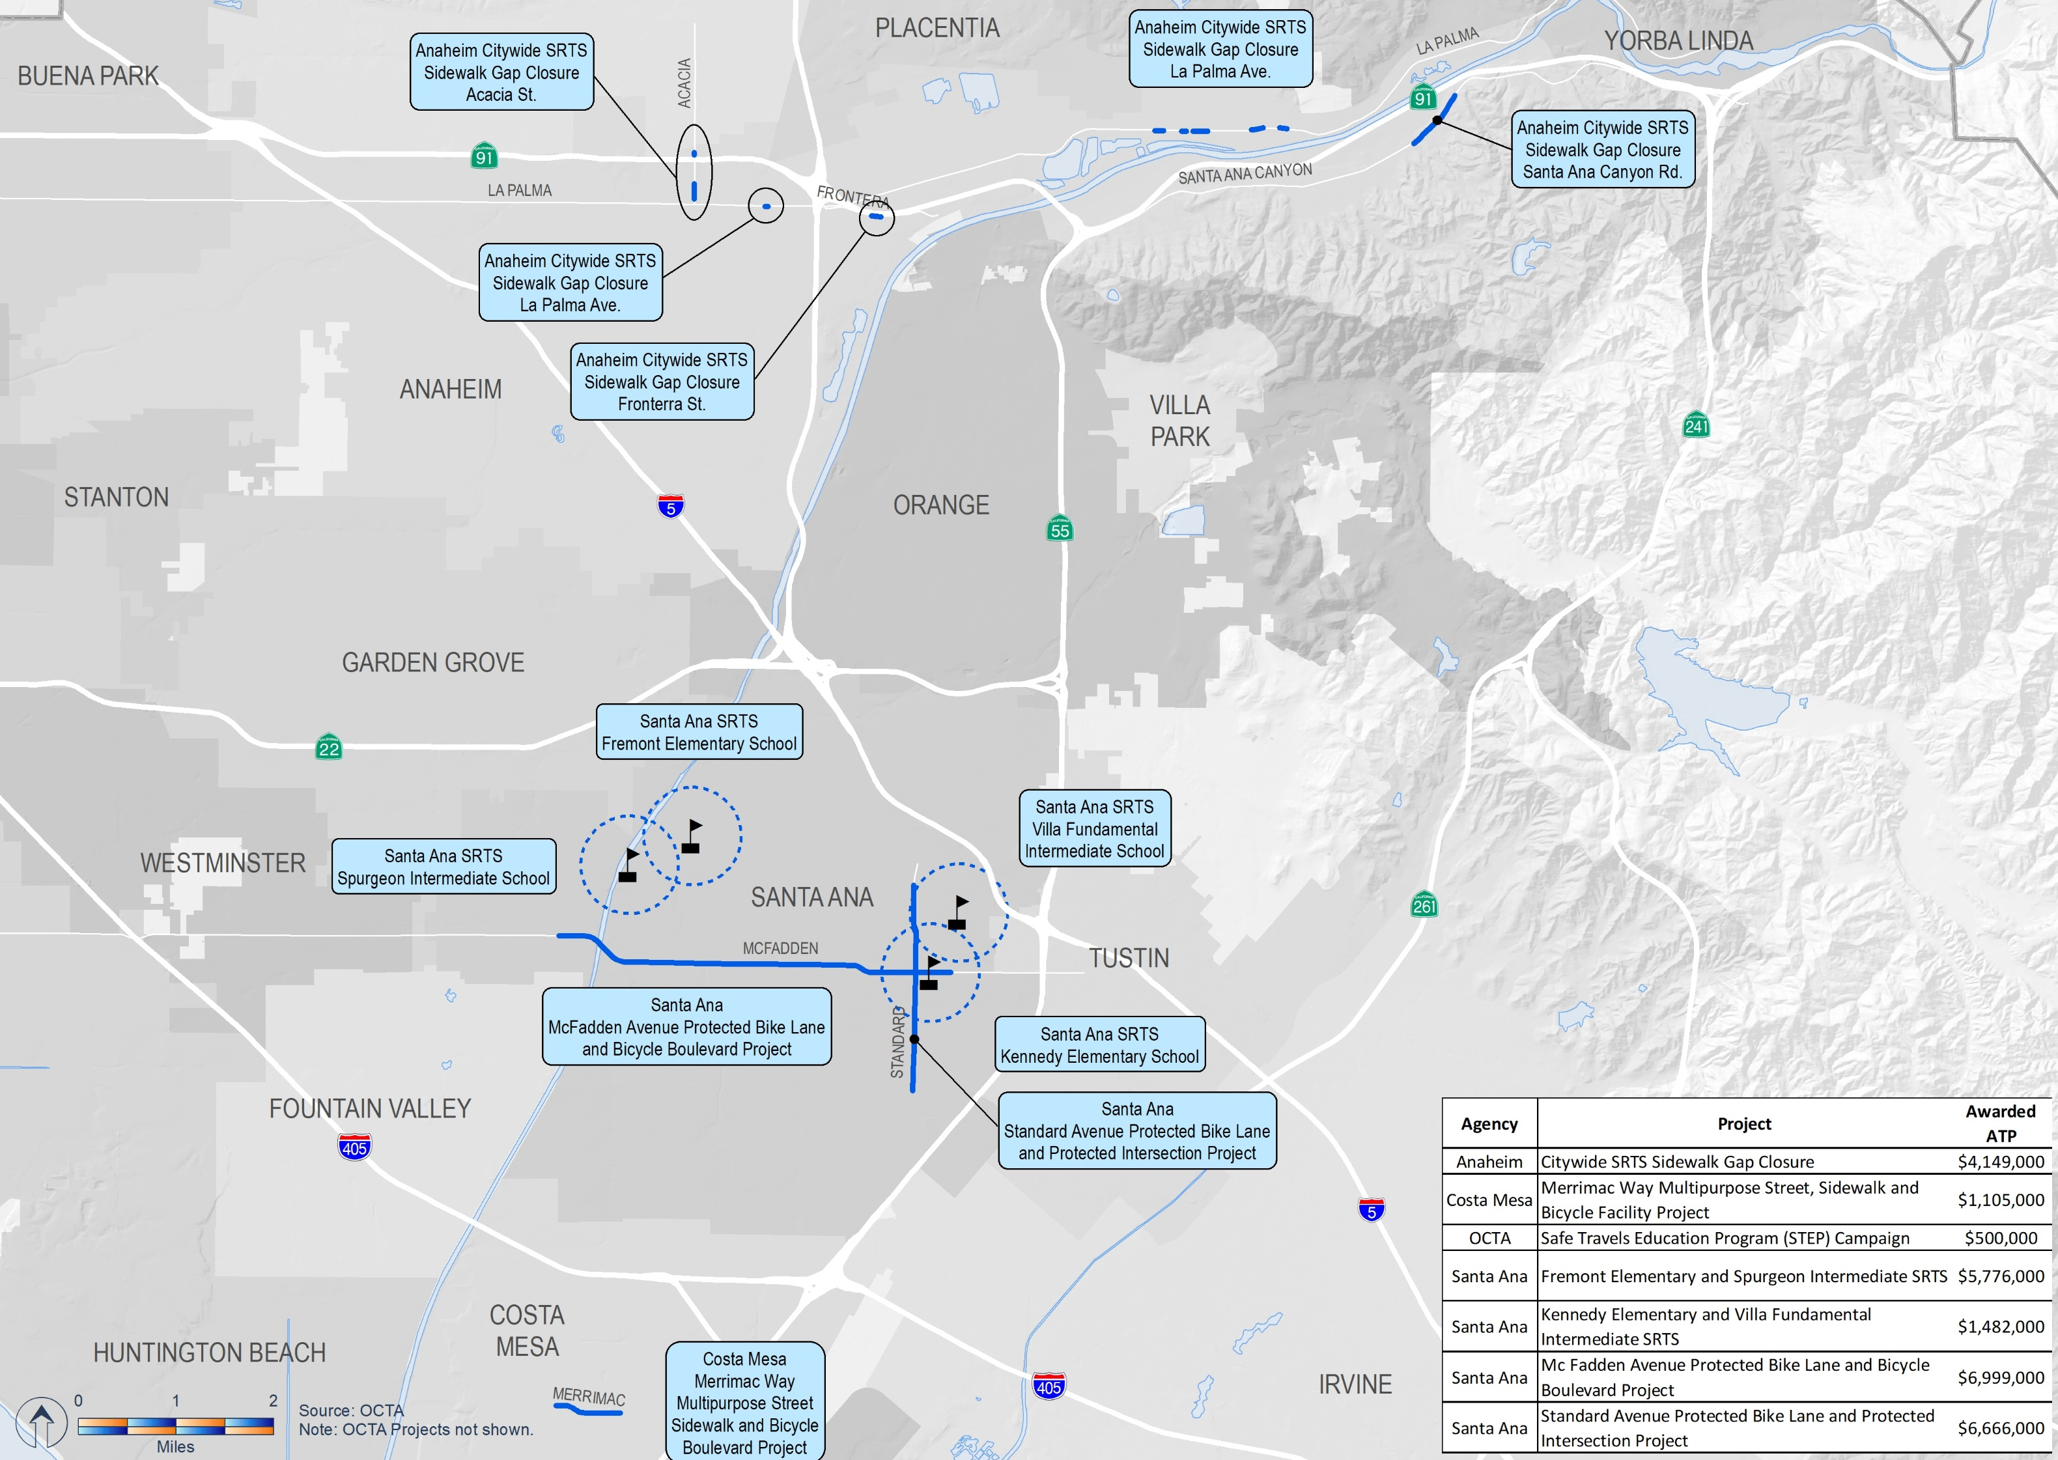
Cycle 4 (2019) Active Transportation Program
Notes:
Orange County received about $26.6 million in Cycle 4
$11.4 million in statewide awards, and $15.2 million through regional SCAG awards.

Slide 3

Cycle 5 (2021) Program Schedule
2021 ATP Schedule | Date
CTC ATP Branch Workshop | March 11, 2020
Call for Projects Opens | March 25, 2020
Project Applications Due (Quick Build) | July 15, 2020
Project Applications Due (All other application types) | September 15, 2020
Staff Recommendations (Quick Build) | September 15, 2020
Adoption of Quick Build Program of Projects | December 2-3, 2020
Staff Recommendations for Statewide Component | February 15, 2021
Adoption of Statewide Component | March 2021
Adoption of Regional (MPO) Component | June 2021

Slide 4
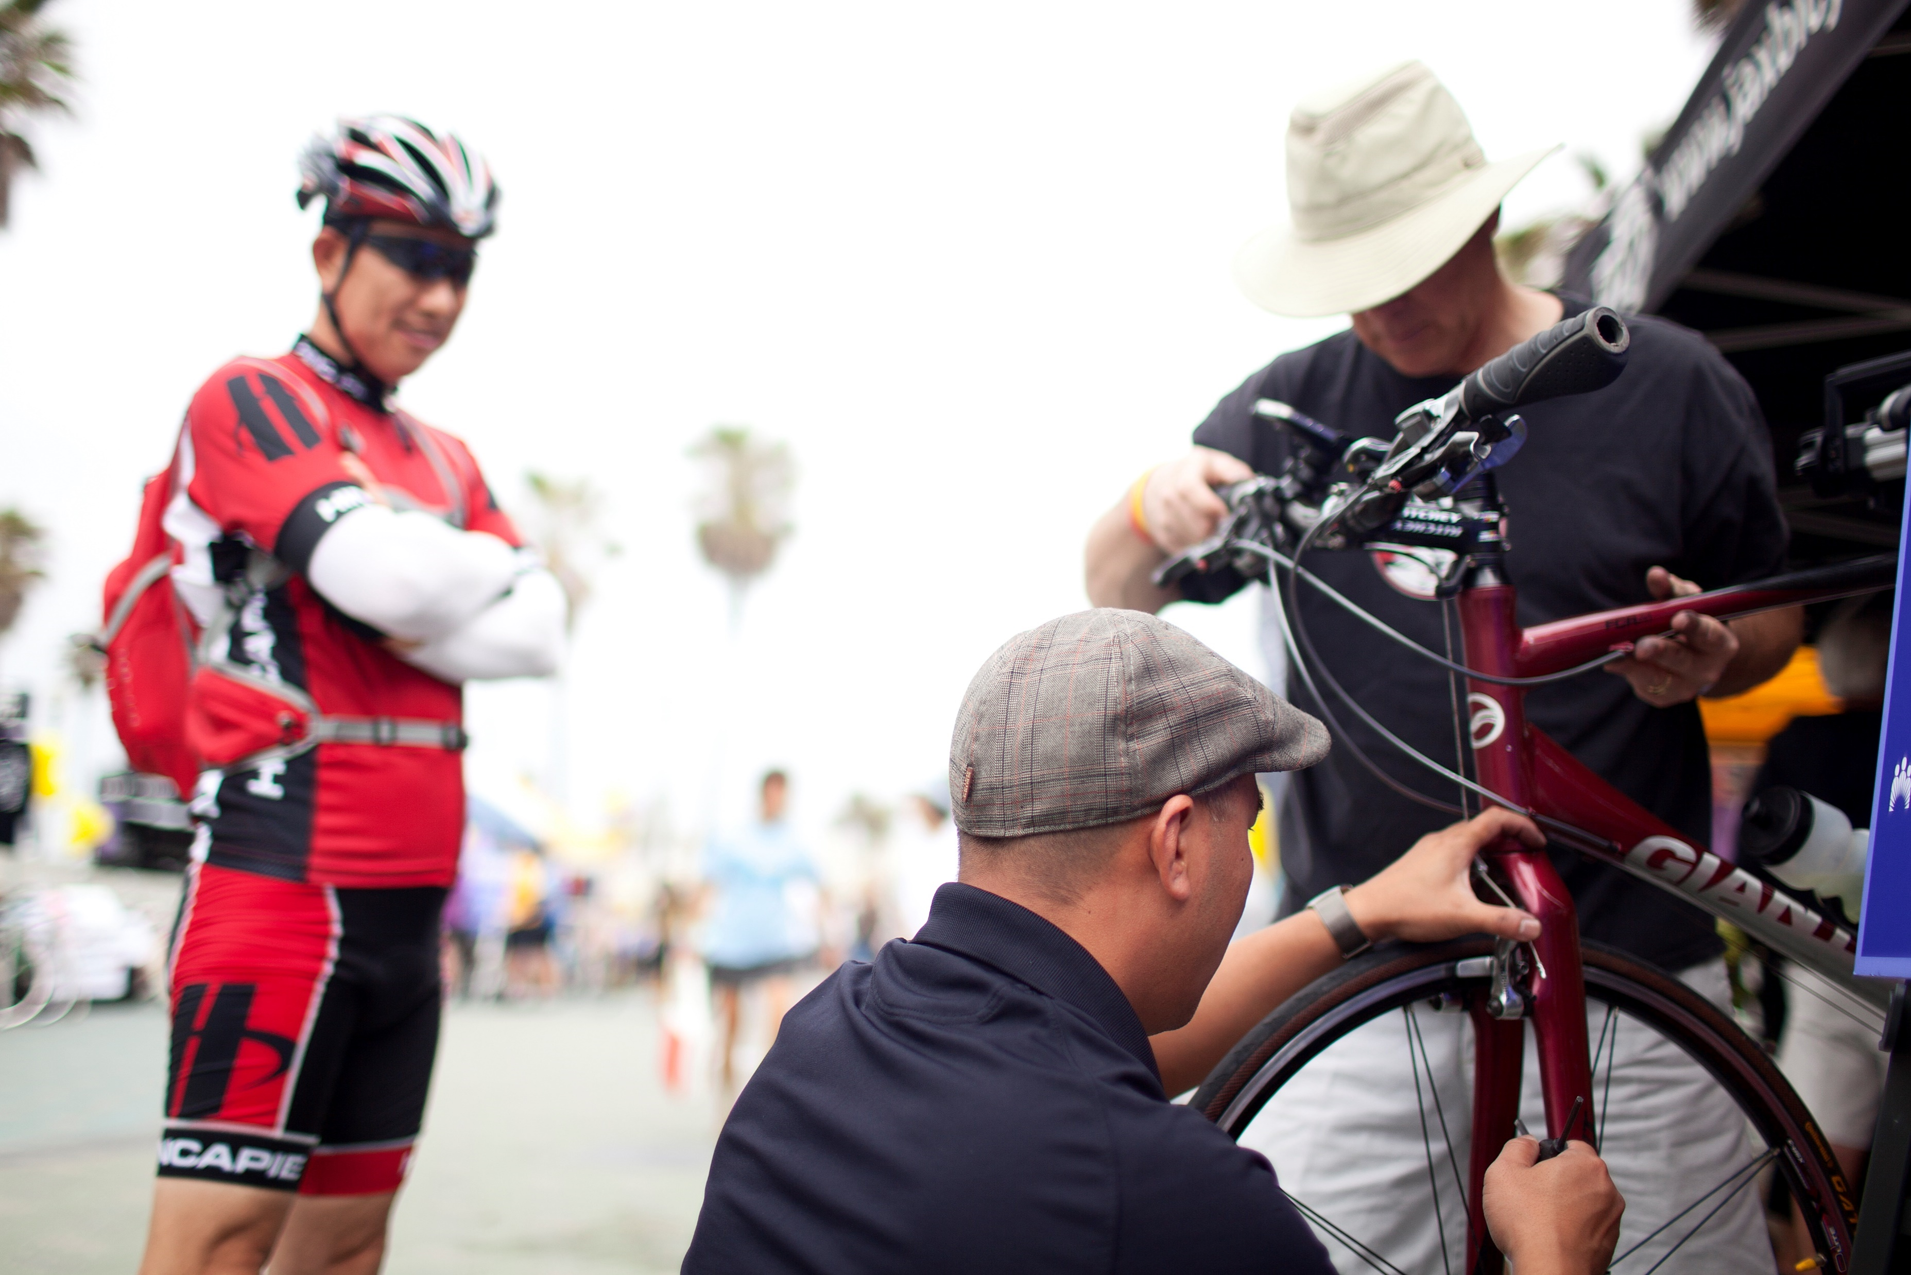
Cycle 5 (2021) Active Transportation Program
2021 Active Transportation Program – $445.5 million available
Fiscal Years 2021-2022 through 2024-2025
ATP Summary | Amount
Conservation Corps Set-Aside | $4.0 million
Statewide Call | $220.8 million
Small Urban & Rural | $44.1 million
Regional (Large MPO’s) | $176.6 million
Total | $445.5 million

Slide 5



Regional SCAG Region Funding
$93.4 million
$4.6 million for planning
$14.9 million
Notes:
Of the $176.6 million which is distributed through large MPO’s, SCAG’s share is $93.4 million
5% of the SCAG share about $4.5 million will go through their Sustainable Communities Program
Remainder is distributed through population-based funding targets – OC gets approximately 17% of it

Slide 6
Regional Component SCAG Selection Process
Statewide Applications are submitted
OCTA screens all applications (from Orange County only) for locally and regionally adopted plan consistency and may assign up to 20 additional points based on these provisions
OCTA submits additional point recommendations to SCAG
The additional points are included in scores for projects considered through SCAG selection process
Notes:
Additional points must be based on plan consistency per SB99
Parallel to statewide scoring
Still needs to go through OCTA, SCAG, CTC approvals
Additional points only officially get added to scores for projects not selected for funding through the statewide call

Slide 7
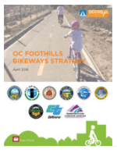
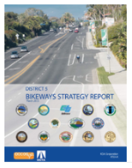
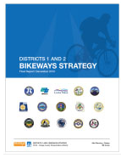
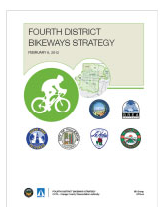
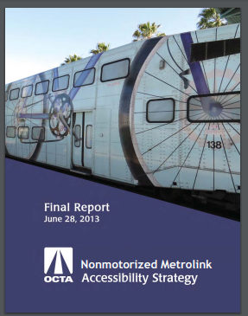

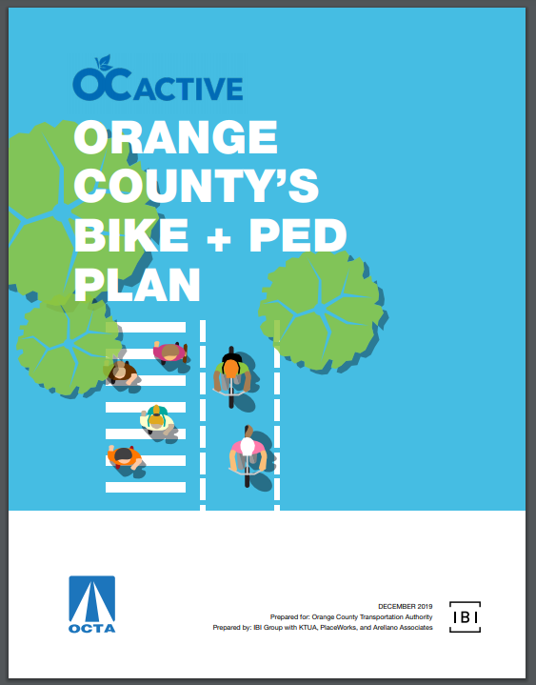
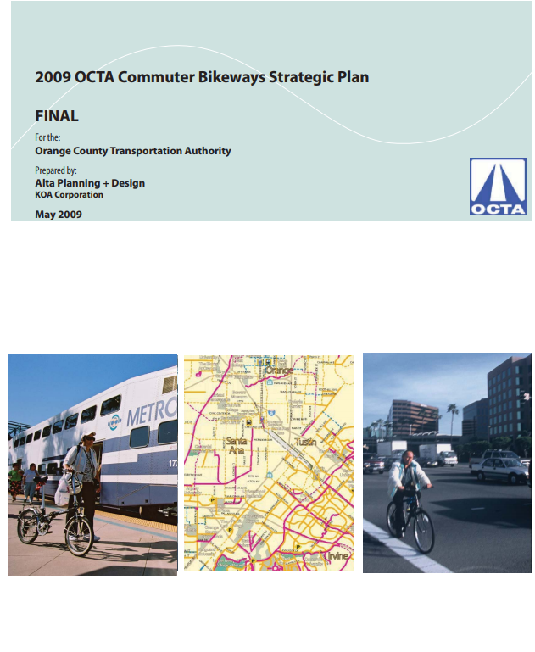
20-Point Methodology
Plan | Point Value
A planned bikeway in the Orange County Commuter Bikeways Strategic Plan or OC Active | 10
Project is included in the Orange County district bikeway strategies | 10
Project is included in the OCTA non-motorized Metrolink Accessibility Strategy | 10
Project is a sidewalk along a roadway on the Master Plan of Arterial Highways | 5
Project is included in a state or local agency bicycle or pedestrian master plan, active transportation plan, or complete streets plan | 5
Project is included in a local Safe Routes to Schools Plan Project is included in a local safety plan, including but not limited to, Safe Routes to Schools, Local Roadway Safety Plan, Vision Zero Plan, or implements countermeasures to identified crash typologies in the project area consistent with the Orange County Systemic Safety Plan | 5
Project is included in a specific plan or corridor plan | 2
Project is included in local agency general plan or circulation element | 2
https://octa.legistar.com/LegislationDetail.aspx?ID=4625364&GUID=8A37E819-D262-4EEA-89A2-C95D6C77DBAF&Options=&Search=
Notes:
Developed in collaboration with Caltrans
Approved by OCTA Board September 14th
Laid out several plan consistencies by which projects can earn points, its capped at 20
Updates expand safety plan types
2009 Commuter Bikeway Strategic Plan phased out by OC Active

Slide 8
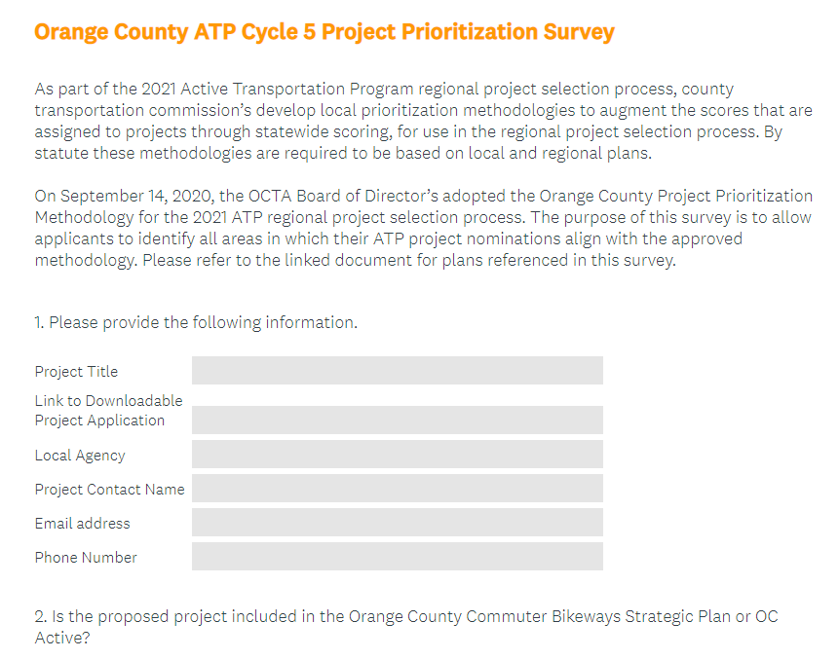
Coordination with Local Agencies
Notes:
Survey will allow them to identify which plans align with their project
Will go out this afternoon (Sept 15th) through bike-ped liaisons, TAC/TSC’s, and/or through ATP project application contact

Slide 9
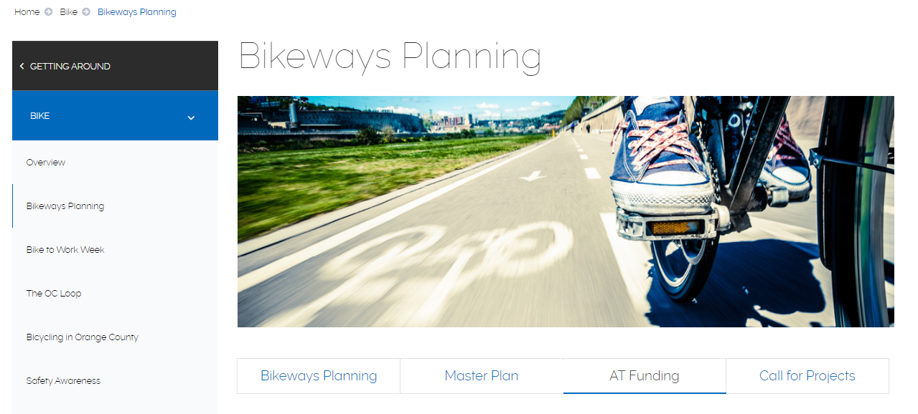
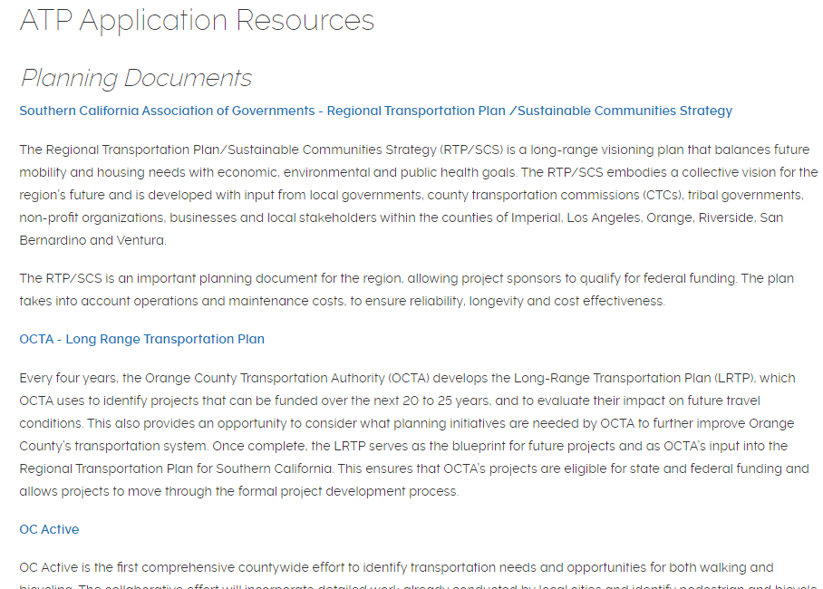
Bikeways Planning Webpage
http://www.octa.net/Bike/Bikeways-Planning/

Slide 10
Sustainable Communities Program
2020-21 SCAG Sustainable Communities Program
$4.6 million expected
Project Types
Community and Area Plans
Infrastructure Demonstration Projects (Quick Build)
Network Visioning and Implementation

Slide 11

FY 2021-22 Caltrans Transportation Planning
Caltrans Transportation Planning Grants
Estimated October 2020 release
Grant Types
Sustainable Communities Grants - $29.5 million expected
Strategic Partnership Grants - $4.5 million expected

Slide 12
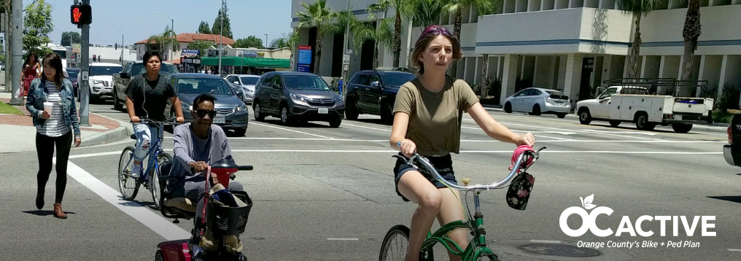
Questions?
Louis Zhao
Section Manager, Discretionary Funding Programs
714-560-5494
lzhao@octa.net
Denise Arriaga
Transportation Funding Analyst
714-560-5489
darriaga@octa.net

