Slide 1
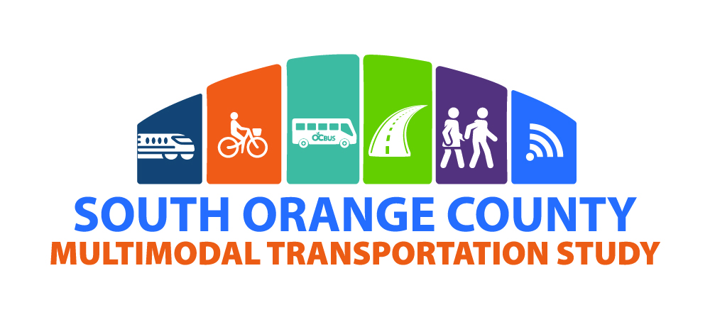
October 27, 2020
Special Needs Advisory Committee Meeting

Slide 2
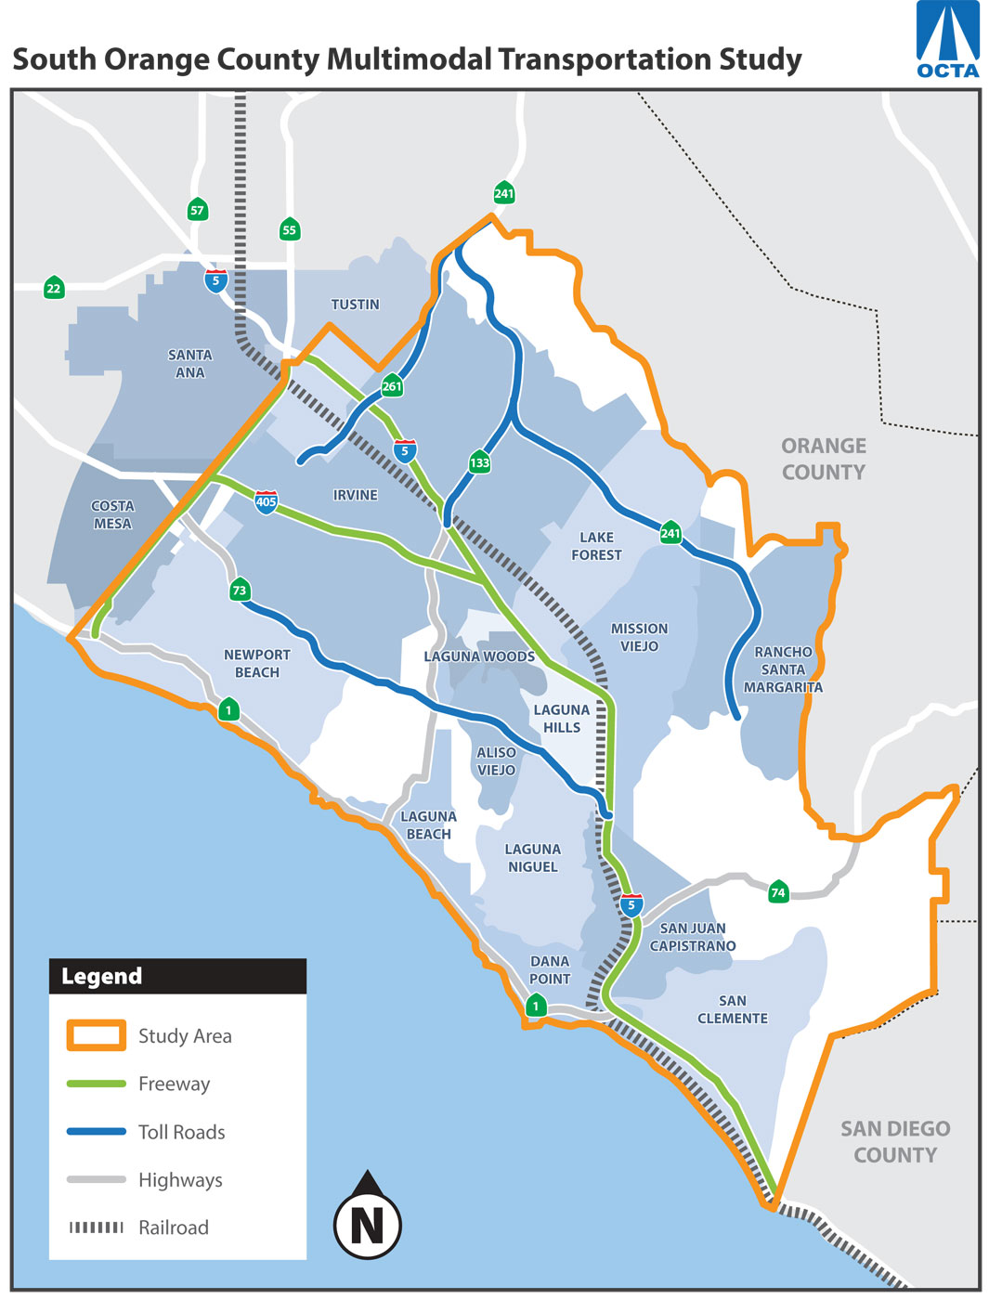
Study Objectives
Develop consensus on a set of multimodal transportation improvements
Update to 2008 South Orange County Major Investment Study (SOCMIS)
Reflect progress and latest planning assumptions

Slide 3
Study Scope Highlights
Phase 1
Phase 2
Phase 3
Identify Issues and Opportunities
Develop Purpose and Need Statement
Develop Initial Alternative Strategies
Screening Alternative Strategies
Select Reduced Set of Alternative Strategies
Analysis of Reduced Set
Recommend a Locally Preferred Strategy
2020
2021

Slide 4
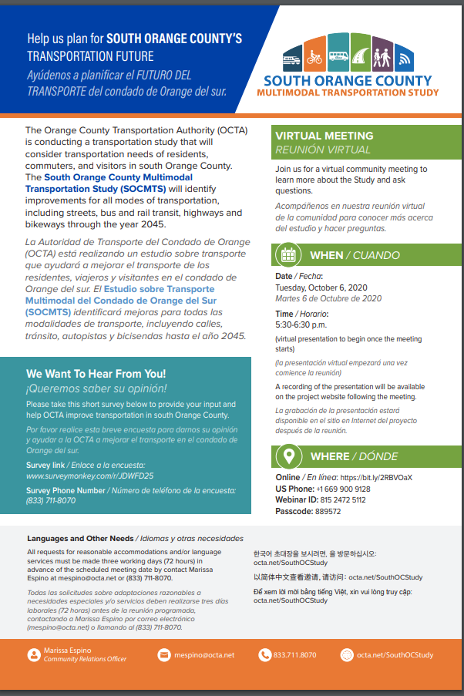
Public Engagement
Online survey open until Oct. 30
SouthOCStudysurvey.com
Hotline
(833) 711-8070
Public Webinar
Recording and FAQ available on
octa.net/SouthOCStudy

Slide 5
Bus Rapid transit on Freeways Study
Overview Presentation
October 27, 2020
Notes:
So now I will be providing an overview of the Bus Rapid Transit on Freeways Study.

Slide 6
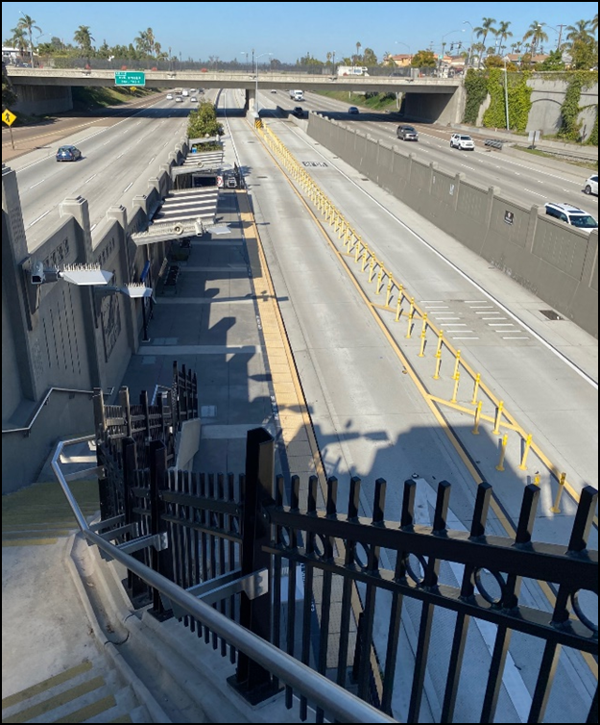
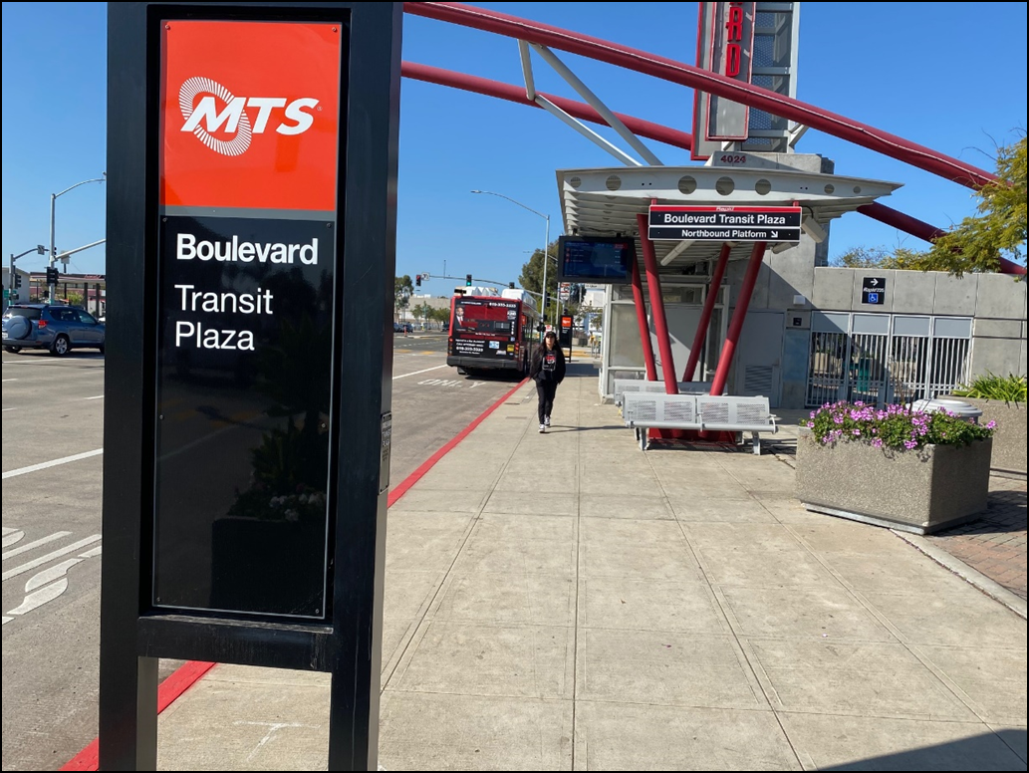
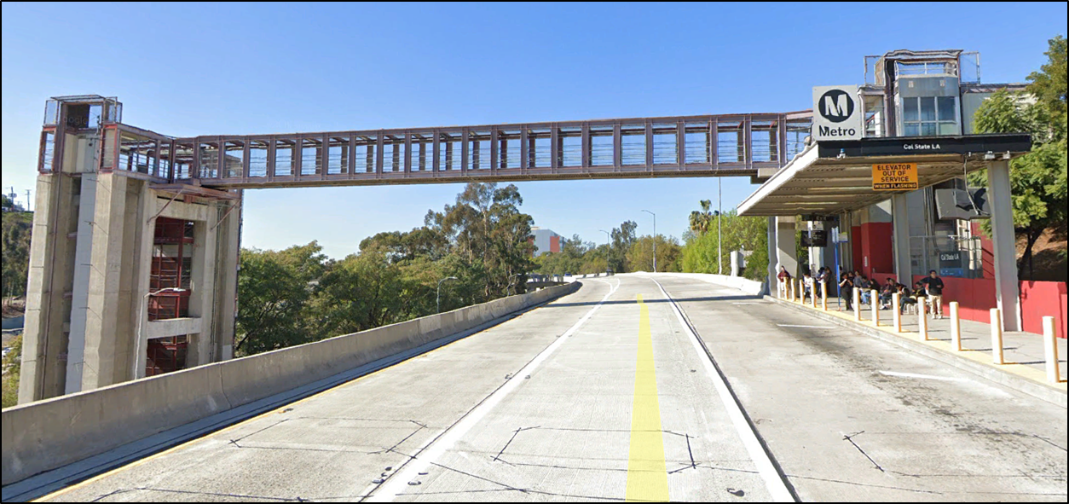
What is Freeway BRT?
Express bus service that travels mostly on the freeways, taking advantage of carpool lanes, express lanes/toll lanes or even shoulder lanes to serve key destinations.
Stations can be on or near the freeway and connect to key destinations using local bus service and shuttles.
Notes:
First off, what is freeway Bus Rapid Transit (BRT) service?
Freeway BRT is … Express bus service that travels mostly on the freeways, taking advantage of carpool lanes, express lanes/toll lanes or even shoulder lanes to serve key destinations.
Stations can be on or near the freeway and connect to key destinations using local bus service and shuttles.

Slide 7
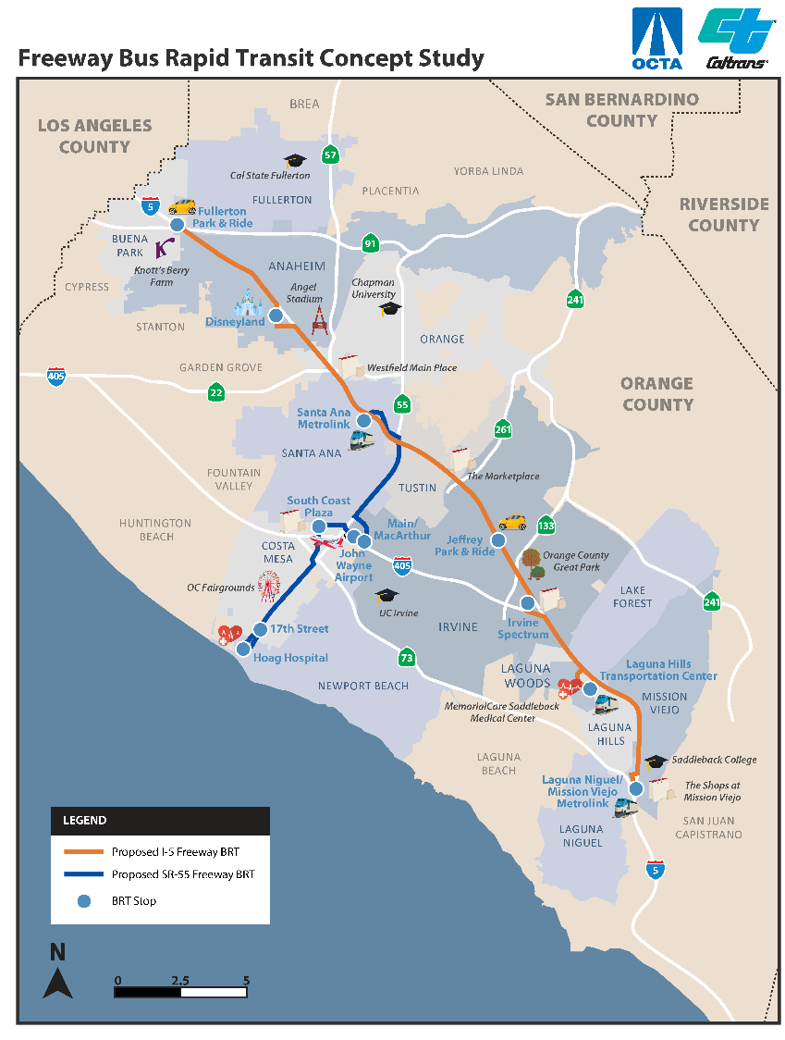
Study Overview
Study Area Focus
  I-5 from Fullerton Park and Ride to Laguna Niguel/Mission Viejo Metrolink Station
  SR-55 from Santa Ana Regional Transit Center to Hoag Hospital Newport Beach
  Objectives
    Develop conceptual alternatives for each corridor
    Identify needed infrastructure for inclusion in future freeway projects
Notes:
Prior to this study, a number of studies have analyzed how to best utilize the freeway network to move as many people around the county as efficiently as possible. And specifically how to make the High Occupancy Vehicle (HOV) lanes work as well as they can. -- One aspect of this is to ensure that the HOV lanes can also serve as bus transit lanes – and provide bus riders with express service to various parts of the county.
The study focuses on two specific freeway corridors which have demonstrated strong travel demand for both car trips and transit trips. OCTA evaluated several of the major freeways in Orange County and the I-5 and SR-55 ranked the highest in potential to attract riders. The study area focuses on the I-5 from the Fullerton Park and Ride to the Laguna Niguel/Mission Viejo Metrolink station and the SR-55 from the Santa Ana Regional Transit Center to Hoag Hospital in Newport Beach
The main objective of the study is to develop conceptual routes for each of these corridors and to identify any needed infrastructure for these routes, such as new ramps or new stations.
It’s also worth noting…
that two thirds of the county’s population live within a 3-mile radius of these corridors and could potentially use these services, and that express bus service on freeways has proven to work well in counties with both urban and suburban areas – very similar to Orange County.

Slide 8
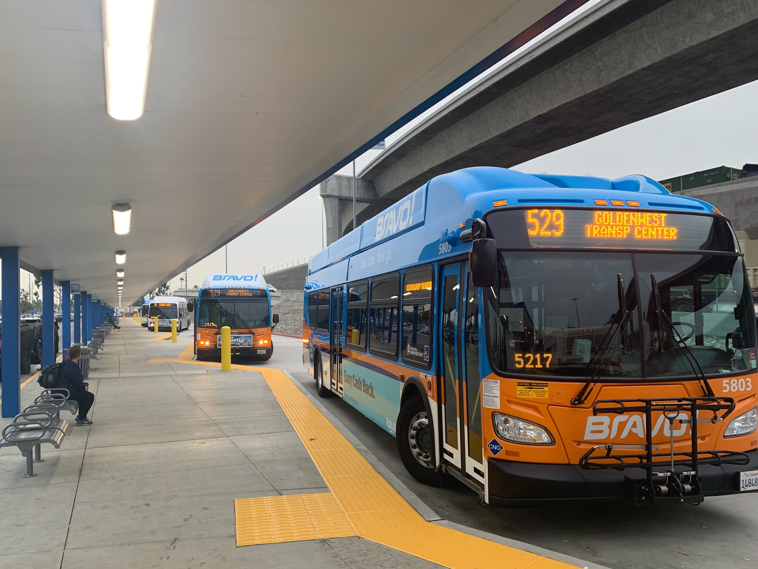
Study Process and Schedule
Step 1
Purpose and Need (Mar–Jun 2020)
Step 2
Alternatives Development (Jul-Oct 2020)
Step 3
Alternatives Evaluation (Nov-Feb)
Step 4
Draft Final Report (Mar-Apr 2021)
Notes:
There are four distinct steps in this study:
Purpose and Need – in this step we review prior studies, analyze existing conditions, and identify needs, goals and objectives.
The next step, which is what we are in right now, is the Alternatives Development. Based on the analysis from Step 1 we start to layout conceptual routes and stop locations and begin talking with the cities, public and stakeholders to identify possible constraints and receive other comments.
The third step is Alternatives Evaluation in which we develop cost estimates and ridership estimates to see which concepts perform the best.
Finally we summarize this information in a Draft Final Report and make it available for review and comment – (and present the results to the OCTA transit committee and Board.)

Slide 9
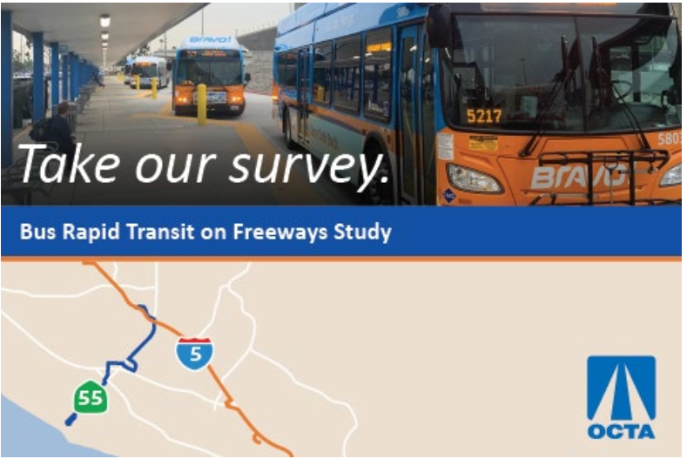
Stay Involved
Online survey open until Nov. 16
FreewayBusSurvey.com
Hotline
(909) 494-2900
Public Webinar
Recording available at
octa.net/FreewayBRT
Notes:
For this study we also have an online survey you can take at Freeway Bus Survey .com.
The survey will be open until Nov. 16 so please feel free to share with your neighbors and communities. ​
We also have a hotline number and to learn more about he study, please visit octa.net/FreewayBRT
Jared will be sending out all of the stay involved information for both this study and the South County study in case you are interested in taking the surveys and sharing it with others.
That concludes my presentation. Thank you.

